Slide 1
Notes:
Not dealing with the root cause of a problem within our body or mind, whether it be physical, emotional, mental, or spiritual, will eventually cause something, somewhere to BREAK

Slide 2
Learning to Love Your Soul
Spiritually, Mentally, and Emotionally
Notes:
Not dealing with the root cause of a problem within our body, whether it be physical, emotional, or spiritual, will eventually cause something, somewhere to BREAK

Slide 3
How do you identify yourself?
Notes:
There is nothing greater than to know and be known, or in other words, to love and be loved.
Whether we admit it or not, we all have this desire at some level.
We all have a need and desire for intimacy, but not as the world would define it.

Slide 4
How do you identify yourself?
As a son or daughter of God?
By a particular sin or struggle?
Notes:
There is nothing greater than to know and be known, or in other words, to love and be loved.
Whether we admit it or not, we all have this desire at some level.
We all have a need and desire for intimacy, but not as the world would define it.

Slide 5
Mosiah 3:8-9
8 And now, because of the covenant which ye have made, ye shall be called the children of Christ, his sons, and his daughters: 9 For behold, this day he hath spiritually begotten you; for ye say that your hearts are changed through faith on his name; therefore, ye are born of him, and have become his sons and his daughters.
Notes:
There is nothing greater than to know and be known, or in other words, to love and be loved.
Whether we admit it or not, we all have this desire at some level.
We all have a need and desire for intimacy, but not as the world would define it.

Slide 6
To Know
AND
Be Known
Notes:
There is nothing greater than to know and be known, or in other words, to love and be loved.
Whether we admit it or not, we all have this desire at some level.
We all have a need and desire for intimacy, but not as the world would define it.

Slide 7
1 Corinthians 8:3-7
8:3 But if any man love God, the same is known of Him. 8:4 …we know… that there is none other God but one. 8:5 For though there be that are called gods, whether in heaven or in earth… 8:6 But to us there is but one God, the Father, of whom are all things, and we in Him, and one Lord Jesus Christ, by whom are all things, and we by Him. 8:7 Howbeit, there is not in every man that knowledge;…
Notes:
Paul tells the Corinthians that those who love God are known by Him,
And through their love for God, they know Him too
Although, not everyone has this knowledge
D&C 36:12a-b
12a And Enoch beheld the Son of man ascend up unto the Father; and he called unto the Lord, saying, Will you not come again upon the earth, for inasmuch as you are God, and I know you, and you have sworn unto me, and commanded me that I should ask in the name of your Only Begotten, 12b you have made me, and given unto me a right to your throne, and not of myself, but through your own grace; wherefore, I ask you if you will not come again on the earth?

Slide 8
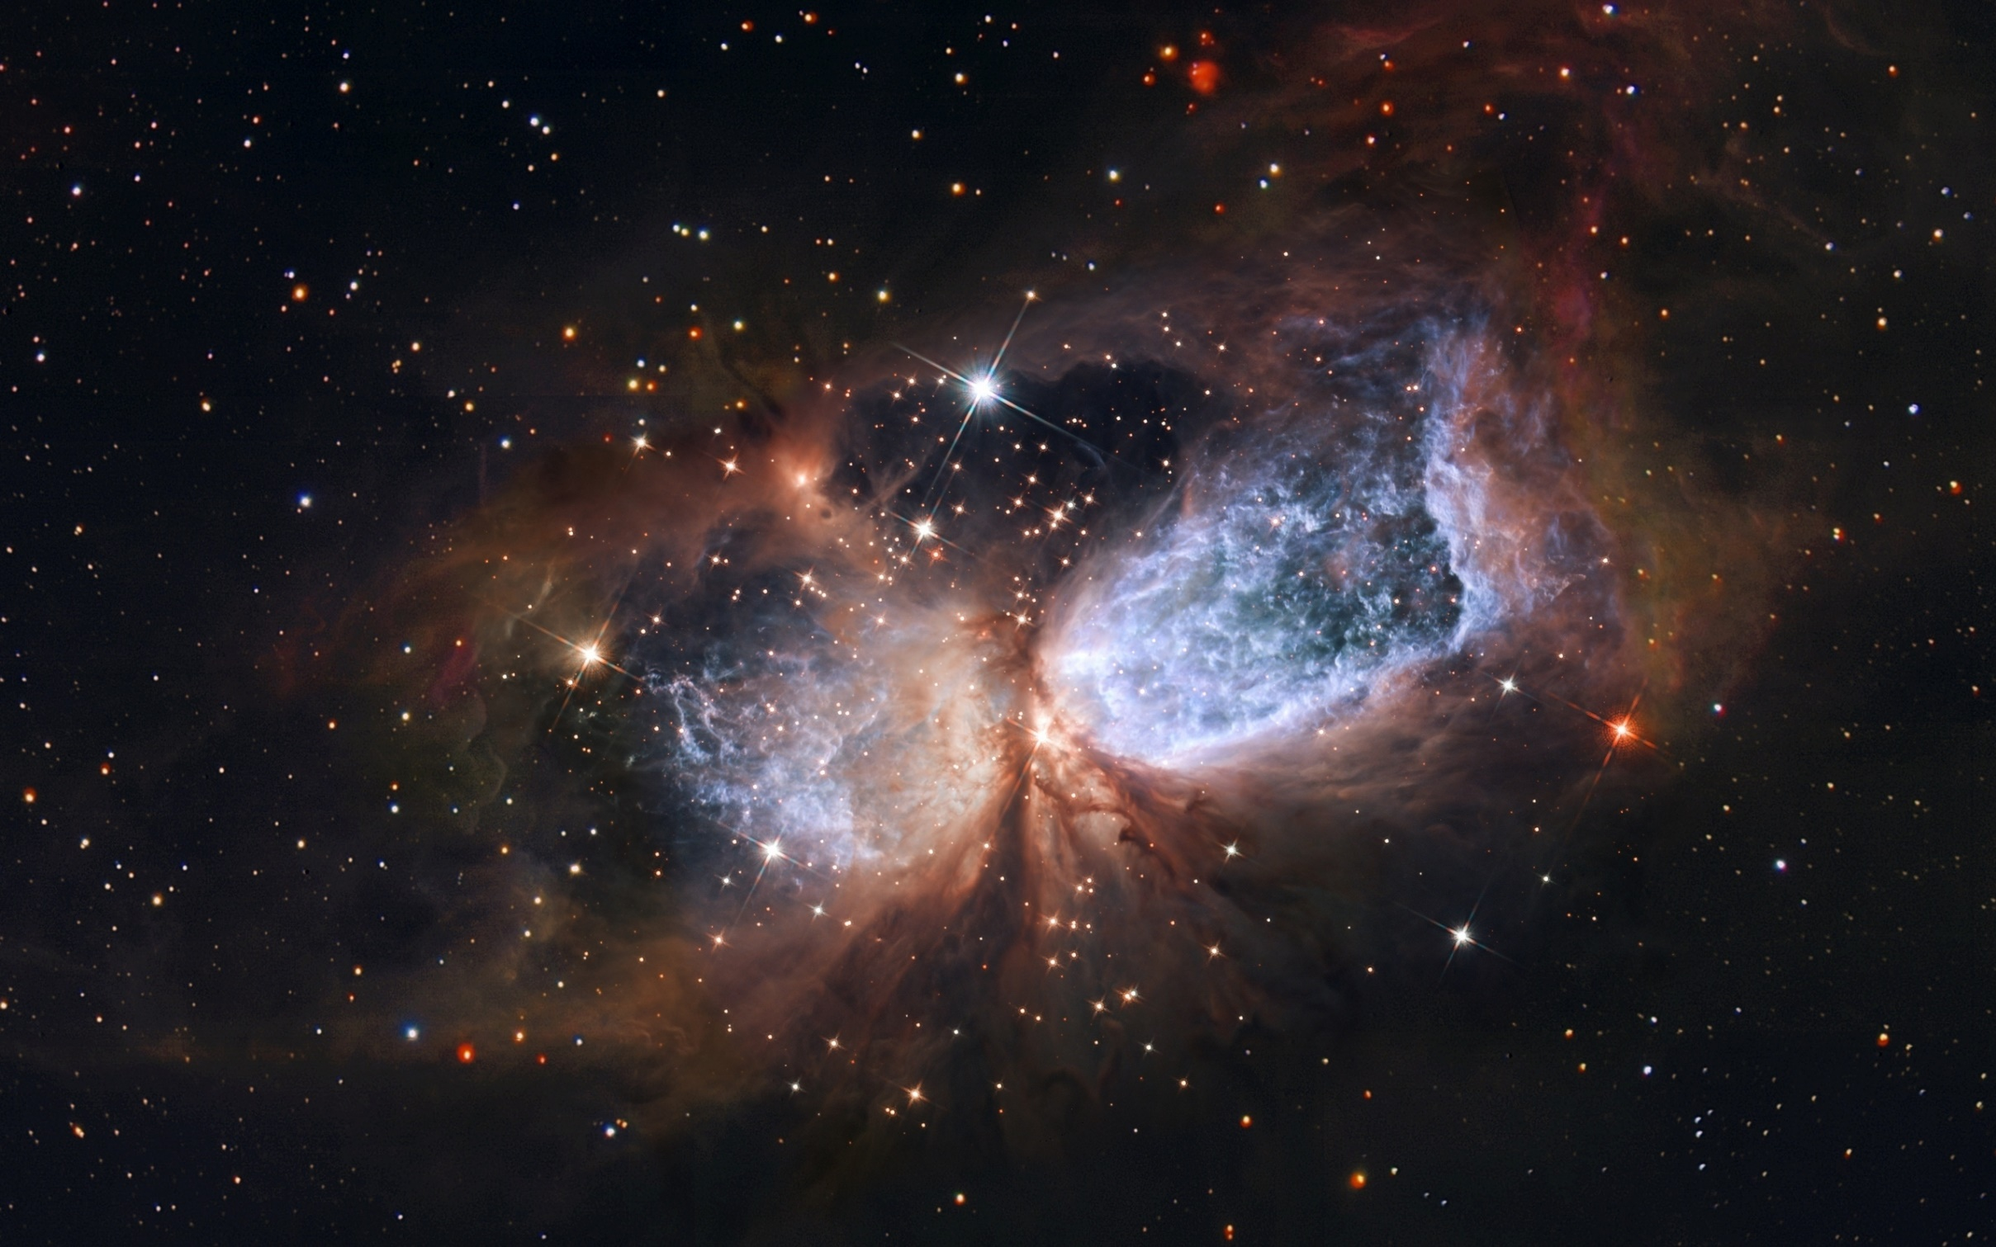
Notes:
What greater revelation is there than knowing God and knowing that He knows who you are too
We often see the universe around us, but fail to recognize that there is a universe within us.
This universe is not just spiritual, but emotional, mental, biological, chemical
We have needs and it is important to understand what those are.
Car analogy. We cruise along as best we can even though we might be driving inefficiently. It helps to have a better understanding of the vehicle so it can meet its full potential. We rarely talk about emotions, hormones, chemicals, etc. We simply believe we are not trying hard enough, not praying enough, not exercising enough faith.
We must learn to listen to our own self, hear our heart, understand our faults.
We give our self the assurance that we need to feel whole.

Slide 10
Intimacy
Vulnerability
Shame
is the ability to be vulnerable
is the risk of sharing yourself and your shame
is based on who you are, not what you did
Notes:
Intimacy is the ability to be vulnerable
Vulnerability is the uncertainty and risk of sharing yourself and your shame
Shame is based on who you are, whereas guilt or blame is based on what you did. We might say I am sorry for making a mistake (guilt or blame), or I am mistake (shame). Shame says there is something uniquely wrong with me. Shame makes it difficult to receive healing and tends to begat more shame. It can move us to seek for comfort in our struggle rather than help us get out of them. We feel inadequate, tired of the fight, depressed, anxious, etc.

Slide 11
Women
Men
Spiritual
is based on the image of perfection
is based on the image of weakness
is based on the image of worthiness or value
Notes:
Shame for women is based on the image to be perfect
Shame for men is based on the image to not be weak
Shame in a spiritual sense seems to be based on how we view ourselves in relation to our own image of who we think or feel God is. In other words, we are not good enough for God to love

Slide 12
Five Levels of Intimacy
Notes:
Intimacy is the ability to be vulnerable and we all have a need for it at some level

Slide 13
Five Levels of Intimacy
1. Spiritual
2. Emotional
3. Social
4. Physical
5. Romantic
– sharing deep, safe conversations about God
– being vulnerable with my hurt and pain
– enjoying the same activities, hobbies
– experiencing non-romantic touch
– romantic closeness within marriage
Notes:
Intimacy is the ability to be vulnerable and we all have a need for it at some level

Slide 14
Matthew 11:28-30
28 All things are delivered unto me of my Father; and no man knoweth the Son, but the Father; neither knoweth any man the Father, save the Son, and they to whom the Son will reveal himself; they shall see the Father also. 29 Then spake Jesus, saying, Come unto me, all ye that labor and are heavy laden, and I will give you rest. 30 Take my yoke upon you, and learn of me; for I am meek and lowly in heart; and ye shall find rest unto your souls; for my yoke is easy and my burden is light.
Notes:
Intimacy is not just with other people, it is especially with God.

Slide 15
Intimacy
Vulnerability
Shame
Are we willing to be intimate with God?
Are we willing to be vulnerable with God?
Are we willing to share our shame with God?
Notes:
Are we willing to do this with ourselves and others?

Slide 16
Acceptance
Accountability
Affirmation
Notes:
Add a fourth box with the words “Unconditional love”

Slide 17
John 3:16-17
3:16 For God so loved the world, that He gave His Only Begotten Son, that whosoever believeth on Him should not perish; but have everlasting life. 3:17 For God sent not His Son into the world to condemn the world; but that the world through Him might be saved.
Notes:
If we are not willing to be intimate or vulnerable with God, we might not truly believe He loves us

Slide 18
John 3:16-17
3:16 For God so loved YOU, that He gave His Only Begotten Son, that whosoever believeth on Him should not perish; but have everlasting life. 3:17 For God sent not His Son into the world to condemn the world; but that the world through Him might be saved.
Notes:
Man is not worthless. The measure of man is not what they are worth in the eyes of the world…
When our foundation is not sure and steadfast, we begin to lose sight of this truth.
And while some are still able to see the truth, they are not able to experience it.

Slide 19
Matthew 22:35-39
22:35 Master, which is the great commandment in the law? 22:36 Jesus said unto him, Thou shalt love the Lord thy God with all thy heart, and with all thy soul, and with all thy mind. 22:37 This is the first and great commandment. 22:38 And the second is like unto it; Thou shalt love thy neighbor as thyself. 22:39 On these two commandments hang all the law and the prophets.
Notes:
If we cannot love our self as Christ loves us, how can we love our neighbor?
And if we cannot love them, how can we serve them, share with them, and ultimately point them to Christ and His Kingdom so that we might bring souls unto God?
If we cannot love our self, how can we love the God who made us?
God never intended us to harbor a hatred for our soul.
We will never be whole until we love ourselves as Christ loves us.

Slide 20
Does this relate to Zion and the Kingdom?
“For this is Zion, THE PURE IN HEART.”
[DC 94:5c]
Notes:
Absolutely! the foundation of Zion, “For this is Zion, THE PURE IN HEART.” [DC 94:5c]

Slide 21
Kinesiology
Notes:
Not dealing with the root cause of a problem within our body or mind, whether it be physical, emotional, mental, or spiritual, will eventually cause something, somewhere to BREAK
When we are broken, our ability to love is broken. Thus our ministry is not as effective, and our life will be filled with hurt and pain
But when we are whole we are able to comfort others
2 Corinthians 1:3-5
3 Blessed be God, even the Father of our Lord Jesus Christ, the Father of mercies, and the God of all comfort, 4 Who comforteth us in all our tribulation, that we may be able to comfort them which are in any trouble, by the comfort wherewith we ourselves are comforted of God. 5 For as the sufferings of Christ abound in us, so our consolation also aboundeth by Christ.

Slide 22
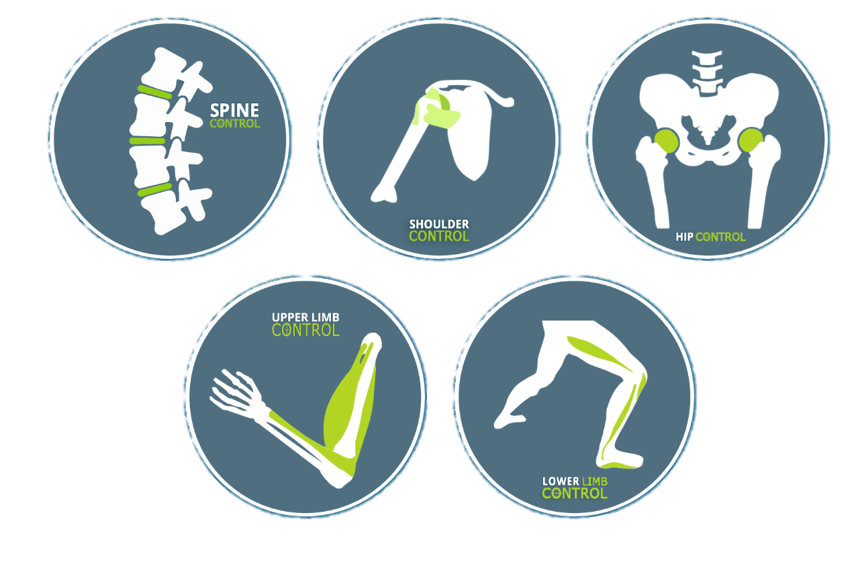
Kinesiology
“the study of the mechanics of body movements”
Notes:
The program is constructed upon the principle of building a functional foundation of correct movement and activation patterns (M/APs).
Overtime, we can develop dysfunctional muscles and structural alignments that alter our M/APs through excess strain and inefficient movement pattern choices.
Eventually these abnormal M/APs produce compensational and dysfunctional movements which can result in pain or worse, in injury.

Slide 23
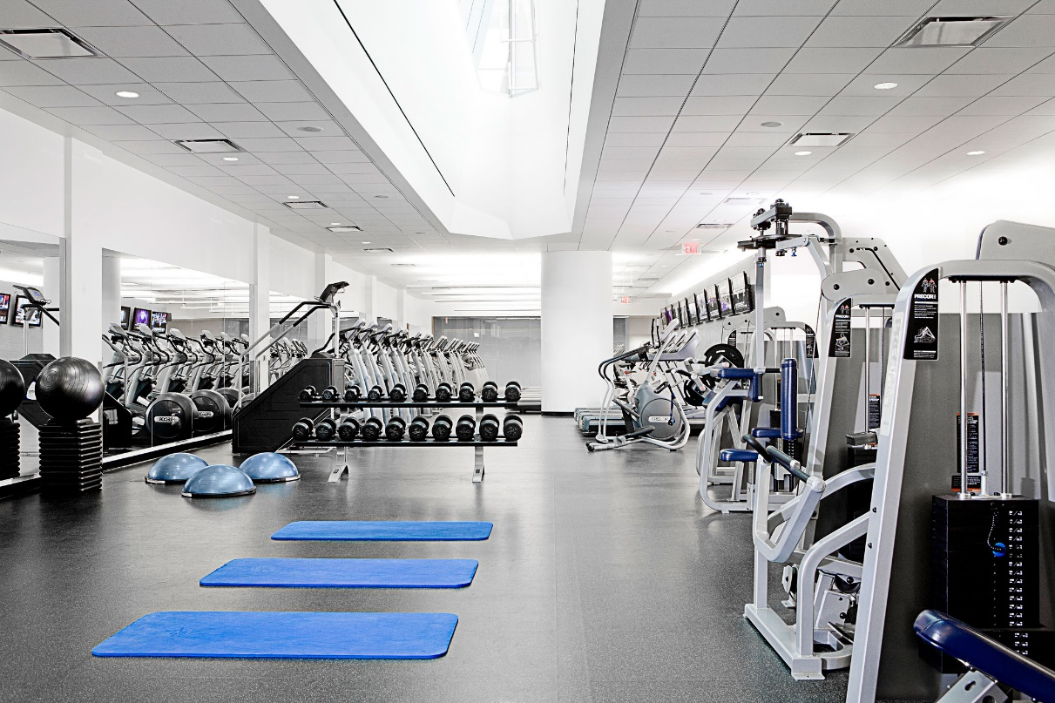
Kinesiology
“the study of the mechanics of body movements”
Notes:
In the fitness world, people often attempt to treat the symptom of their weakness or pain, but fail to address the source of the problem.
Instead of trying to sort through the different compensations that can layer upon each other, kinesiology teaches that one must go to the source of all movement.
In other words, the structure and function of joints and muscles, and everything that functions to create movement.

Slide 24
Helaman 2:74-75
2:74 And now my sons, remember, remember that it is upon the rock of our Redeemer, who is Christ, the Son of God, that ye must build your foundation, that when the devil shall send forth his mighty winds; yea, his shafts in the whirlwind; 2:75 Yea, when all his hail and his mighty storm shall beat upon you, it shall have no power over you, to drag you down to the gulf of misery and endless wo, because of the rock upon which ye are built, which is a sure foundation, a foundation whereon if men build, they can not fall.
Notes:
The same is true spiritually and emotionally.
As life lays hold upon us, we tend to form dysfunctional responses to the situations we experience.
If these are not addressed, we tend to fall back to them when certain events arise because of the neurological responses that have become engraven within us.
Thus it feels as if we have no agency or choice, causing confusion, hurt, pain, and even further, hatred for ourselves.
For some, we are left asking, “Why can I not overcome this?”
The answer is because we have not properly addressed the root cause, which is our relationship with God, with ours self, and with others as illuminated by the light of Christ and the Holy Ghost.
We must build our foundation on Jesus Christ

Slide 25
Dysfunctional and Compensatory Movement
Muscular Imbalance
Muscular Weakness
Irregular Movement
Notes:
Kinesiology explains that we form dysfunctional M/APs through three primary root causes, muscular imbalance, muscular weakness, and dysfunctional movement, with each cause influencing the other.
Muscular imbalances are often a result of two things: repetitive positions or repetitive movements.
Weakness also occurs, in part, as a result of repetitive positions or movements. If we start to engage in the same positions or movements repetitively, then our body struggles to respond when it is asked to do something different. However, weakness can also occur from the simple principle, “Use or lose it.”
Finally, irregular movement occurs as a result of either of the first two root causes, but it also occurs due to incorrect knowledge, coaching, or training of a movement. If someone is learning a movement but they learn a dysfunctional pattern instead and then continue to train that pattern, they are programming their neuromuscular system with this dysfunctional pattern so this becomes their default way of executing this movement.
The brain works the same way

Slide 26
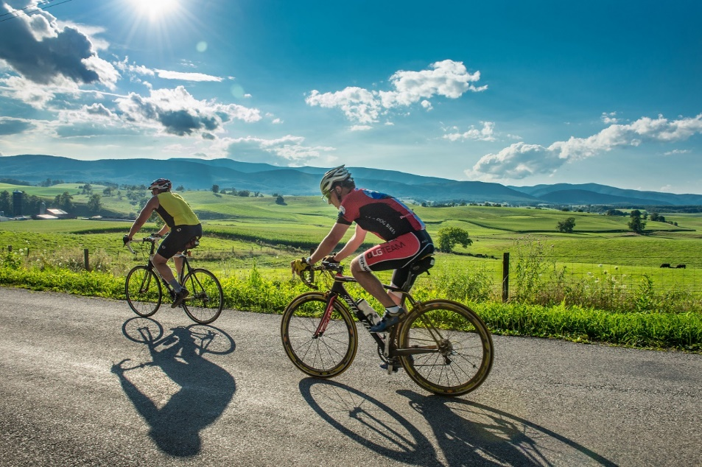
Muscular
Imbalance
Notes:
For example, professional cyclists saddle their riding bikes for hundreds, if not thousands, of miles per week, which they often do for years or decades. Doing so results in the adaptive shortening of the hip flexors due to both position (sitting without ever moving the hip into full extension) and activation (everything is strengthened in this limited position) to the point where true extension of the hip cannot be achieved. This also impacts their internal and external hip rotation, causing it to shorten and weaken.

Slide 27
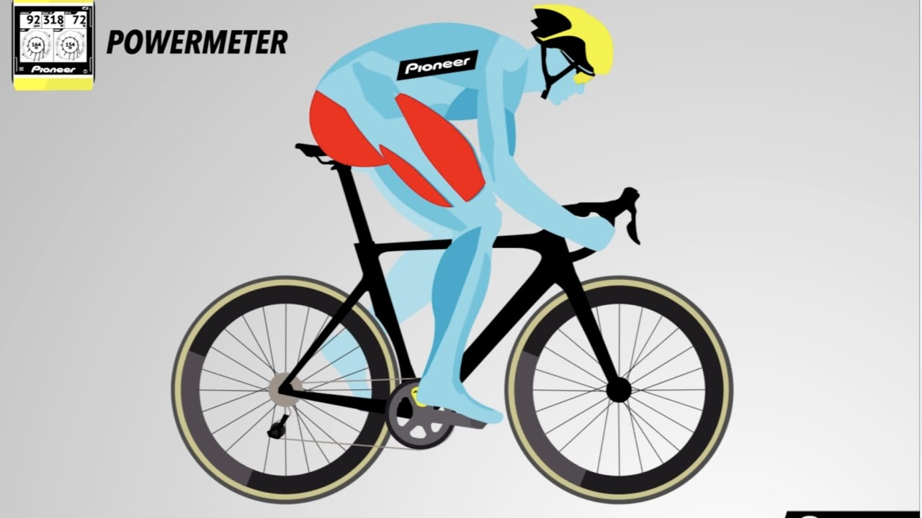
Muscular
Imbalance
Muscular
Weakness
Notes:
To continue with this example, certain muscles may weaken because the cyclist is not achieving full extension as stated previously. Thereby, when they attempt an activity which requires this muscle to create or stabilize movement, it is too weak to contribute properly.

Slide 28
Muscular
Imbalance
Muscular
Weakness
Irregular
Movement
Dysfunctional or Compensatory
Movement Pattern
Notes:
In response, their neuromuscular system finds an alternate way of achieving their movement goal. This is defined as a compensatory movement pattern. However, this will effectively program the cyclist’s neuromuscular system with a dysfunctional pattern so it becomes their default method for executing this movement.
Thus, because they have lost both range and strength in various movements and muscles, any task which requires the abilities that they have lost will result in some type of compensation or dysfunctional movement. Over time, moving in a compensated way can result in pain or injury if the source is not corrected.

Slide 29
3-Step Process to Healing
1. Addressing Structural Limitations
2. Activation and Dissociation
3. Functional Integration
Notes:
First, if the active and passive structures of a person’s joints do not allow proper movement, no amount of training will correct it. The first step is to address joint mobility and tissue quality.
Before one can move properly, they must break their old, dysfunctional patterns. In scripture, we would call this putting off the old and putting on the new. If certain movements are always performed together, they can become associated through repetition. Dissociation is the act of breaking associated patterns, which we can accomplish by performing the opposite movement. This is done in order to open up one’s neuromuscular system so that they can independently control every joint, movement, and even muscle. Doing so creates a plethora of smooth, controlled movements to choose from in order to accomplish whatever movement task is at hand. Dissociation gives us the power to choose the right M/AP for the job. However, once a person breaks their old patterns, they must ensure that all their muscles are active and strong enough to perform the tasks demanded of them. Some muscle may have atrophied due to dormancy. Building strength is the next step in the activation process. This is done by repeatedly applying the principle of progressive overload.
Finally, now that a person’s slate is clean in regards to their M/AP, they are ready to integrate everything into functional M/APs so that their body can move freely and without pain. All of one’s previous work culminates into creation functional M/APs so that when they navigate their life, they will have solid M/APs from which to move from, minimizing injury risk and maximizing performance.

Slide 30
Spiritual and Emotional Dysfunctional Patterns
Relation Imbalance
Relation Weakness
Irregular Response
Notes:
Through incorrect relationships with our Heavenly Father, our self, and or our neighbors, we tend to form compensatory and dysfunctional response patterns.
We form these responses through three primary root causes. Again, just as in kinesiology, each root cause influences the other.
Life in this present world consists of relationships, whether it be with God, our self, or others. The truth of this concept is evident in the two great commandments
In part, the Gospel is about the quality of our relationship with the Father, the Son, and the Holy Ghost, which is displayed through our relationships with our self and our neighbor.

Slide 31
Relation
Imbalance
Notes:
The foundation for this relationship is our sense of self-worth and value. If this relation is imbalanced, it will also affect how we value others. This imbalance occurs in one of two ways.
One, we believe that we have little or no worth.
Two, we believe that we are worth more than others.
In either situation, our relation with our self and our neighbor will be effected.

Slide 32
Relation
Imbalance
Relation
Weakness
Notes:
Relation imbalance coincides with relation weakness.
The more we struggle to believe or to see that we have value or that we are worth the same as our neighbor,
the greater our relations will weaken and become unstable.

Slide 33
Relation
Imbalance
Relation
Weakness
Irregular
Response
Notes:
The more unstable our relations become the more susceptible we are to irregular responses, such as…
anger, doubt, envy, fear, guilt, hatred, jealousy, lust, mocking, pride, self-abasement (in a negative sense, not true humility), self-pity, etc.
If we continue down this path, we begin to respond to life and to God in a spiritually, emotionally, and mentally dysfunctional way without even realizing what we are doing.
This creates the illusion that we do not have a choice nor do we have self-control. Thus our agency becomes compromised as our intelligence, meaning our ability to discern good from evil, becomes darkened.
This will inevitably lead to pain, indifference, or even sin, unless this pattern is broken

Slide 34
“Nobody is anybody until someone loves them”
Relation Imbalance
Relation Weakness
Irregular Response
“Why should I even love myself?”
“I am worthless”
“No one loves me”
Notes:
It is important to recognize that these three root causes are not always initiated by the person themselves, but by outside forces, such as other individuals or environments, whether just perceived or real. Nevertheless, as difficult as it may appear, we always have a choice. The purpose of this work, in part, is to reestablish our agency so that we can make a godly choice.
Apostle Arthur Oakman once said, “Nobody is anybody until someone loves them.”
Without the reception of love and intimacy from our families, friends, or peers, it is difficult to establish the proper relation balance.
If a person grows up from a toddler, to a teenager, to an adult without ever receiving love, whether truthfully or perceived, this will obviously have a profound impact upon their life. It will effect both their relationship with their own self and with others.
Zion consists entirely of relationships, which is something we must work on at every level.
Whether we experience anger, pride, hatred of self, self-abasement, lust, etc., these spiritual, emotional, and mental dysfunctional responses can be traced back to a relation imbalance, a relation weakness, or a irregular response that has become our default. This dysfunction can quickly create the illusion that we have no choice or control over ourselves, and worse, they tend to separate us from the Father, the Lord Jesus, and the Holy Spirit. This pattern can swiftly snowball and perpetuate itself until we feel all is lost. We become discouraged, frustrated, and lose all hope. So what can we do to stop this destructive pattern?

Slide 35
Notes:
The human brain is a battery, or a collection of approximately 80 billion batteries. Each neuron in the brain possesses the ability to accumulate a charge across its cell membrane, which results in a small, but meaningful voltage. All your neurons together can generate enough electricity to power a low-wattage bulb. In fact, neurons send info to your brain at more than 150 miles per hour.
Whenever we dream, laugh, think, see, or move, it’s because tiny chemical and electrical signals are racing between these neurons along billions of tiny neuron highways. Our brain is constantly sending messages along certain pathways of neurons over and over, forming new connections and patterns. In fact, the structure of our brain changes every time we learn, as well as whenever you have a new thought or memory.
We think and speak at incredible speeds. For example, when we walk into a room we immediately starting thinking the following…
"Am I safe? Do I know anyone here? How am I dressed in comparison to everyone in the room? How comfortable am I?" Etc. So when we select a seat in the room it is not totally without reason.

Slide 36
Ephesians 4:22-24
22 And now I speak unto you concerning the former conversation, by exhortation, that ye put off the old man, which is corrupt according to the deceitful lusts; 23 And be renewed in the mind of the Sprit; 24 And that ye put on the new man, which after God is created in righteousness and true holiness.
Notes:
However, this also can lock in neurochemical patterns, both good and bad, which can effect how we react and or behave in certain situations. For example, when a trigger is pulled it can create an unconscious response.
If certain needs are not met, such as 5 different parts of intimacy, we can react in a way to try to get what we need.
These can create bad patterns and responses that are difficult to control
The way we overcome bad patterns is by putting off the old and putting on the new.

Slide 37
2 Corinthians 1:3-5
3 Blessed be God, even the Father of our Lord Jesus Christ, the Father of mercies, and the God of all comfort, 4 Who comforteth us in all our tribulation, that we may be able to comfort them which are in any trouble, by the comfort wherewith we ourselves are comforted of God. 5 For as the sufferings of Christ abound in us, so our consolation also aboundeth by Christ.
Notes:
Once we have done so, we are free to help our fellow-man

Slide 38
Concern about my body
Imbalance
Not happy with who I am
Weakness
Want what others have
Response
Wish I could look different
Compare and jealousy
Always gauging myself
Exercise
Depression
Anxiety
Notes:
The irregular response is “compare and jealousy” and “always gauging myself”
The compensatory pattern is to exercise, but to do so with an improper focus [vanity instead of health]
The dysfunctional pattern is depression and anxiety when I cannot address my irregular response

Slide 39
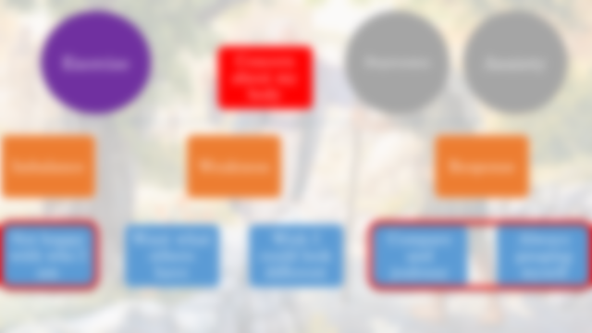
Concern about my body
Dysfunctional Pattern
Notes:
The irregular response is “compare and jealousy” and “always gauging myself”
The compensatory pattern is to exercise, but to do so with an improper focus [vanity instead of health]
The dysfunctional pattern is depression and anxiety when I cannot address my irregular response

Slide 40
Root Causes
Imbalance
Weakness
Response
Not happy with who I am
Want what others have
Wish I could look different
Compare and jealousy
Always gauging myself
Notes:
The irregular response is “compare and jealousy” and “always gauging myself”
The compensatory pattern is to exercise, but to do so with an improper focus [vanity instead of health]
The dysfunctional pattern is depression and anxiety when I cannot address my irregular response

Slide 41
Exercise
Compensatory Response
Notes:
The irregular response is “compare and jealousy” and “always gauging myself”
The compensatory pattern is to exercise, but to do so with an improper focus [vanity instead of health]
The dysfunctional pattern is depression and anxiety when I cannot address my irregular response

Slide 42
Depression
Anxiety
Dysfunctional Response
Notes:
The irregular response is “compare and jealousy” and “always gauging myself”
The compensatory pattern is to exercise, but to do so with an improper focus [vanity instead of health]
The dysfunctional Response is depression and anxiety when I cannot address my irregular response

Slide 43
Imbalance
I have no worth
Weakness
Want to be… than others
Response
Judge others harshly
I am worth more…
Belittle
Cut people down for their imperfections
Cut myself down
Notes:
The irregular response is “judge others harshly”
The compensatory pattern is to belittle others
The dysfunctional pattern is to cut myself down when I cannot address my irregular response

Slide 44
“Nobody is anybody until someone loves them”
Relation Imbalance
Relation Weakness
Irregular Response
“Why should I even love myself?”
“I am worthless”
“No one loves me”
Notes:
Without the reception of love and intimacy from our families, friends, or peers, it is difficult to establish the proper relation balance.
If a person grows up from a toddler, to a teenager, to an adult without ever receiving love, whether truthfully or perceived, this will obviously have a profound impact upon their life.
It will effect both their relationship with their own self and with others.
Zion consists entirely of relationships, which is something we must work on at every level.
Whether we experience anger, pride, hatred of self, self-abasement, lust, etc., these spiritual, emotional, and mental dysfunctional responses can be traced back to a relation imbalance, a relation weakness, or a irregular response that has become our default. This dysfunction can quickly create the illusion that we have no choice or control over ourselves, and worse, they tend to separate us from the Father, the Lord Jesus, and the Holy Spirit. This pattern can swiftly snowball and perpetuate itself until we feel all is lost. We become discouraged, frustrated, and lose all hope. So what can we do to stop this destructive pattern?

Slide 45
Notes:
The purpose of this class is to increase our intelligence, not that we are unintelligent, but we struggle to see the “choice” that we have.
The reason God gave man intelligence first, and then agency, is because we cannot have agency without intelligence.
There has to be some manner of light, or discernment.
Once we obtain intelligence, or in other words light and truth, so that now we can see the path we ought to take, we now have power to choose what we want.
Hopefully this class illumines the path as well as encourages us to choose the better path.

Slide 46
Learning to Love Your Soul
Healing and Restoration
Notes:
The purpose of the Restoration movement is centered upon Jesus Christ our Lord. It is only in and through Him that we can become restored to our proper image by the power of the Holy Ghost.

Slide 47
Parable of the Prodigal Son
15:11 And He said, A certain man had two sons; 15:12 And the younger of them said to his father, Father, give me the portion of goods which falleth to me. And he divided unto them his living. 15:13 And not many days after, the younger son gathered all together, and took his journey into a far country, and there wasted his substance with riotous living. 15:14 And when he had spent all, there arose a mighty famine in that land and he began to be in want. 15:15 And he went and joined himself to a citizen of that country; and he sent him into his fields to feed swine. 15:16 And he would fain have filled his belly with the husks which the swine did eat; and no man gave unto him…
Notes:
At this moment, I imagine the prodigal son reached the lowest point in his life.

Slide 48
Parable of the Prodigal Son
15:17 And when he came to himself he said, How many hired servants of my father's have bread enough and to spare, and I perish with hunger! 15:18 I will arise and go to my father, and will say unto him, Father, I have sinned against heaven, and before thee; 15:19 And am no more worthy to be called thy son; make me as one of thy hired servants. 15:20 And he arose and came to his father. But when he was yet a great way off, his father saw him, and had compassion, and ran, and fell on his neck, and kissed him…
Notes:
James 1:23 For if any be a hearer of the word, and not a doer, he is like unto a man beholding his natural face in a glass; 1:24 For he beholdeth himself, and goeth his way, and straightway forgetteth what manner of man he was.
The prodigal son forgot what manner of man he was.
He was not the servant of a pig farmer who had once been a beloved son,
he was a beloved son who had lost sight of himself because of his riotous living.
The same principle applies to us, for in the Lord Jesus Christ we see clearly who we are, we are children of God.

Slide 49
Parable of the Prodigal Son
15:21 And the son said unto him, Father, I have sinned against heaven, and in thy sight, and am no more worthy to be called thy son. 15:22 But the father said unto his servants, Bring forth the best robe, and put it on him; and put a ring on his finger, and shoes on his feet; 15:23 And bring hither the fatted calf, and kill it; and let us eat and be merry; 15:24 For this my son was dead, and is alive again; he was lost, and is found. And they began to be merry.
Notes:
Obviously, the prodigal son was not physically dead, as he could breath, move, and do according to his own will. But yet, was he truly alive?
Perhaps the best way to answer is by asking the question, “What does it mean to be dead?” James records that… “For, as the body without the Spirit is dead, so faith without works is dead.” [James 2:25] In other words, if the Spirit of Christ does not dwell within us, then we have no life with God. For… “it is the Spirit that quickeneth; the flesh profiteth nothing…” [John 6:63]. The prodigal son then was dead to his father because of the choices he made.
The only way to live again was to correct that relationship.

Slide 50
1. Address Our View and Understanding of Our True Worth
2. Dissociate Our Dysfunctional Patterns by Applying Righteous Actions
3. Walk in a Newness of Life through Faith, Hope, Charity, and Humility
Notes:
These steps require that we discover and address the root causes. To do so we must be vigilant in our heart and mind.
These processes are not for the casual glance, to pick them up and put them back on the shelf. Our eye must be single upon them.
It will require discipline, desire, and commitment, just as when we entered into the covenant of baptism, saying, “Father, I want to be a disciple of Christ.”

Slide 51
1. Address Our View and Understanding of Our True Worth
Notes:
First, if we do not understand what we mean to God, no amount of Church related activities, while certainly a good start, will ever set us completely free.
For these things alone will not bring us to our true self.

Slide 52
Pride
Imbalance
Elevated sense of self-worth
Weakness
Forgot his father’s love
Response
Did not respect his father
Demanded his inheritance
Riotous living
Notes:
The son had an elevated sense of self-worth, as he felt entitled to his inheritance and demanded his father to give it to him on his terms, rather than his father’s.
As these desires and ideas began to settle within the young man’s heart and mind, his relation with his father and with his true self became imbalanced and weak, causing him to forget, or even ignore, the love that his father had for him.
Without the true weight of his father’s love in mind, perhaps it became easy for the young man to no longer respect his father or his authority.
As these thoughts grew deeper, perhaps the son questioned, “Why should I wait for my inheritance when I want it now. Why would it be such a bad thing to receive it?”
Thus the relation imbalance created a weakness in the young man’s spiritual sight and perpetuated the dysfunctional response, pride.
We often do the same thing in our spiritual walk with God
God is not merely asking us to die unto ourself, but to live with Him. When the prodigal son went to his father, he was already dead. He did not need to die again, he needed to live again.

Slide 53
“He must die unto himself”
Pride
Demanded his inheritance
Riotous living
He did not need to die again
He needed to live again
Notes:
God is not merely asking us to die unto ourself, but to live with Him.
When the prodigal son went to his father, he was already dead.
The father said, this my son was once dead…
He did not need to die again, he needed to live again.

Slide 54
“He must die unto himself”
Understand his true worth
Remember the love of his father
Respect his father
He did not need to die again
He needed to live again
Notes:
God is not merely asking us to die unto ourself, but to live with Him.
When the prodigal son went to his father, he was already dead.
The father said, this my son was once dead…
He did not need to die again, he needed to live again.

Slide 55
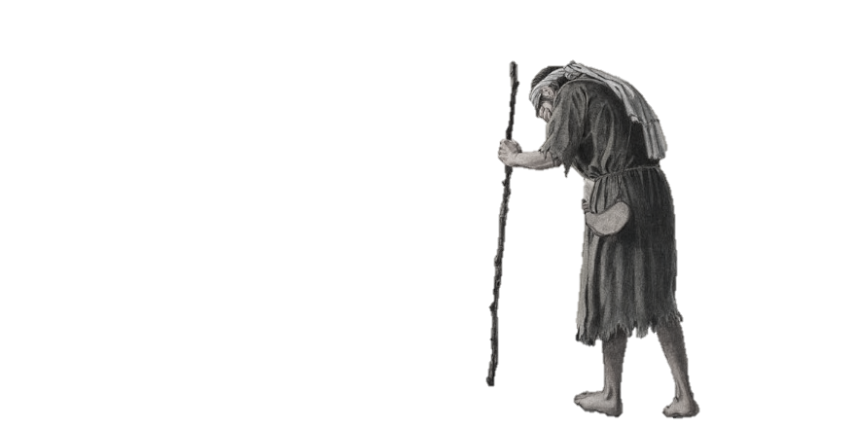
Notes:
Undoubtedly, the son never set out to hurt his father or himself, but as the sight of his true self grew dim, so did his willingness to obey his father diminish until he was completely swallowed up by life due to his riotous living.
Very few of us set out to be desperately wicked. Unfortunately, if we do not see how much our soul is worth, whether we lost sight of this truth or never gained it to start with, the instability which comes in the wake of such an imbalance can lead to pain, suffering, and even sin.
For the young man, he had to hit bottom before he came to himself and thus was able to truly reconcile with his father. Hopefully, that is not the destiny which we will choose.

Slide 56
Notes:
We have heard of the Father’s love for us in countless classes and sermons, and yet this fundamental principle of the Gospel is so hard to truly feel within our own soul. And though we might study God’s love in an academic way through the scriptures, we must have the Spirit with us in order to gain true insight.
The young man did not come to himself simply by reading about his father’s love, but as he recognized his dire circumstance, he remembered what it was like when he lived with his father.
As this realization struck him, the young son set his life in such a way to return to his father in the hope that his father might forgive him.
When the young man returned home, he received a perfect knowledge of his father’s love by the way that the father embraced him.
What are ways we can learn of the Father’s love?

Slide 57
Give up
Imbalance
Distrust of God
Weakness
Weakened faith
Response
Fear and doubt
Support of a friend
Sharing with my parents
Notes:
Coming unto the Father through Jesus Christ is easier said than done. We might be able to quote scripture that we should follow, such as DC 90:1a, 3b, and Ether 2:4, or principles, such as a broken heart and a contrite spirit. But what do these things mean? What is a practical way that we can come unto God?
Testimony of coming unto God after getting angry at work: I was scheduled to record for the radio program at 10 am, but did not realize that we had a meeting with VIUS that same morning at 8:30. I believe Tom told me about the meeting but I did not put it in my calendar. Moreover, I had not prepared for the radio recording yet, which was on our COVID-19 survey, because the survey numbers can change and I usually wait until the morning of before I prepare. I should have looked at the survey responses regardless, but I did not. So when I got called to Tom’s office for an unexpected meeting I was incredibly angry and I cursed in my heart. I felt terrible. The Lord spoke to me before I walked in that I should pray beforehand, but I did not. I just persisted in my anger. I felt terrible afterward, but thank the Lord I did not crucify myself, yet even though I asked my boss to forgive me (though he might not have known I was angry to begin with), as well as the Lord, my heart still felt heavy and sad. This is because I was hoping the consequence of what I did would go away, but this is not how coming unto the Father works. We must own our consequences as Adam and Eve did. In this, it is not that sin that matters as much as the fact they we repented and came unto the Father. Then perhaps we can be even as Adam and Eve who were thankful for their transgression, which is a very odd statement and way of thinking.
Let us not focus on the fall but on the one who redeems!

Slide 58
DC 50:8e-g
50:8e Fear not, little children, for you are mine, and I have overcome the world, and you are of them that my Father hath given me; and none of them that my Father hath given me shall be lost; 50:8f and the Father and I are one; I am in the Father and the Father in me; and inasmuch as ye have received me, ye are in me, and I in you; wherefore I am in your midst; 50:8g and I am the good Shepherd (and the stone of Israel: he that buildeth upon this rock shall never fall), and the day cometh that you shall hear my voice and see me, and know that I am. Watch, therefore, that ye may be ready. Even so. Amen.
Notes:
The Lord Jesus Christ promised that inasmuch as we receive Him, we are in Him and He is in our midst
We must receive Him as a little child

Slide 59
59:4d yea, all things which come of the earth, in the season thereof, are made for the benefit and the use of man, both to please the eye, and to gladden the heart; yea, for food and for raiment, for taste and for smell, to strengthen the body, and to enliven the soul.
Notes:
When I am struggling with self-hatred, anger, etc. It helps to remind myself that God does in fact love me. For me, I try to recall the scriptures and testimonies that have exemplified this truth. However, there are other avenues as well, for God speaks to us all a little differently. Even in a sunrise, or in a rainbow.
Example at work with coffee. I was unusually tired and was tempted to drink coffee as in the olden days. However, when I prayed about it, I felt that I should not partake.
I became angry and wanted to rebel.
Then I remembered this class and began to think, “Why would God not want me to have coffee.”
I recalled how it negatively effects me. The anger began to dissipate, as well as the temptation

Slide 60
18:12 How think ye? If a man have a hundred sheep, and one of them be gone astray, doth he not leave the ninety and nine, and goeth into the mountains and seeketh that which is gone astray?
Notes:
The Lord has never abandoned me.
He has sought for me

Slide 61
1:17 Every good gift and every perfect gift is from above, and cometh down from the Father of lights, with whom is no variableness, neither shadow of turning.
Notes:
How many gifts has the Lord blessed us with?
Make a list of all the blessings and testimonies you have personally received from God
Matthew 7:20
20 If ye then, being evil, know how to give good gifts unto your children, how much more shall your Father who is in heaven give good things to them that ask him?

Slide 62
Mosiah 2:20-22
2:20 Even so I would that ye should remember, and always retain in remembrance, the greatness of God, and your own nothingness, and his goodness and long suffering towards you unworthy creatures, 2:21 And humble yourselves even in the depths of humility…2:22 And behold, I say unto you, that if ye do this, ye shall always rejoice, and be filled with the love of God, and always retain a remission of your sins;
Notes:
Humility is the key to addressing our view of our value.
True humility contains two principles: remember the greatness of God and remember our nothingness
We must never confuse unworthiness, with worthlessness. They are not the same.
Why would Jesus Christ choose to do what He did for something that was of no worth?

Slide 63
2. Dissociate Our Dysfunctional Patterns, Apply Righteous Actions
Notes:
As we start the process to restoration and healing by seeking our true self-worth, we will undoubtedly notice dysfunctional spiritual, emotional, and mental patterns in our lives. How do we break them?
In the parable of the prodigal son, the young man became aware of his pride once he reached rock bottom.
However, there are other avenues to break our destructive patterns.
Namely, a relationship with the Father, the Son, and the Holy Ghost.
So how do we develop our relationship with God in such a way that we have power to overcome all things, even ourselves?

Slide 64
Concern about my body
Imbalance
Not happy with who I am
Weakness
Want what others have
Response
Wish I could look different
Compare and jealousy
Always gauging myself
Exercise
Depression
Anxiety
Notes:
I was unhappy with my weight especially, but while I was upset about it, I did not do anything to change it.
Merely stopping my comparison, jealousy, and gauging of myself would not help
I was finally able to start working out and exercising, causing me lose the weight.
But also recognize that I am a child of God, He does not care what I look like as long as I am healthy (stewardship)
This increased further with better eating habits, though I was far from perfect.

Slide 65
Unhappy with myself because…
Become healthy
Exercise
Eat properly
Self-confidence
Get plenty of rest
Find your Root Cause
What is the opposite?
What are the actions?
Notes:
Once you have plotted or diagramed yourself and have a better knowledge of your root cause, then begin to start asking yourself, “What is the opposite?”

Slide 66
Elevated sense of self-worth
Humility
Repent
Come back to his father
Become a servant
Find your Root Cause
What is the opposite?
What are the actions?
Notes:
Example of the Prodigal Son

Slide 67
Alma 12:4-5
12:3 And what added more to his joy, they were still his brethren in the Lord; yea, and they had waxed strong in the knowledge of the truth; 12:4 For they were men of a sound understanding, and they had searched the scriptures diligently, that they might know the word of God. 12:5 But this is not all: they had given themselves to much prayer, and fasting, therefore they had the spirit of prophecy, and the spirit of revelation, and when they taught, they taught with power and authority, even as with the power and authority of God.
Notes:
Through study we learn of God, through prayer we commune with God, and through fasting we rejoice in God
These three principles are not merely good habits of behavior, but they are key in order to dissociate ourselves from current and past destructive patterns.
For by study, we learn who God is so that we might also learn who He is asking us to be;
through prayer we have power in the moment to break our chains and change our course; and
through fasting we acquire the strength to loose every band, to undo the heavy burden, to let the oppressed go free, and to break the band of every yoke.
Fasting teaches self-control and humility, not by punishment, but through active sacrifice

Slide 68
2 Nephi 3:31-34
3:31 Nevertheless, the great goodness of the Lord, in showing me His great and marvelous works, my heart exclaimeth, O wretched man that I am; yea, my heart sorroweth because of my flesh. 3:32 My soul grieveth because of mine iniquities. 3:33 I am encompassed about because of the temptations and the sins which doth so easily beset me. 3:34 And when I desire to rejoice, my heart groaneth because of my sins; nevertheless, I know in whom I have trusted.
Notes:
2 Nephi 3:29-50

Slide 69
Study
3:29 For my soul delighteth in the scriptures, and my heart pondereth them…
Prayer
3:39 And by day have I waxed bold in mighty prayer before Him…
Fasting
3:47 Rejoice, O my heart, and give place no more for the enemy of my soul…3:50 Rejoice, O my heart, and cry unto the Lord, and say, O Lord, I will praise thee for ever…
Notes:
Even though Nephi was man of God, one who had received countless experiences, he still struggled with sin and temptation just as we do today. How was he able to overcome? The answer is in his testimony from 2 Nephi 3:29-66.
These principles allowed Nephi to see the destructive patterns he might have had in his life, and the strength to dissociate himself from them. So much so that he could exclaim “He [God] hath filled me with His love, even unto the consuming of my flesh…”

Slide 70
3. Walk in a Newness of Life through Faith, Hope, Charity, and Humility
Notes:
The final process of our restoration is to gather all that we have learned in the first two steps, and integrate them into a new life.
Obviously, the prodigal son was not physically dead, as he could breath, move, and do according to his own will. But yet, was he truly alive?
Perhaps the best way to answer is by asking the question, “What does it mean to be dead?” James records that… “For, as the body without the Spirit is dead, so faith without works is dead.” [James 2:25] In other words, if the Spirit of Christ does not dwell within us, then we have no life with God. For… “it is the Spirit that quickeneth; the flesh profiteth nothing…” [John 6:63]. The prodigal son then was dead to his father because of the choices he made. The only way to live again was to correct that relationship.

Slide 71
Ephesians 4:22-24
4:22 And now I speak unto you concerning the former conversation, by exhortation, that ye put off the old man, which is corrupt according to the deceitful lusts; 4:23 And be renewed in the mind of the Sprit; 4:24 And that ye put on the new man, which after God is created in righteousness and true holiness.
Notes:
God has called His children to mortify their old man, and… “put on the new man, which after God is created in righteousness and true holiness.” The Lord explained the way to do so in His answer to Moroni’s prayer concerning the weakness of his writing.
Romans 6 and 8 talk of putting to death the old man and living unto Christ. That we might be free

Slide 72
Romans 6:4-7
6:4 Therefore we are buried with Him by baptism into death; that like as Christ was raised up from the dead by the glory of the Father, even so we also should walk in newness of life. 6:5 For if we have been planted together in the likeness of His death, we shall be also in the likeness of His resurrection; 6:6 Knowing this, that our old man is crucified with Him, that the body of sin might be destroyed, that henceforth we should not serve sin. 6:7 For he that is dead to sin is freed from sin…
Notes:
8:13 For if ye live after the flesh, unto sin, ye shall die; but if ye through the Spirit do mortify the deeds of the body, ye shall live unto Christ. [Romans 8:13]

Slide 73
Romans 6:8-11
6:8 Now if we be dead with Christ, we believe that we shall also live with Him; 6:9 Knowing that Christ being raised from the dead dieth no more; death hath no more dominion over Him. 6:10 For in that He died, He died unto sin once; but in that He liveth, He liveth unto God. 6:11 Likewise reckon ye also yourselves to be dead indeed unto sin, but alive unto God through Jesus Christ our Lord.

Slide 74
Romans 6:8-11
6:8 Now if we be dead with Christ, we believe that we shall also live with Him; 6:9 Knowing that Christ being raised from the dead dieth no more; death hath no more dominion over Him. 6:10 For in that He died, He died unto sin once; but in that He liveth, He liveth FOR God. 6:11 Likewise reckon ye also yourselves to be dead indeed unto sin, but alive FOR God through Jesus Christ our Lord.
Notes:
It is not so much about what we are doing, it is what we are not doing.
Insert ourselves into God, instead of trying to insert Him into us
Do we want to win God?

Slide 75
What are your Passions?
How can it be used for the Kingdom?
How can you nurture it?
Playing the Organ/Piano
Music for the saints
Take lessons and practice
Teaching Children
Sunday School Class
Study material and all good books
Photography
Capture the beauty of God’s creation
Read and/or take classes
Notes:
How can we live for God?

Slide 76
Ether 5:27-29
5:27 And when I had said this, the Lord spake unto me, saying…my grace is sufficient for the meek… and if men come unto me, I will shew unto them their weakness. 5:28 I give unto men weakness, that they may be humble; and my grace is sufficient for all men that humble themselves before me; for if they humble themselves before me, and have faith in me, then will I make weak things become strong unto them. 5:29 Behold, I will shew unto the Gentiles their weakness, and I will shew unto them that faith, hope, and charity, bringeth unto me the fountain of all righteousness
Notes:
humility is the key to establishing a right relationship with both God and our self.
A humble person is one who has control over their own heart and mind, Moroni 7:49-50 “…save he shall be meek and lowly in heart…his faith and hope are vain”

Slide 77
Faith
Do you have faith that God loves you?
Do you have faith that God loves the world?
How do we discover the truth for ourself?
Have you spent time in prayer, study, and fasting?
Notes:
If no, what steps ought we to take in order to exercise our faith that God is love?
If the answer is yes, how should we respond to God’s love?

Slide 78
Hope
Do you have hope in the promises of God?
Do you have hope in the atonement of Christ?
Do you hope that He will answer your prayers and your questions?
Do you have hope in a better world?
Do you have hope that Zion will be?
Do you have hope in the resurrection and eternal life?
Notes:
If you do not hope, what assurances will you have?
Do you have hope that you can overcome all things in Christ?
Do you have hope that you can be happy and joyful in this life?

Slide 79
Charity
Do you have charity, or the pure love of Christ?
Have you experienced it in your life?
Have you prayed…“unto the Father with all the energy of heart, that ye may be filled with this love which He hath bestowed upon all who are true followers of His Son Jesus Christ…?” [Moroni 7:53]
Notes:
If we have not done so, when will we start?

Slide 80
Humility
“Could ye say, if ye were called to die at this time, within yourselves, that ye have been sufficiently humble?” [Alma 3:48
Have we delayed our coming unto Christ?
How much longer shall we delay?
Notes:
If we have not, then Jesus would counsel us, saying… “Come unto me, all ye that labor and are heavy laden and I will give you rest. Take my yoke upon you, and learn of me; for I am meek and lowly in heart; and ye shall find rest unto your souls; for my yoke is easy and my burden is light.” [Matthew 11:29-30]

Slide 81
How can I do more when I am filled with…
The Kingdom of God
Anger
Doubt
Envy
Fear
Guilt
Hatred
Jealousy
Lust
Mocking
Pride
Self-abasement
Self-pity
Notes:
The truth is that though we frequently hear the message of Zion and Christ’s Kingdom, many of us are struggling with all sorts of trials. And yet God is calling us to do more for Him and for His creation. Yet the way for healing and restoration is come unto the Father through Jesus Christ, His Son that we might learn to love our self rightly and obtain eternal and everlasting happiness.
[Add picture of the Kingdom in the background?

Slide 82
Notes:
The purpose of this class is to increase our intelligence, not that we are unintelligent, but we struggle to see the “choice” that we have. The reason God gave man intelligence first, and then agency, is because we cannot have agency without intelligence. There has to be some manner of light, or discernment. Once we obtain intelligence, or in other words light and truth, so that now we can see the path we ought to take, we now have power to choose what we want. Hopefully this class illumines the path as well as encourages us to choose the better path.

Slide 83
Learning to Love Your Soul
Step Two: Applying What We Have Learned

Slide 84
1. Address Our View of the Truth

Slide 85
“Nobody is anybody until someone loves them”
Relation Imbalance
Relation Weakness
Dysfunctional Response
“Why should I even love myself?”
“I am worthless”
“No one loves me”
Notes:
Zion consists entirely of relationships, which is something we must work on at every level.
Whether we experience anger, pride, hatred of self, self-abasement, lust, etc., these spiritual, emotional, and mental dysfunctional responses can be traced back to a relation imbalance, a relation weakness, or a dysfunctional response that has become our default.
This dysfunction can quickly create the illusion that we have no choice or control over ourselves, and worse, they tend to separate us from the Father, the Lord Jesus, and the Holy Spirit.
This pattern can swiftly snowball and perpetuate itself until we feel all is lost. We become discouraged, frustrated, and lose all hope. So what can we do to stop this destructive pattern?

Slide 86
1. Address Our View of the Truth
2. Dissociate Our Dysfunctional Patterns by Applying Righteous Actions

Slide 87
Find your Root Cause
What is the Opposite?
What are the actions?
Exercise
Become healthy
Unhappy with myself because…
Eat Properly
Self-confidence
Get Plenty of Rest

Slide 88
1. Address Our View of the Truth
2. Dissociate Our Dysfunctional Patterns by Applying Righteous Actions
3. Walk in a Newness of Life

Slide 89
What are your Passions?
How can it be used for the Kingdom?
How can you nurture it?
Playing the Organ/Piano
Music for the saints
Take lessons and practice
Teaching Children
Sunday School Class
Study material and all good books
Photography
Capture the beauty of God’s creation
Read and/or take classes
Notes:
How can we live for God?

Slide 90
Moroni 6:4-7
6:4 And after they had been received in baptism, and were wrought upon and cleansed by the power of the Holy Ghost, they were numbered among the people of the church of Christ, 6:5 And their names were taken, that they might be remembered and nourished by the good word of God, to keep them in the right way, to keep them continually watchful unto prayer, relying alone upon the merits of Christ, who was the author and the finisher of their faith…
Notes:
Now we come back to this class, and remember the promises that we made in the baptism of the water and the Spirit as shown in Mosiah 9:39-42.
In particular, that we would enter into the fold of God and be willing to bear one another’s burdens that they may be light. And that we would mourn and comfort those in need.

Slide 91
Moroni 6:4-7
6:6 And the church did meet together oft, to fast and to pray, and to speak one with another concerning the welfare of their souls: and they did meet together oft to partake of bread and wine, in remembrance of the Lord Jesus; 6:7 And they were strict to observe that there should be no iniquity among them…
Notes:
Now we come back to this class, and remember the promises that we made in the baptism of the water and the Spirit as shown in Mosiah 9:39-42.
In particular, that we would enter into the fold of God and be willing to bear one another’s burdens that they may be light. And that we would mourn and comfort those in need.

Slide 92
Fear
Miserable
I will not come unto the Father
Relation Imbalance
Relation Weakness
Dysfunctional Response
Refusal to believe that God is enough
Seeking for things outside of God
Anxiety and Restlessness
Do nothing
Notes:
Discovering our root struggles does not mean that we need to always explore the deepest, darkest corners of our heart, mind, and soul, but that we might find the peace and strength to overcome all obstacles that inhibit not only the Kingdom of God, but also our ability to come unto the Father, through Jesus Christ.
Share my experience regarding God not being enough.
The anxiety and restlessness concerning Friday and the realization that I am seeking to be filled by looking in the wrong places [John 6:26]
I have been doing this for a long time, as I have sought for fulfillment in video games, anime, etc.
When I had my testimony and began to change, I started to notice that my previous life did not fill me anymore, yet I was not eager or prone to leave them behind or let them go.
It created a battle within me that has caused me much grief. Essentially, I was not willing to participate in the things of God because they did not appear pleasing, but yet I was not wanting to participate in those other things because they made me miserable. I was miserable if I did God’s will, and miserable if I did not.
From here, I noticed that I have been seeking for fulfillment and happiness in everything but God it seems. (At least, at certain times anyway)
The root cause is my refusal to believe that God is enough to make me happy.

Slide 93
26:3 Thou wilt keep him in perfect peace, whose mind is stayed on thee; because he trusteth in thee. [Isaiah 26:3]

Slide 94
2 Nephi 7:40
7:40 Therefore cheer up your hearts, and remember that ye are free to act for yourselves; to choose the way of everlasting death, or the way of eternal life.

Slide 95
Find your Root Cause
What is the Opposite?
What are the actions?
Trust
Recognize…
Refusal to believe that God is enough
Obey
Believe…
Live for Him

Slide 96
What are your Passions?
How can it be used for the Kingdom?
How can you nurture it?
Studying
Classes
Learn from others
Preaching
Edify and Exhort
Prayer and Preparation
Visiting
Grow in love
Dedicate more time to visit
Notes:
How can we live for God?

