Slide 1

Notes:
Introduce Topic
Reason I first created this class was because I kept hearing our youth repeat protestant beliefs on the end times and I wanted to know what the scriptures said about these topics and here is the forth generation of rework since that original class.

Slide 2

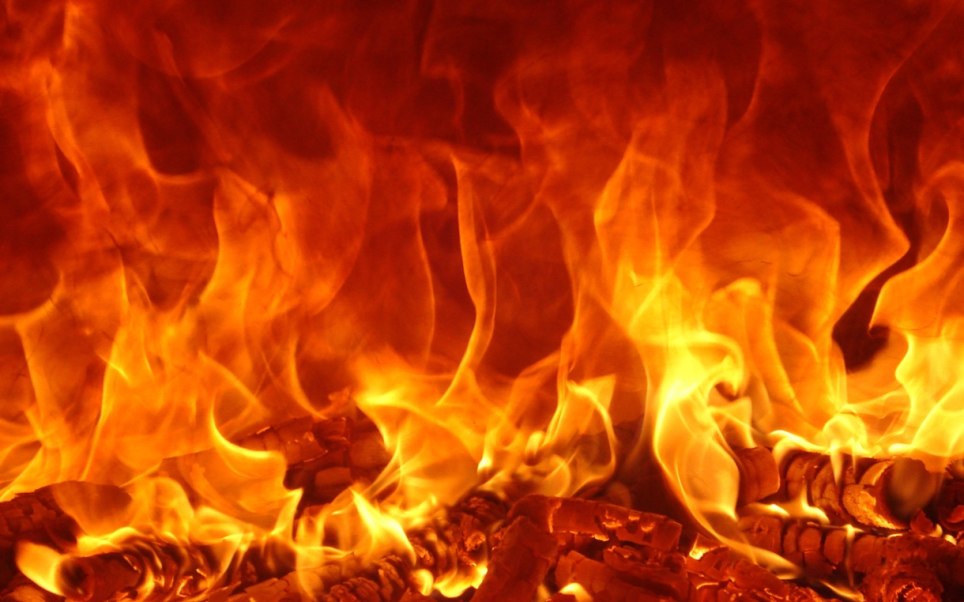
SEVEN YEARS TRIBULATION
Truth or Fiction?
Notes:
Introduce Topic
Reason I first created this class was because I kept hearing our youth repeat protestant beliefs on the end times and I wanted to know what the scriptures said about these topics and here is the forth generation of rework since that original class.

Slide 3

Seven Years Tribulation
& “THE” anti-Christ
Elder Benjamin Pedersen
Outreach Restoration Branch
(816) 517-7971
b1nzion@yahoo.com
Notes:
Name is Benjamin Pedersen
Elder at Outreach Restoration Branch
Teaching on the concept of Seven Years Tribulation

Slide 4
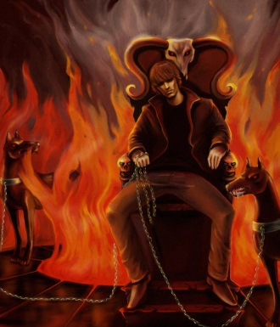
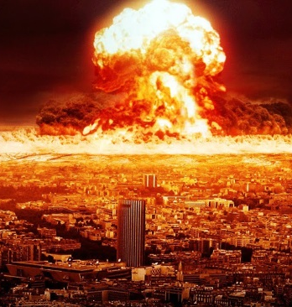
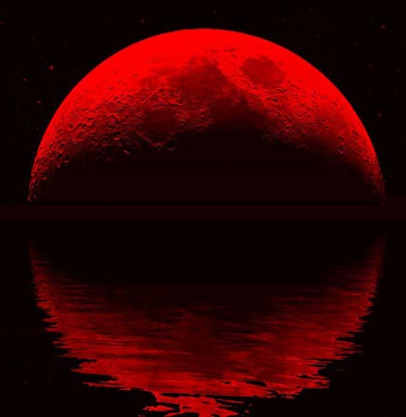
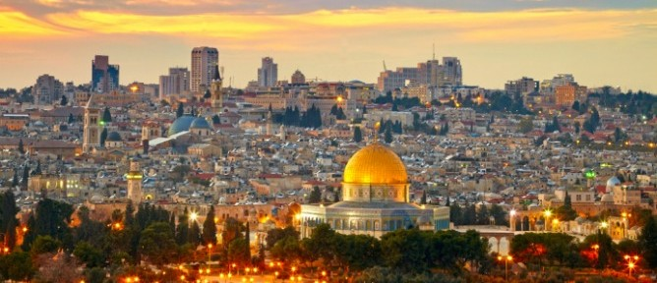
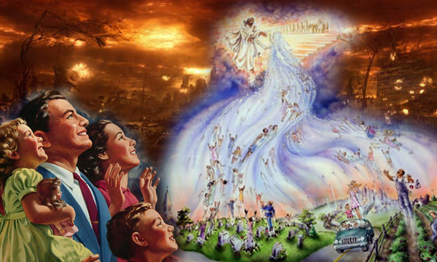
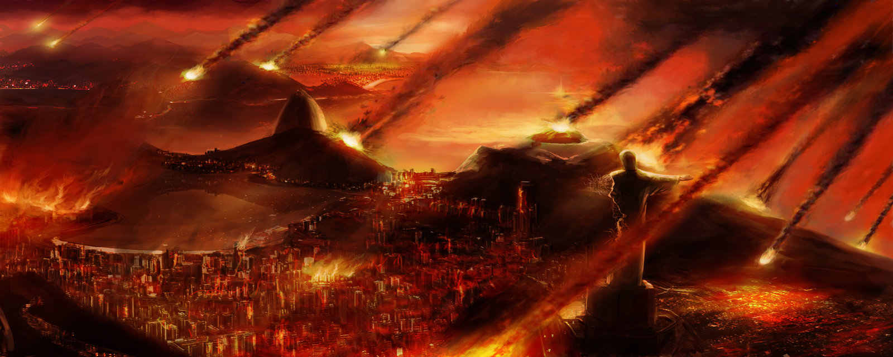

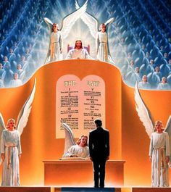
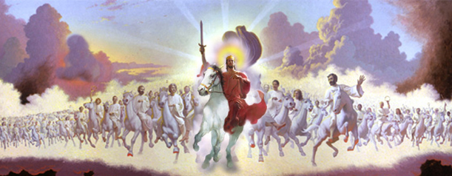
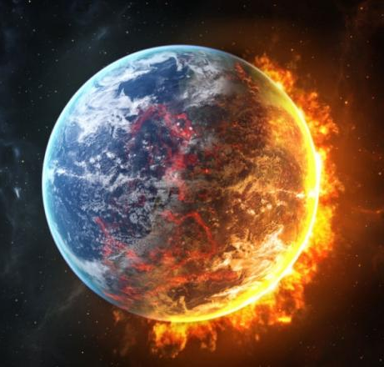
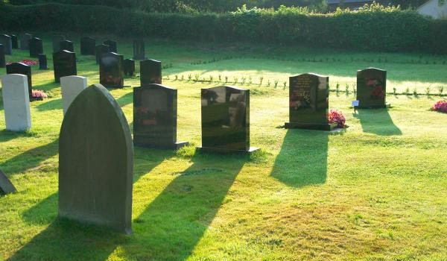
End Times
Blood Moon
Zion
Armageddon
Rapture
Tribulation
Judgment
Anti-Christ
Earth Destroyed
Resurrection
Christ’s Return
Temple Destroyed
Notes:
We hear of all kinds of ideas about what to expect in the end times.

Slide 5

Does Satan want us to know what will happen in the end times?

Slide 6
And the angel of the Lord said unto me, Thou hast beheld that the book [BIBLE] proceeded forth from the mouth of a Jew; and when it proceeded forth from the mouth of a Jew it contained the plainness of the gospel of the Lord, of whom the twelve apostles bear record; and they bear record according to the truth which is in the Lamb of God:
Wherefore, these things go forth from the Jews in purity unto the Gentiles, according to the truth which is in God:
1 Nephi 3:165-175 (Cont.)→
Notes:
Why are we to know the signs?
SO WE CAN BE READY!!

Slide 7
And after they go forth by the hand of the twelve apostles of the Lamb, from the Jews unto the Gentiles, thou seest the foundation of a great and abominable church, which is most abominable above all other churches;
For behold, they have taken away from the gospel of the Lamb many parts which are plain and most precious;
And also many covenants of the Lord have they taken away;
1 Nephi 3:165-175 (Cont.)→
Notes:
Why are we to know the signs?
SO WE CAN BE READY!!

Slide 8
And all this have they done that they might pervert the right ways of the Lord; that they might blind the eyes and harden the hearts of the children of men:
Wherefore, thou seest that after the book hath gone forth through the hands of the great and abominable church that there are many plain and precious things taken away from the book, which is the book of the Lamb of God;
And after these plain and precious things were taken away, it goeth forth unto all the nations of the Gentiles:
1 Nephi 3:165-175 (Cont.)→
Notes:
Why are we to know the signs?
SO WE CAN BE READY!!

Slide 9
Thou seest because of the many plain and precious things which have been taken out of the book, which were plain unto the understanding of the children of men, according to the plainness which is in the Lamb of God;
Because of these things which are taken away out of the gospel of the Lamb, an exceeding great many do stumble, yea, insomuch that Satan hath great power over them;
1 Nephi 3:165-175
Notes:
Why are we to know the signs?
SO WE CAN BE READY!!

Slide 10
Summary of 1 Nephi 3:165-175:
Bible was given in purity and truth
  Plain and precious things were taken away
Why?
  To pervert the right ways of the Lord
  To blind our eyes
  To harden our hearts
Result:
  An exceeding great many of people do stumble
  Satan hath great power over people
Notes:
Why are we to know the signs?
SO WE CAN BE READY!!

Slide 11
Satan wants us ignorant of God’s plan and he wants to destroy us

Slide 12
God wants us to know of His plan and to save all who will
God LOVES all people, everywhere, not just us!

Slide 13
21b And I give unto you a commandment, that you shall teach one another the doctrine of the kingdom; teach ye diligently and my grace shall attend you, that you may be instructed more perfectly in theory, in principle, in doctrine, in the law of the gospel, in all things that pertain unto the kingdom of God, that is expedient for you to understand;
21c of things both in heaven, and in earth, and under the earth; things which have been; things which are; things which must shortly come to pass;
D&C 85:21b-23b (Cont.→)
Notes:
The key is treasuring the word of God enough to know it and write it upon our hearts so that we are not deceived when false beliefs and signs are taught.

Slide 14
21d things which are at home; things which are abroad; the wars and the perplexities of the nations; and the judgments which are on the land;
21e and a knowledge also of countries, and of kingdoms, that ye may be prepared in all things when I shall send you again, to magnify the calling whereunto I have called you, and the mission with which I have commissioned you.
22a Behold, I sent you out to testify and warn the people, and it becometh every man who hath been warned, to warn his neighbor; therefore, they are left without excuse, and their sins are upon their own heads.
D&C 85:21b-23b (Cont.→)
Notes:
The key is treasuring the word of God enough to know it and write it upon our hearts so that we are not deceived when false beliefs and signs are taught.

Slide 15
22b He that seeketh me early shall find me, and shall not be forsaken.
23a Therefore, tarry ye, and labor diligently, that you may be perfected in your ministry, to go forth among the Gentiles for the last time, as many as the mouth of the Lord shall name, to bind up the law, and seal up the testimony, and to prepare the Saints for the hour of judgment, which is to come;
23b that their souls may escape the wrath of God, the desolation of abomination, which await the wicked, both in this world, and in the world to come.
D&C 85:21b-23b
Notes:
The key is treasuring the word of God enough to know it and write it upon our hearts so that we are not deceived when false beliefs and signs are taught.

Slide 16
End Times

Slide 17
Is it possible that some things taught about the end times are deceptions of Satan?

Slide 18
How are we to know what to believe?

Slide 19
Importance of Signs
And they shall see the Son of man coming in the clouds of heaven, with power and great glory.
And whoso treasureth up my word
shall not be deceived.
Mark 13:42-43
Notes:
The key is treasuring the word of God enough to know it and write it upon our hearts so that we are not deceived when false beliefs and signs are taught.

Slide 20
Importance of Signs
Surely the Lord God will do nothing, until he revealeth the secret unto his servants the prophets.
Amos 3:7
And unto you it shall be given to know the signs of the times, and the signs of the coming of the Son of man...
D&C 68:1f-h

Slide 21
Importance of Signs
And what I say unto one, I say unto all men; Watch, therefore, for ye know not at what hour Lord doth come.
But know this, if the good man of the house had known in what watch the thief would come, he would have watched, and would not have suffered his house to have been broken up; but would have been ready.
Therefore be ye also ready; for in such an hour as ye think not, the Son of Man cometh.
Matthew 24:49-51
Notes:
Why are we to know the signs?
SO WE CAN BE READY!!

Slide 22
Importance of Signs
Treasure up the WORD
God will reveal to prophets what is to come
Told to know the signs
We won’t know the day nor the hour, but we are to know the times
Watch and be READY (ready is the hard part)
Notes:
If we study signs all day long and don’t prepare our hearts, then it doesn’t profit anything.
My hope is that this class rekindles your desires to know the scriptures more and to be more engaged and active in the work of God’s kingdom, even Zion.

Slide 23
Importance of Signs
Satan does not want us ready:
He wants us to believe that things that have ALREADY happened are yet to come
He wants us looking for things that will not happen
He twists the word of God so we don’t understand God’s plan
We’ll see examples of all three in this class

Slide 24
General Background

Slide 25
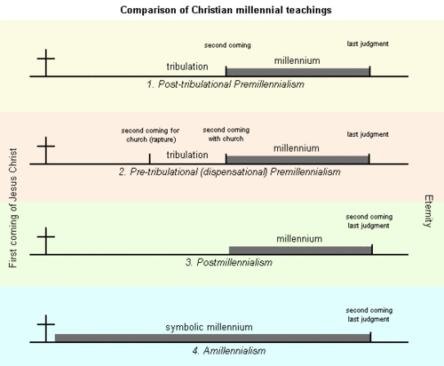
What do OTHERS believe?
Tribulation, Christ, Millennium, Judgment
Christ w/rapture, Tribulation, Christ w/church & Millennium, Judgment
Millennium, Christ w/Judgment
Symbolic Millennium, Christ w/Judgment
http://en.wikipedia.org/wiki/Tribulation
Notes:
There are many other believes than these 4.

Slide 26
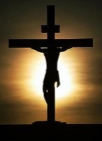

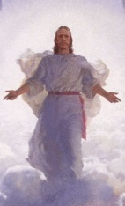
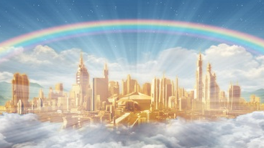
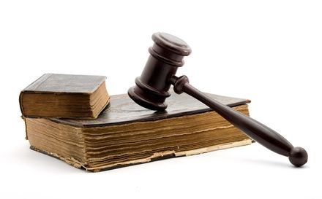

What do OTHERS believe?
1.
2.
3.
4.

Slide 27
What do WE believe?
Restoration of Christ’s Church
Little Season
Apostasy
?
Millennial Reign
Second Coming With His Church
Final Judgment
When do we believe tribulation will occur or has occurred?
How long will this tribulation be or how long was it?
Notes:
What other things have we heard about that are supposed to happen before Christ returns?
How about in relation to His church?
How about in relation to the United States?

Slide 28

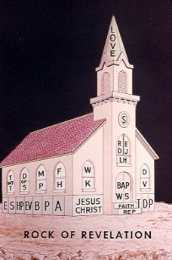
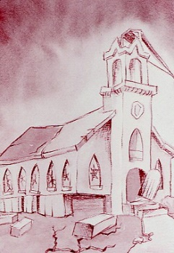
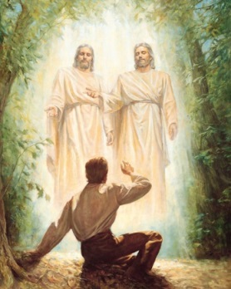
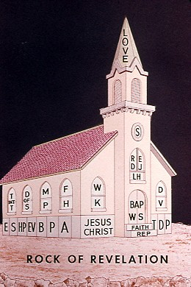

What do WE believe?
?

Slide 29
What do WE believe?
What about 7 years tribulation?
What have we heard about 7 years tribulation?

Slide 30
Seven Years Tribulation Idea
The tribulation is a future time of world distress lasting seven years. The Antichrist will rule the world as a political and religious leader for the seven years. The first three and one half years will be a time of peace and prosperity. The Antichrist then puts an end to sacrifice and offering in the rebuilt temple.
Note: The temple in Jerusalem was destroyed and the belief is that it will be rebuilt and then destroyed again.

Slide 31
Seven Years Tribulation Idea
The last half of the seven years is a world holocaust never matched since the beginning of time. The Christian believers will be raptured out either in the beginning (pre-trib), middle (mid-trib) or after the seven years (post-trib).
Armageddon, the last big war, will bring an end to this world as we know it. Christ will then come again with His raptured saints to establish a Kingdom of God on earth called the millennium.

Slide 32
Seven Years Tribulation Idea
Scriptures people use to support 7 Years Tribulation:
Daniel’s vision in Daniel chapter 9
  Prophecy of seventy weeks and things that would happen during these weeks
New Testament (KJV or other version)
  Jesus’ prophecies of the destruction of the temple in Jerusalem, His return, and horrible things that would occur
The Book of Revelation
  Talks about beasts, false prophets, calamities
Notes:
These scriptures are used by others, together, to build upon one another, and create the idea of 7 years tribulation, the antiChrist and many other beliefs.

Slide 33



What do OTHERS believe?
Foundation of the concept of 7 years tribulation
Daniel’s 70 Weeks
Matt. 24 Mark 13 Luke 21
Revelation 1,260 days/years

Slide 34
Restoration Gospel Is Critical to Understanding

Slide 35
Restored Gospel Is Critical
Ye are not sent forth to be taught, but to teach the children of men the things which I have put into your hands by the power of my Spirit; and ye are to be taught from on high.
D&C 43:4b-c
Notes:
Arthur Oakman said that “We have nothing to learn from theologians”
They do not have the promise of the Holy Ghost after baptism and they do not have the fullness of the gospel

Slide 36
Restored Gospel Is Critical
POINTS OF REFERENCE
Instructions:
Look for the tree
Turn left and go 50 paces
Then go right 25 paces
Now left again for 100 paces
What is your point of reference?

Slide 37


Restored Gospel Is Critical
What kind of tree?
Would any tree work?
Notes:
A ship sailing could set a course using the North Star…it’s a reliable reference point.

Slide 38
Restored Gospel Is Critical
Points of Reference Definition:
Benjamin Definition: Point in time, an event, or object which is used to measure or align other events or objects
Dictionary: point of reference - an indicator that orients you…
benchmark - a surveyor's mark on a permanent object of predetermined position and elevation used as a reference point
landmark - a mark showing the boundary of a piece of land
target, mark - a reference point to shoot at; "his arrow hit the mark“
indicator - a signal for attracting attention

Slide 39
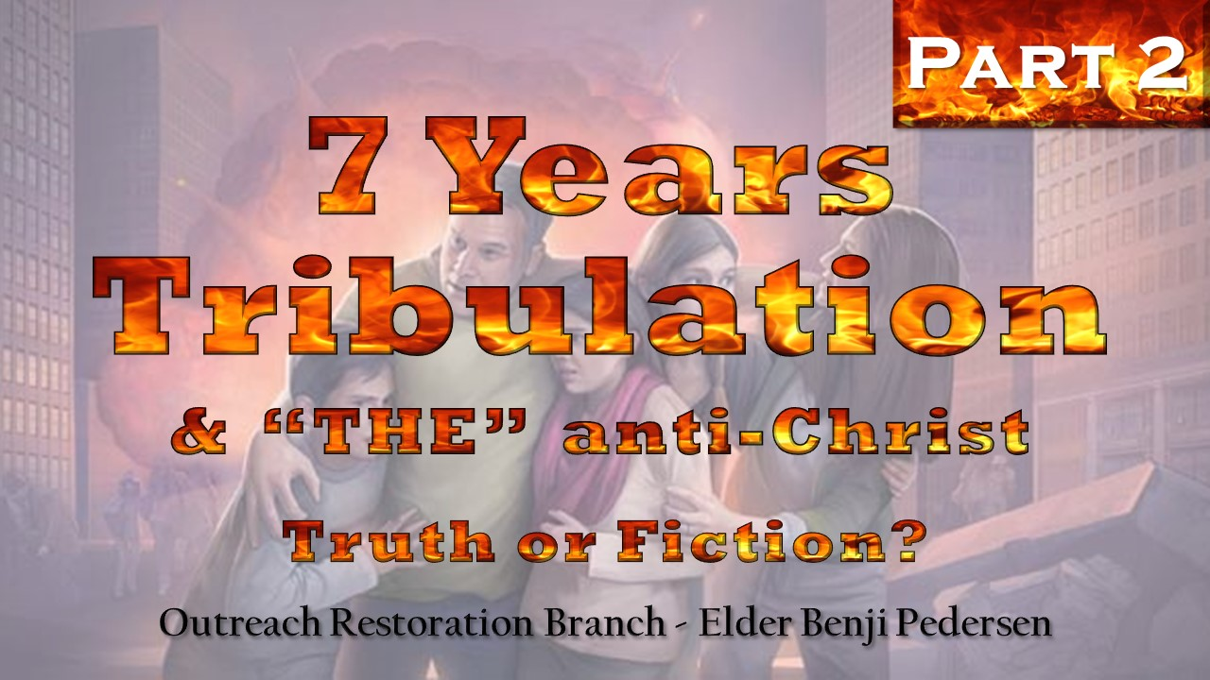

Slide 40
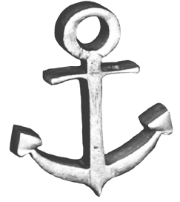
Restored Gospel Is Critical
Illustration of Reference Point:
Known Point of Reference
Timeline
History
Prophecy
Anchor Point

Slide 41
Restored Gospel Is Critical
Example:
Book of Mormon Prophecy of Christ’s Birth and destruction at his death:
Therefore there shall be one day and a night, and a day, as if it were one day, and there were no night; and this shall be unto you for a sign; for ye shall know of the rising of the sun, and also of its setting;
Helaman 5:57
What is our point of reference here?

Slide 42
Restored Gospel Is Critical
Sources of references points for prophecy and revelation:
Old & New Testaments
Historical records
Book of Mormon
Doctrine & Covenants
Church History & records
Personal revelation from God

Slide 43
Restored Gospel Is Critical
Old & New Testaments
Historical Records
Can we FULLY understand with only a PORTION of the knowledge?
Book of Mormon
Doctrine & Covenants
Church History & Records
Personal Revelation
(KJV)
Sources of our REFERENCE POINTS to understand prophecy
Restored Gospel Is Critical

Slide 44
Restored Gospel Is Critical
Inspired Version is absolutely needed to understand end-time concepts
  Matthew 24, Mark 13 and Luke 21 are dramatically different in the KJV from the IV
Falling away and restoration of the gospel give us reference points for scriptures that others use for the idea of 7 years tribulation
  See Book of Revelation covering 1,260 years or the 42 months (will touch on later)

Slide 45
Restored Gospel Is Critical
But God hath revealed them unto us by his Spirit; for the Spirit searcheth all things, yea, the deep things of God.
For what man knoweth the things of a man, save the spirit of man which is in him? even so the things of God knoweth no man, except he has the Spirit of God…
But the natural man receiveth not the things of the Spirit of God; for they are foolishness unto him; neither can he know them, because they are spiritually discerned.
1 Corinthians 2:10-14
Notes:
It is critical, when studying anything, but especially the signs of the end times, that we have the Lord’s Spirit in power in our lives so that we can know these things which are DEEPLY SPIRITUAL.

Slide 46
God WANTS us to know and understand. He speaks in plainness to those who have His Holy Spirit.

Slide 47
Restored Gospel Is Critical
Thou seest because of the many plain and precious things which have been taken out of the book, which were plain unto the understanding of the children of men, according to the plainness which is in the Lamb of God;
1 Nephi 3:174
Then the disciples came and said unto him, Why speakest thou unto them in parables? He answered and said unto them, Because it is given unto you to know the mysteries of the kingdom of heaven, but to them it is not given.
Matthew 13:9-10
Notes:
God gives us understanding in plainness.
It is given to us to know and understand. God speaks clearly to us who have His word and who have His Spirit.

Slide 48
Restored Gospel Is Critical
15b yea, and I will also bring to light my gospel [BOM], which was ministered unto them, and, behold, they shall not deny that which you have received, but they shall build it up, and shall bring to light the true points of my doctrine; yea, and the only doctrine which is in me;
15c and this I do, that I may establish my gospel, that there may not be so much contention;
15d yea, Satan doth stir up the hearts of the people to contention, concerning the points of my doctrine; and in these things they do err, for they do WREST the Scriptures, and do not understand them;
D&C 3:15b-d
Notes:
It is critical, when studying anything, but especially the signs of the end times, that we have the Lord’s Spirit in power in our lives so that we can know these things which are DEEPLY SPIRITUAL.

Slide 49
Restored Gospel Is Critical
Definition of wrest:
1: to pull, force, or move by violent wringing or twisting movements
2: to gain with difficulty by or as if by force, violence, or determined labor
Merriam-Webster Dictionary
Force the Scriptures
Twist the Scriptures
Notes:
It is critical, when studying anything, but especially the signs of the end times, that we have the Lord’s Spirit in power in our lives so that we can know these things which are DEEPLY SPIRITUAL.

Slide 50
Restored Gospel Is Critical
Behold, the scriptures are before you; if ye will wrest them it shall be to your own destruction.
Alma 10:17
And now my son, I have somewhat to say concerning the restoration of which has been spoken: for behold, some have wrested the scriptures, and have gone far astray, because of this thing.
Alma 19:62
Notes:
God gives us understanding in plainness.
It is given to us to know and understand. God speaks clearly to us who have His word and who have His Spirit.

Slide 51
Numbers

Slide 52
Numbers
After the number of days in which he searched the land, even forty days, each day for a year, shall ye bear your iniquities, even forty years, and ye shall know my breach of promise.
Numbers 14:34

Slide 53
Numbers
And when thou hast accomplished them, lie again on thy right side, and thou shalt bear the iniquity of the house of Judah forty days; I have appointed thee each day for a year.
Ezekiel 4:6

Slide 54
Numbers
Day is 1 year
Week has 7 days
Month has 30 days
Year has 360 days
Time is 1 year
Score is 20 units

Slide 55
Numbers
Daniel 9 refers to 70 weeks
= 70 weeks X 7 days/week
= 490 days
= 490 years
Revelation 13:5 refers to 42 months
= 30 days/month X 42 months
= 1,260 days
= 1,260 years
Notes:
We will cover these in more detail later.

Slide 56
Numbers
Revelation 12:14 refers to a time, times, and half a time (1 time = 1 year)
= 1 year + 2 years + ½ year
= 3½ years
= 360 years + 720 years + 180 years
= 1,260 years
Revelation 12:5 states that this same period is 1,260 years (Inspired Version)
Notes:
We will cover these in more detail later.

Slide 57
Parts of this Class:
Daniel’s Vision of 70 Weeks
Christ’s Prophecy of His Return
The Book of Revelation
Other Notes
CONCLUSION – Truth or Fiction?
“THE” anti-Christ
Destruction of the wicked (additional class)
Notes:
We will cover what we can and not rush through these points.

Slide 58
SEVEN YEARS TRIBULATION
Truth or Fiction?

Slide 59
Daniel’s 70 Weeks

Slide 60
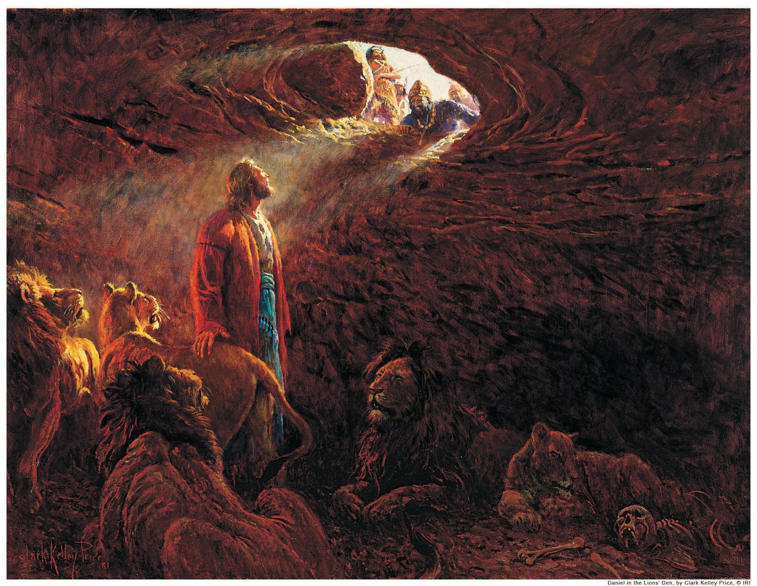
Notes:
Who was Daniel and what are some things he is known for?
“12 Biblical Facts about Daniel” by Jeffrey Kranz (Oct. 16, 2016)
THE most renowned prophet ever, beside Christ. LEGENDARY STATUS!
Muslims revere here, all across the middle east.
Was royalty from King David’s line. Was hansom. Was wise and intelligent.
Gifted with interpreting dreams & ALSO HAD many DREAMS.
Daniel oversaw all the pagan magicians of Babylon.
Daniel was a high-ranking governmental official under 4 kings (Nebuchadnezzar, Belshazzar, Darius, & Cyrus).
Daniel was also given a Babylonian name, like Shadrach, Meshach, & Abednego. His name was “Belteshazzar”, which means, “Bel protect him.” Bel was their pagan god.
Daniel’s ministry spanned the entire 70 years of captivity in Babylon.
Daniel introduced the angels Gabriel and Michael, for the first time in the scriptures.

Slide 61
Daniel’s 70 Weeks
Daniel 9:16-27
Prophecy over Jerusalem
  To rebuild
  How much time until Messiah
  Prophesies what the Messiah will do
  Desolation to come upon Jerusalem (Jews)

Slide 62
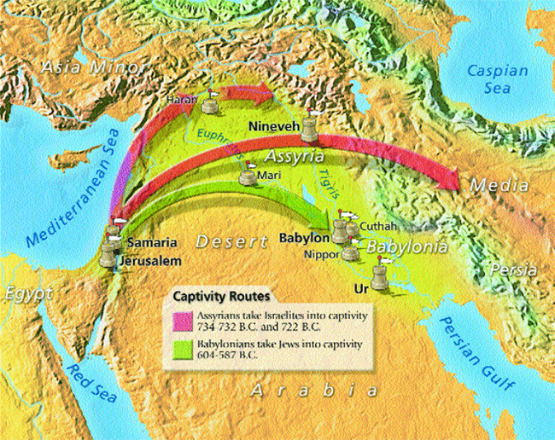
Daniel’s 70 Weeks

Slide 63
Daniel’s 70 Weeks
Plan for the Daniel 9 part of the class:
Read entire passage
Go through it verse by verse
Hit other points of certain verses

Slide 64
Daniel’s 70 Weeks
Daniel 9:16-27
16 O Lord, according to all thy righteousness, I beseech thee, let thine anger and thy fury be turned away from thy city Jerusalem, thy holy mountain; because for our sins, and for the iniquities of our fathers, Jerusalem and thy people are become a reproach to all that are about us.
17 Now therefore, O our God, hear the prayer of thy servant, and his supplications, and cause thy face to shine upon thy sanctuary that is desolate, for the Lord's sake.
18 O my God, incline thine ear, and hear; open thine eyes, and behold our desolations, and the city which is called by thy name; for we do not present our supplications before thee for our righteousnesses, but for thy great mercies.
(Cont. →)

Slide 65
Daniel’s 70 Weeks
Daniel 9:16-27 (cont.)
19 O Lord, hear; O Lord, forgive; O Lord, hearken and do; defer not, for thine own sake, O my God; for thy city and thy people are called by thy name.
20 And while I was speaking, and praying, and confessing my sin and the sin of my people Israel, and presenting my supplication before the Lord my God for the holy mountain of my God;
21 Yea, while I was speaking in prayer, even the man Gabriel, whom I had seen in the vision at the beginning, being caused to fly swiftly, touched me about the time of the evening oblation. (Cont. →)

Slide 66
Daniel’s 70 Weeks
Daniel 9:16-27 (cont.)
22 And he informed me, and talked with me, and said, O Daniel, I am now come forth to give thee skill and understanding.
23 At the beginning of thy supplications the commandment came forth, and I am come to show thee; for thou art greatly beloved; therefore understand the matter, and consider the vision.
24 Seventy weeks are determined upon thy people and upon thy holy city, to finish the transgression, and to make an end of sins, and to make reconciliation for iniquity, and to bring in everlasting righteousness, and to seal up the vision and prophecy, and to anoint the Most Holy. (Cont. →)

Slide 67
Daniel’s 70 Weeks
Daniel 9:16-27 (cont.)
25 Know therefore and understand, that from the going forth of the commandment to restore and to build Jerusalem, unto the Messiah the Prince, shall be seven weeks, and threescore and two weeks; the street shall be built again, and the wall, even in troublous times.
26 And after threescore and two weeks shall Messiah be cut off, but not for himself; and the people of the prince that shall come shall destroy the city and the sanctuary; and the end thereof shall be with a flood, and unto the end of the war desolations are determined. (Cont. →)

Slide 68
Daniel’s 70 Weeks
Daniel 9:16-27 (cont.)
27 And he shall confirm the covenant with many for one week; and in the midst of the week he shall cause the sacrifice and the oblation to cease, and for the overspreading of abominations he shall make it desolate, even until the consummation, and that determined shall be poured upon the desolate.

Slide 69
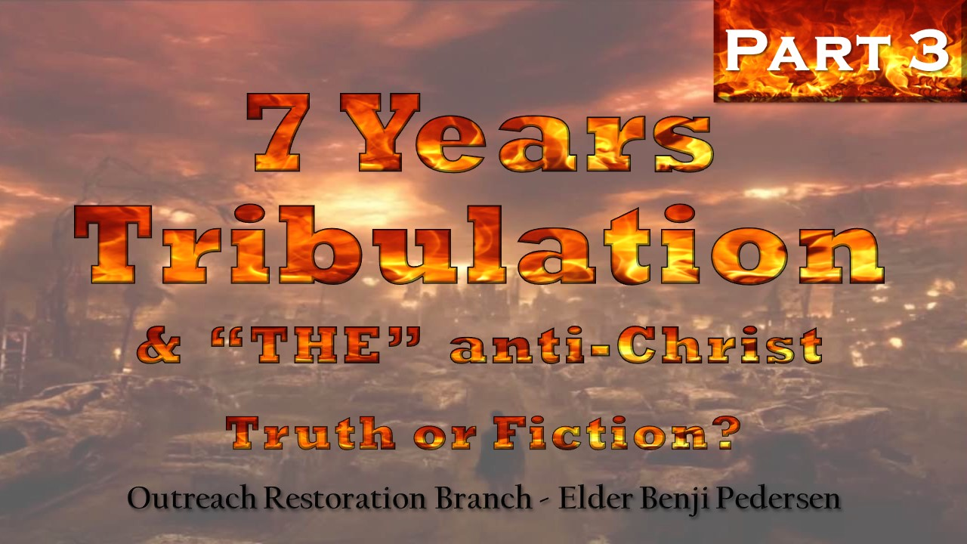

Slide 70
Daniel’s 70 Weeks
What was Daniel praying about in chapter 9?
VERY important to understand the context of his prayer.
16 O Lord, according to all thy righteousness, I beseech thee, let thine anger and thy fury be turned away from thy city Jerusalem, thy holy mountain…
20 And while I was speaking, and praying, and confessing my sin and the sin of my people Israel, and presenting my supplication before the Lord my God for the holy mountain of my God;…
Notes:
Context is everything!!!

Slide 71
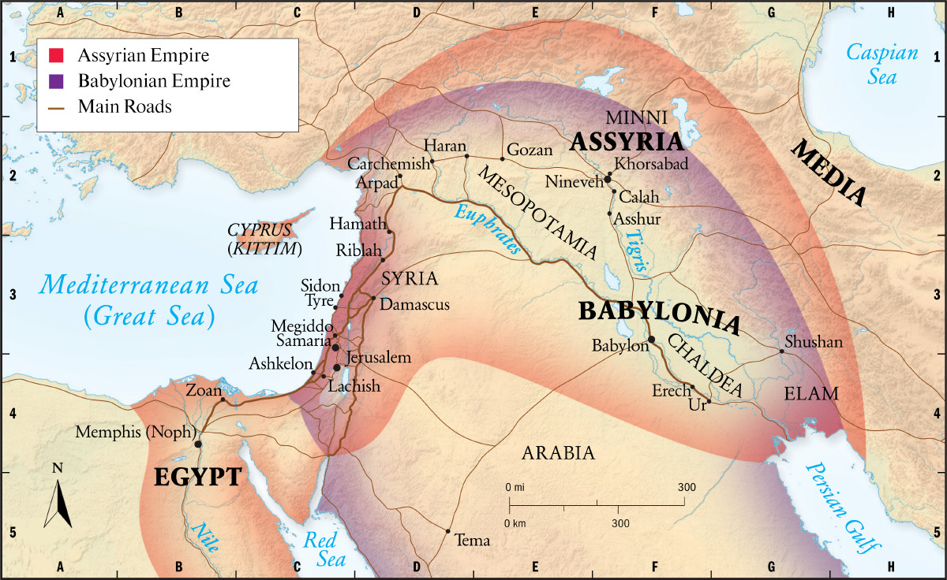
Daniel’s 70 Weeks
He is praying about Jerusalem
Daniel is here in captivity
Notes:
Context is everything!!!

Slide 72
Daniel’s 70 Weeks
21 Yea, while I was speaking in prayer, even the man Gabriel, whom I had seen in the vision at the beginning, being cause to fly swiftly, touched me about the time of the evening oblation.
22 And he informed me, and talked with me, and said, O Daniel, I am now come forth to give thee skill and understanding.
23 At the beginning of thy supplications the commandment came forth, and I am come to show thee; for thou art greatly beloved; therefore understand the matter, and consider the vision.
city Jerusalem, thy holy mountain

Slide 73
Daniel’s 70 Weeks
24 Seventy weeks are determined upon thy people and upon thy holy city,
to finish the transgression,
and to make an end of sins,
and to make reconciliation for iniquity,
and to bring in everlasting righteousness,
and to seal up the vision and prophecy,
and to anoint the Most Holy.
NUMBERS:
70 weeks = 7 days X 70 weeks = 490 days = 490 years

Slide 74
Daniel’s 70 Weeks
25 Know therefore and understand, that from the going forth of the commandment to restore and to build Jerusalem, unto the Messiah the Prince, shall be seven weeks, and threescore and two weeks; the street shall be built again, and the wall, even in troublous times.
NUMBERS:
Seven weeks + Threescore and two weeks
= 7 (rebuild) + 60 + 2 weeks (until Messiah)
= 69 weeks = 483 years

Slide 75
Daniel’s 70 Weeks
26 And after threescore and two weeks shall Messiah be cut off, but not for himself; and the people of the prince that shall come shall destroy the city and the sanctuary; and the end thereof shall be with a flood, and unto the end of the war desolations are determinable.
Summary:
Jesus shall be cut off after:
7 weeks (to build) from verse 25 +
62 weeks from verse 26 = 69 weeks or 483 years

Slide 76
Daniel’s 70 Weeks
27 And he shall confirm the covenant with many for one week; and in the midst of the week he shall cause the sacrifice and the oblation to cease, and for the overspreading of abominations he shall make it desolate, even until the consummation, and that determination shall be poured upon the desolate.
NUMBERS:
7 weeks to rebuild + 62 weeks to Christ + 1 of covenant
= 70 weeks are determined upon the holy city

Slide 77
Daniel’s 70 Weeks
SUMMARY OF NUMBERS:
7 weeks (rebuild)
+ 62 weeks (until Messiah)
+ 1 week (he will confirm his covenant)
= 70 weeks = 490 years
Determined upon whom?
JERUSALEM

Slide 78
Daniel’s 70 Weeks
7 “Weeks”
(49 Years)
62 “Weeks”
(434 Years)
1 “Week”
(7 Years)
Building Jerusalem
Waiting
1st 69th 70th
Last 1 “Week”
3 ½ Years
3 ½ Years
/\
“He will be cut off in the midst of week”

Slide 79
Daniel’s 70 Weeks
When do the 70 weeks start?
25 Know therefore and understand, that from the going forth of the commandment to restore and to build Jerusalem, unto the Messiah the Prince, shall be seven weeks, and threescore and two weeks; the street shall be built again, and the wall, even in troublous times.
Point of Reference

Slide 80
Daniel’s 70 Weeks
Point of Reference
And he (Ezra) came to Jerusalem in the fifth month, which was in the seventh year of the king…Now this is the copy of the letter that the king Artaxerxes gave unto Ezra the priest…I make a decree, that all they of the people of Israel, and of his priests and Levites, in my realm, which are minded of their own freewill to go up to Jerusalem, go with thee.
Ezra 7:6–26
The seventh year of king Artaxerxes is known to be 457 B.C.
Notes:
These dates are rough dates because there could be as much as 6 years of errors in our current dating system.

Slide 81
Daniel’s 70 Weeks
When do the 70 weeks start?
They started approximately 457 B.C. (1st decree)
7 “Weeks”
(49 Years)
62 “Weeks”
(434 Years)
1 “Week”
(7 Years)
Building Jerusalem
Waiting
1st 69th 70th
~457 B.C. + 483 years ((7+62)x7) = ~A.D. 27

Slide 82
Daniel’s 70 Weeks
What is commonly believed?

Slide 83
Daniel’s 70 Weeks
What is commonly believed:
After the 7 + 62 weeks is when Christ died or was “cut off”
After that comes a prince of the people, “THE” anti-Christ
27 And he (“THE” anti-Christ) shall confirm the covenant with many for one week; and in the midst of the week, he shall cause the sacrifice and the oblation to cease, and for the overspreading of abominations he shall make it desolate, even until the consummation, and that determined shall be poured upon the desolate.

Slide 84
Daniel’s 70 Weeks
What is commonly believed:
This one week for a covenant is the time of tribulation
This one week of tribulation was put on hold until the last days
7 “Weeks”
(49 Years)
62 “Weeks”
(434 Years)
1 “Week”
(7 Years)
Building Jerusalem
Waiting
Yet to come
1st 69th 70th
~457 B.C. + 483 years (7+62x7) = ~A.D. 27 LAST DAYS
THE GAP THEORY
They say there is a full 2,000 years between the 69th and the 70th weeks.

Slide 85
Daniel’s 70 Weeks
GAP Theory
First 69 Weeks
Last 1 Week
2,000
YEARS
Daniel’s 70 Week Vision
  Has prophecy ever worked like this before?

Slide 86
Daniel’s 70 Weeks
Now lets try to understand what the scriptures say

Slide 87
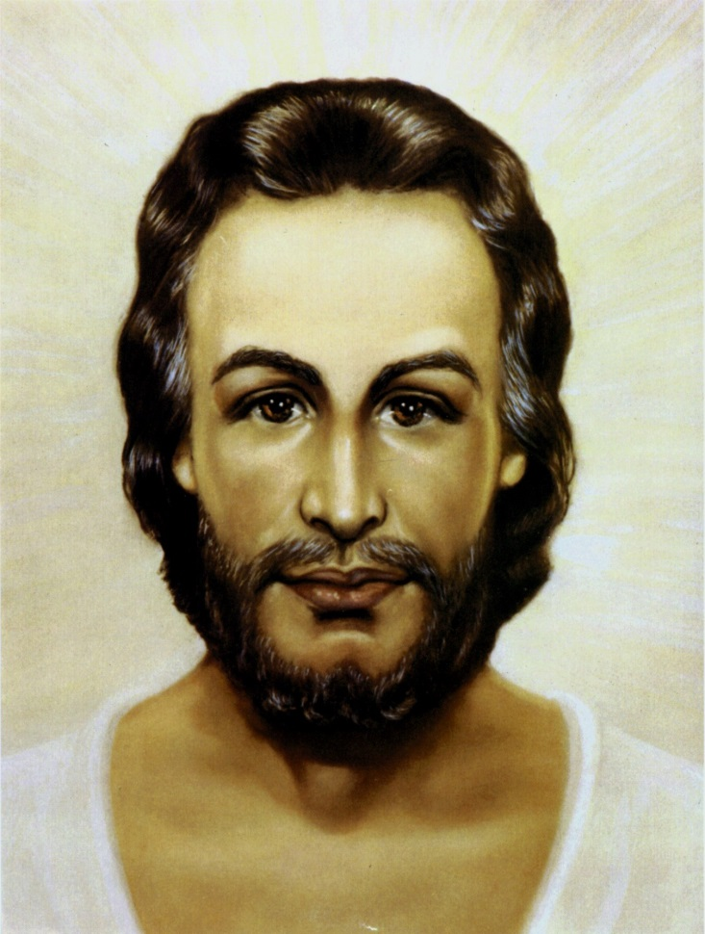

Daniel’s 70 Weeks
24 Seventy weeks are determined upon thy people and upon thy holy city,
to finish the transgression,
and to make an end of sins,
and to make reconciliation for iniquity,
and to bring in everlasting righteousness,
and to seal up the vision and prophecy,
and to anoint the Most Holy.

Slide 88
Daniel’s 70 Weeks
26 And after threescore and two weeks shall Messiah be cut off, but not for himself; and the people of the prince that shall come shall destroy the city and the sanctuary…
  My attempt to diagram this sentence:
shall
destroy
after
shall
Messiah
be cut off
sanctuary
adjective
verb
subject
verb
verbs
direct object
people
three score and two weeks
indirect-object
  This is important!
prince
sub indirect-object
  How important is this guy?!?!

Slide 89
Daniel’s 70 Weeks
What is commonly believed:
After the 7 + 62 weeks is when Christ died or was “cut off”
After that comes a prince of the people, “THE” anti-Christ
shall
destroy
after
shall
Messiah
be cut off
sanctuary
adjective
verb
subject
verb
verbs
direct object
people
three score and two weeks
indirect-object
  Switched the objects
prince
sub indirect-object

Slide 90
Daniel’s 70 Weeks
What is commonly believed:
27 And he (“THE” anti-Christ) shall confirm the covenant with many for one week; and in the midst of the week, he shall cause the sacrifice and the oblation to cease…
shall
destroy
after
shall
Messiah
be cut off
sanctuary
adjective
verb
subject
verb
verbs
direct object
prince
three score and two weeks
indirect-object
  Switched the subject
people
sub indirect-object

Slide 91
Daniel’s 70 Weeks
26 And after threescore and two weeks shall Messiah be cut off, but not for himself; and the people of the prince that shall come shall destroy the city and the sanctuary…
  My attempt to diagram this sentence:
shall
destroy
after
shall
Messiah
be cut off
sanctuary
adjective
verb
subject
verb
verbs
direct object
people
  IT’S ALL ABOUT JESUS
three score and two weeks
indirect-object
prince
sub indirect-object

Slide 92

Daniel’s 70 Weeks
26 And after threescore and two weeks shall Messiah be cut off, but not for himself; and the people of the prince that shall … 27 And he shall…
Who is being discussed here?
Who is the he ?
a prince
Messiah

Slide 93
Daniel’s 70 Weeks
26 And after threescore and two weeks shall Messiah be cut off, but not for himself; and the people of the prince that shall come shall destroy the city and the sanctuary; and the end thereof shall be with a flood, and unto the end of the war desolations are determinable.
27 And he shall confirm the covenant with many for one week; and in the midst of the week he shall cause the sacrifice and the oblation to cease, and for the overspreading of abominations he shall make it desolate, even until the consummation, and that determination shall be poured upon the desolate.

Slide 94
Daniel’s 70 Weeks
Two thing Daniel prophesied that Christ, the Messiah would accomplish:
Confirm the covenant
Cause the sacrifice and the oblation to cease

Slide 95
Daniel’s 70 Weeks
Now this mediator was not a mediator of the new covenant; but there is one mediator of the new covenant, who is Christ, as it is written in the law concerning the promises made to Abraham and his seed…
Galatians 3:20
And for this cause he is the mediator of the new covenant, that by means of death, for the redemption of the transgressions that were under the first covenant, they which are called might receive the promise of eternal inheritance.
Hebrews 9:15

Slide 96
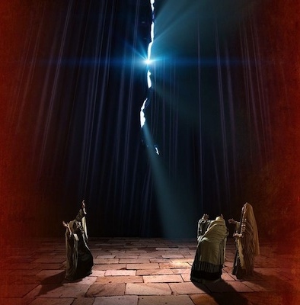
Daniel’s 70 Weeks
Jesus when he had cried again with a loud voice, saying, Father, it is finished, thy will is done, yielded up the ghost. And behold, the veil of the temple was rent in twain from the top to the bottom; and the earth did quake, and the rocks rent;
Matthew 27:54-55

Slide 97
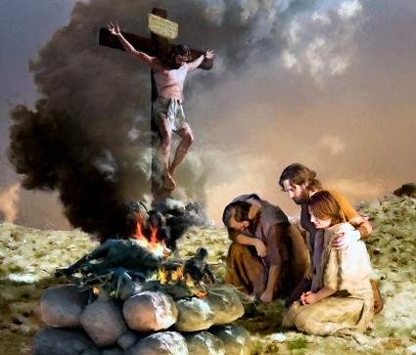
Daniel’s 70 Weeks
I am the light and the life of the world. I am Alpha and Omega, the beginning and the end. And ye shall offer up unto me no more the shedding of blood; yea, your sacrifices and your burnt offerings shall be done away, for I will accept none of your sacrifices
and your burnt offerings; and ye shall offer for a sacrifice unto me a broken heart and a contrite spirit.
3 Nephi 4:48-49

Slide 98
Daniel’s 70 Weeks
24 Seventy weeks are determined upon thy people and upon thy holy city, to finish the transgression, and to make an end of sins, and to make reconciliation for iniquity, and to bring in everlasting righteousness, and to seal up the vision and prophecy, and to anoint the Most Holy.
Daniel 9
This is speaking of Christ and what HE would accomplish.
JESUS came to fulfill the law, to set men free from sin, to reconcile men to God, to bring about everlasting righteousness through the atonement, or his death on the cross, to fulfill the prophecies.

Slide 99
Daniel’s 70 Weeks
For God so loved the world, that he gave his Only Begotten Son, that whosoever believeth on him, should not perish; but have everlasting life.
For God sent not his Son into the world to condemn the world; but that the world through him might be saved.
He who believeth on him is not condemned; but he who believeth not is condemned already, because he hath not believed on the name of the Only Begotten Son of God, which before preached by the mouth of the holy prophets; for they testified of me.
John 3:16-18

Slide 100
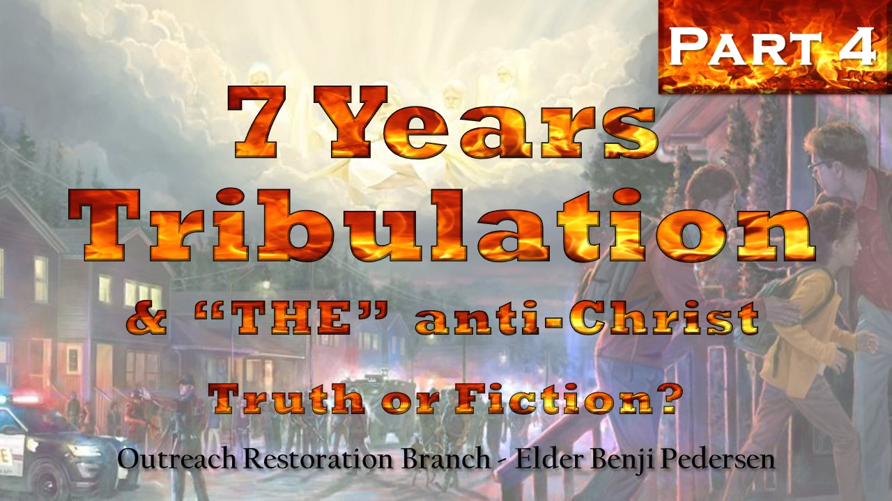

Slide 101
Daniel’s 70 Weeks
What is commonly believed:
After the 7 + 62 weeks is when Christ died or was “cut off”
After that comes a prince of the people, “THE” anti-Christ
shall
destroy
after
shall
Messiah
be cut off
sanctuary
adjective
verb
subject
verb
verbs
direct object
people
three score and two weeks
indirect-object
  Switched the objects
prince
sub indirect-object

Slide 102
Daniel’s 70 Weeks
What is commonly believed:
27 And he (“THE” anti-Christ) shall confirm the covenant with many for one week; and in the midst of the week, he shall cause the sacrifice and the oblation to cease…
shall
destroy
after
shall
Messiah
be cut off
sanctuary
adjective
verb
subject
verb
verbs
direct object
prince
three score and two weeks
indirect-object
  Switched the subject
people
sub indirect-object

Slide 103
Daniel’s 70 Weeks
26 And after threescore and two weeks shall Messiah be cut off, but not for himself; and the people of the prince that shall come shall destroy the city and the sanctuary…
  My attempt to diagram this sentence:
shall
destroy
after
shall
Messiah
be cut off
sanctuary
adjective
verb
subject
verb
verbs
direct object
people
  IT’S ALL ABOUT JESUS
three score and two weeks
indirect-object
prince
sub indirect-object

Slide 104
Daniel’s 70 Weeks
What is the timeline for Christ and this prophecy?

Slide 105
Daniel’s 70 Weeks
When do the 70 weeks start?
They started approximately 457 B.C.
7 “Weeks”
(49 Years)
62 “Weeks”
(434 Years)
1 “Week”
(7 Years)
Building Jerusalem
Waiting
Yet to come?
1st 69th 70th
~457 B.C. + 483 years (62+7x7) = ~A.D. 27
Remember the proclamation? Ezra

Slide 106
Daniel’s 70 Weeks
When did he start his ministry? ~A.D. 27
How long did he preach? ~3½ years
**Remember Jesus was to be cut off in the midst of the week**
Last 1 “Week”
3 ½ Years
3 ½ Years
/\
“He will be cut off in the midst of week”

Slide 107
Daniel’s 70 Weeks
7 “Weeks”
(49 Years)
62 “Weeks”
(434 Years)
1 “Week”
(7 Years)
Building Jerusalem
Waiting
Yet to come?
1st 69th 70th
Last 1 “Week”
NUMBERS:
~457 B.C.
+ 483 years (7+62x7)
= ~A.D. 27
+ 3 ½ years
= ~ A.D. 30
3 ½ Years
3 ½ Years
/\
“He will be cut off in the midst of week”

Slide 108
Daniel’s 70 Weeks
Last 3½ years
  Jesus’ ministry was to the Jews
  After Christ died, the disciples preached mostly to the Jews (Acts chapters 1-8)
  The Sanhedrin stoned Stephen (Acts chapter 7)
  Acts 9-10 we see shift to teaching Gentiles
  Thus approximately 3½ years after the crucifixion— and at the end of the 70-week prophecy given for the Jewish people—the gospel shifted to the Gentiles
  Jesus + Apostles = Confirmed the Covenant for 1 Week (7 years)

Slide 109
Daniel’s 70 Weeks
7 “Weeks”
(49 Years)
62 “Weeks”
(434 Years)
1 “Week”
(7 Years)
Building Jerusalem
Waiting
Yet to come?
1st 69th 70th
Last 1 “Week”
NUMBERS:
~457 B.C.
+ 483 years (7+62x7)
7 = ~A.D. 27
+ 3 ½ years
= ~A.D. 30
+ 3 ½ years
= ~A.D. 33
3 ½ Years
3 ½ Years
/\
“He will be cut off in the midst of week”
Math Check:
~457 B.C.
+ 490 years
= ~A.D. 33
  Close enough…

Slide 110
Daniel’s 70 Weeks
GAP Theory
First 69 Weeks
Last 1 Week
2,000
YEARS
Daniel’s 70 Week Vision
  How could this be believable?
  This last week is when Christ did His work!

Slide 111
Daniel’s 70 Weeks
  What was to happen to the Jews after rejecting Christ and his church?

Slide 112
Daniel’s 70 Weeks
26 And after threescore and two weeks shall Messiah be cut off, but not for himself; and the people of the prince that shall come shall destroy the city and the sanctuary; and the end thereof shall be with a flood, and unto the end of the war desolations are determinable.
27 And he shall confirm the covenant with many for one week; and in the midst of the week he shall cause the sacrifice and the oblation to cease, and for the overspreading of abominations he shall make it desolate, even until the consummation, and that determination shall be poured upon the desolate.
  What is “it”?
  JERUSALEM

Slide 113
Daniel’s 70 Weeks
When ye therefore, shall see the abomination of desolation, spoken of by Daniel the prophet, concerning the destruction of Jerusalem, then ye shall stand in the holy place (Whoso readeth let him understand.)
Then let them who are in Judea, flee into the mountains. Let him who is on the housetop, flee, and not return to take anything out of his house. Neither let him who is in the field return back to take his clothes.
Matthew 24:12-18, 22 (IV) (Cont.)→

Slide 114
Daniel’s 70 Weeks
And woe unto them that are with child, and unto them that give suck in those days! Therefore, pray ye the Lord, that your flight be not in the winter, neither on the Sabbath day.
For then, in those days, shall be great tribulations on the Jews, and upon the inhabitants of Jerusalem; such as was not before sent upon Israel, of God, since the beginning of their kingdom until this time; no, nor ever shall be sent again upon Israel.
Matthew 24:12-18, 22 (IV) (Cont.)→

Slide 115
Daniel’s 70 Weeks
And again, after the tribulation of those days which shall come upon Jerusalem if any man shall say unto you Lo! here is Christ, or there; believe him not,
Matthew 24:12-18, 22 (IV)
  This tribulation is not when Christ will return.
  This tribulation was upon the Jews and Jerusalem.

Slide 116
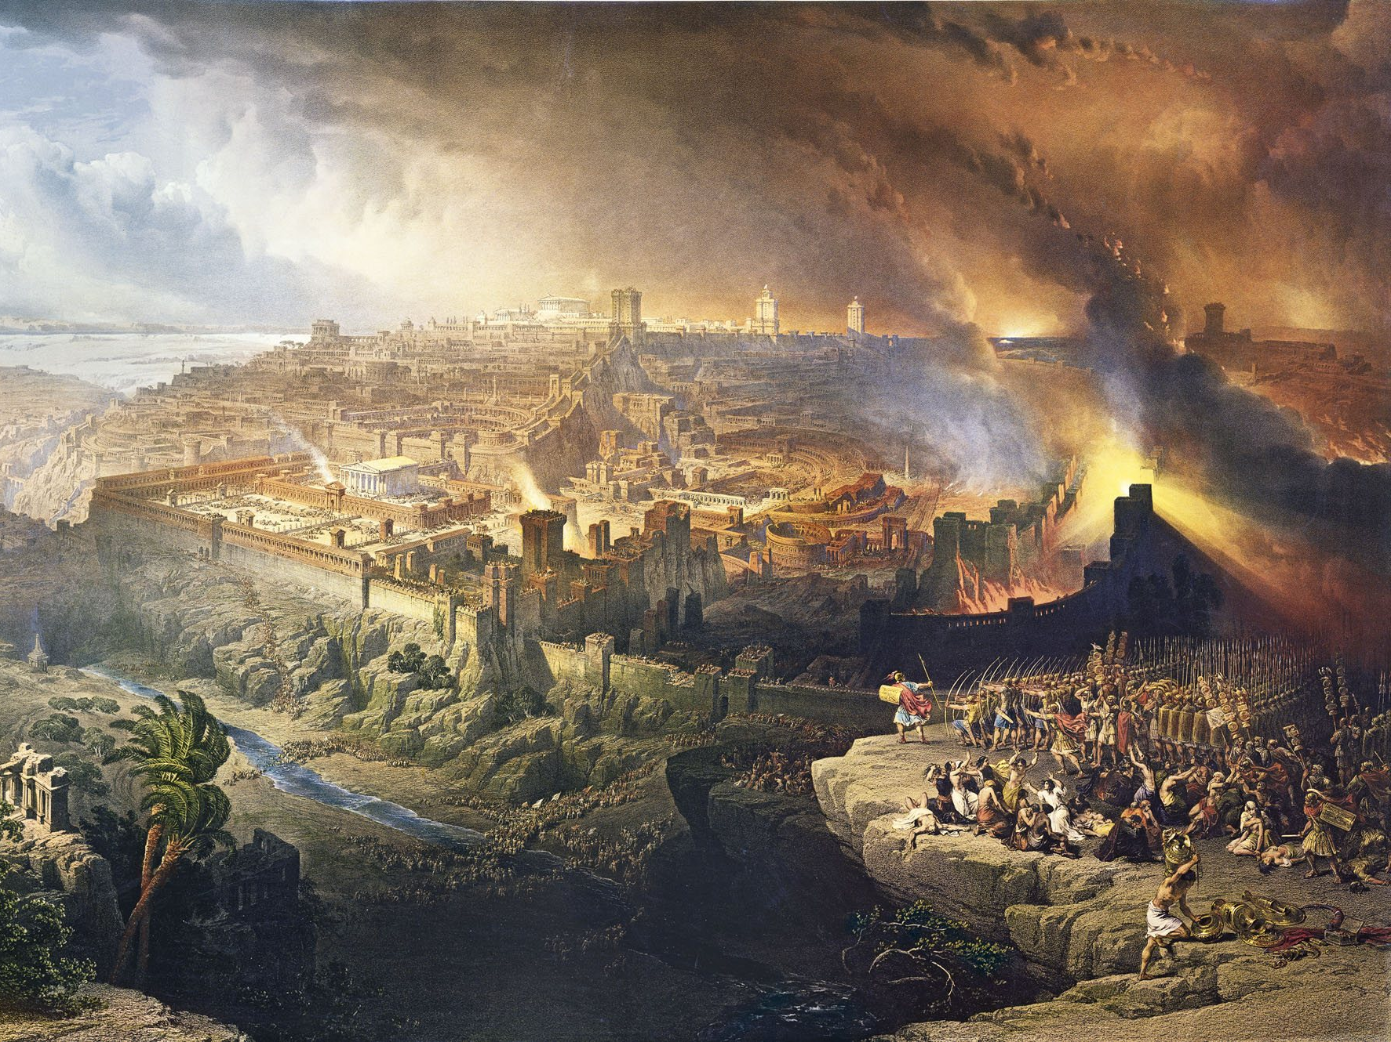
Daniel’s 70 Weeks
In A.D.66 when Cestius came against the city, but unaccountably withdrew, the Christians discerned in this the sign foretold by Christ, and fled while 1,100,000 Jews are said to have been killed in the terrible siege in A.D. 70. (The attack of the Roman warrior Titus occurred in A.D. 70 killing the 1,100,000 Jews)
Eusebius, Church History, book 3, chap. 5

Slide 117
Daniel’s 70 Weeks
Cestius withdrew from a six-month siege of Jerusalem to lead an unsuccessful bid to become emperor of Rome. Vespasian, Titus’ father, also led an army against Rome and was successful in his conquest and to become Emperor of Rome, leaving Titus in charge of the army.
  Thus, Titus was a prince
  The siege destroyed the temple (unintentionally however)

Slide 118
Daniel’s 70 Weeks
26 And after threescore and two weeks shall Messiah be cut off, but not for himself; and the people of the prince that shall come shall destroy the city and the sanctuary…
shall
destroy
after
shall
Messiah
be cut off
sanctuary
adjective
verb
subject
verb
verbs
direct object
people
soldiers
three score and two weeks
indirect-object
prince
Titus
sub indirect-object

Slide 119
Daniel’s 70 Weeks
How long is this desolation to last?
27 And he shall confirm the covenant with many for one week; and in the midst of the week he shall cause the sacrifice and the oblation to cease, and for the overspreading of abominations he shall make it desolate, even until the consummation, and that determination shall be poured upon the desolate.
Definition of consummation:
COMPLETED or FINALIZED

Slide 120
Daniel’s 70 Weeks
Nephi expounding from Zenos to his brothers.
How long is this desolation to last?
251 And as for those who are at Jerusalem, saith the prophet, they shall be scourged by all people, because they crucify the God of Israel, and turn their hearts aside, rejecting signs and wonders, and power and glory of the God of Israel;
252 And because they turn their hearts aside, saith the prophet, and have despised the Holy One of Israel, they shall wander in the flesh, and perish, and become a hiss and a byword, and be hated among all nations;
1 Nephi 5:251-252

Slide 121
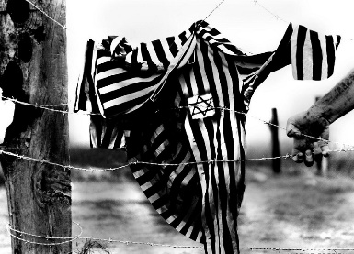
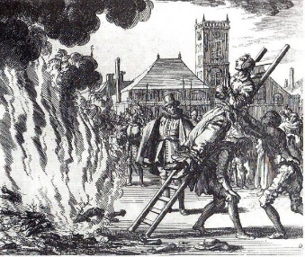
Daniel’s 70 Weeks
How long is this desolation to last?
All things which have befallen them, are only the beginning of the sorrows which shall come upon them…
Matthew 24:19
The children of Israel have seen sorrows since the destruction of Jerusalem in A.D. 70.
Other examples?
Holocaust
Persecution in Spain
Muslims didn’t like them (Ishmael)
Christians didn’t like them (killers of Jesus)
We’ll discuss more in the next section.
When will this desolation be lifted?

Slide 122
Daniel’s 70 Weeks Conclusion

Slide 123
Daniel’s 70 Weeks Conclusion
ALL 70 weeks from Daniel’s vision have been concluded with Christ and the destruction that came after he died.
Thus, there is NOT 1 week of the 70 weeks left to be fulfilled in the end-times.
The Messiah was to seal up the vision.

Slide 124
Daniel’s 70 Weeks Conclusion
Daniel’s vision of the 70 weeks determined upon Jerusalem was
COMPLETED!!!

Slide 125
Daniel’s 70 Weeks Conclusion
Most Bible scholars would agree that Daniel’s 70 weeks were completed if they only looked at Daniel
Confusion comes in with Matthew 24, Mark 13 and Luke 21 (Next part of class)

Slide 126
Satan does not want us ready:
He wants us to believe that things that have ALREADY happened are yet to come
He wants us looking for things that will not happen
He twists the word of God so we don’t understand God’s plan

Slide 127
Any final discussion?

Slide 128
What do OTHERS believe?
Foundation of the concept of 7 years tribulation
Prophecy didn’t fit world view = Incorrect Understanding
Daniel’s 70 Weeks
Matt. 24, Mark 13, Luke 21
Revelation 1,260 days/years

Slide 129
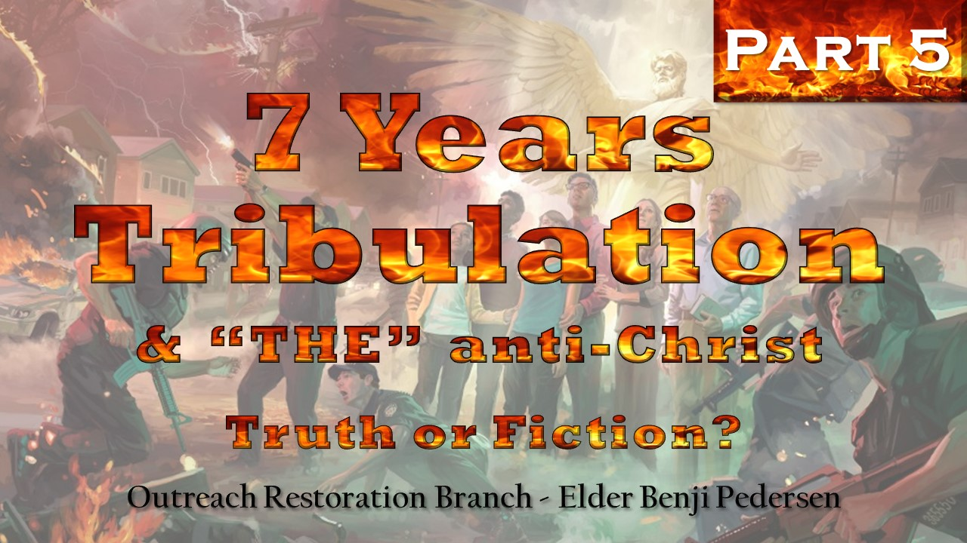

Slide 130
Review

Slide 131
What do OTHERS believe?
Foundation of the concept of 7 years tribulation
Daniel’s 70 Weeks
Matt. 24 Mark 13 Luke 21
Revelation 1,260 days/years

Slide 132
Is it possible that some things taught about the end times are deceptions of Satan?

Slide 133
End Times

Slide 134
Restored Gospel Is Critical
Thou seest because of the many plain and precious things which have been taken out of the book, which were plain unto the understanding of the children of men, according to the plainness which is in the Lamb of God;
1 Nephi 3:174
Notes:
God gives us understanding in plainness.
It is given to us to know and understand. God speaks clearly to us who have His word and who have His Spirit.

Slide 135
Restored Gospel Is Critical
15d yea, Satan doth stir up the hearts of the people to contention, concerning the points of my doctrine; and in these things they do err, for they do WREST the Scriptures, and do not understand them;
D&C 3:15d
1: to pull, force, or move by violent wringing or twisting movements
2: to gain with difficulty by or as if by force, violence, or determined labor
Merriam-Webster Dictionary
Force the Scriptures
Twist the Scriptures
Notes:
It is critical, when studying anything, but especially the signs of the end times, that we have the Lord’s Spirit in power in our lives so that we can know these things which are DEEPLY SPIRITUAL.

Slide 136
Satan wants us ignorant of God’s plan and he wants to destroy us

Slide 137
Daniel’s 70 Weeks
Daniel 9:16-27
Prophecy over Jerusalem
  To rebuild
  How much time until Messiah
  Prophesies what the Messiah will do
  Desolation to come upon Jerusalem (Jews)
  Begins
  Ends
  Decree to rebuild
  End of 1 Week of Confirming the Covenant

Slide 138
Daniel’s 70 Weeks
21 Yea, while I was speaking in prayer, even the man Gabriel, whom I had seen in the vision at the beginning, being cause to fly swiftly, touched me about the time of the evening oblation.
22 And he informed me, and talked with me, and said, O Daniel, I am now come forth to give thee skill and understanding.
23 At the beginning of thy supplications the commandment came forth, and I am come to show thee; for thou art greatly beloved; therefore understand the matter, and consider the vision.
JERUSALEM
city Jerusalem, thy holy mountain

Slide 139
Daniel’s 70 Weeks
7 “Weeks”
(49 Years)
62 “Weeks”
(434 Years)
1 “Week”
(7 Years)
Building Jerusalem
Waiting
Yet to come?
1st 69th 70th
Math Check:
~457 B.C.
+ 490 years
= ~A.D. 33
Last 1 “Week”
3 ½ Years
3 ½ Years
/\
“He will be cut off in the midst of week”
  Jesus + Apostles = Confirmed the Covenant for 1 Week (7 years)
  NEXT = Destruction & Desolation

Slide 140
Daniel’s 70 Weeks
In A.D.66 when Cestius came against the city, but unaccountably withdrew, the Christians discerned in this the sign foretold by Christ, and fled while 1,100,000 Jews are said to have been killed in the terrible siege in A.D. 70. (The attack of the Roman warrior Titus occurred in A.D. 70 killing the 1,100,000 Jews)
Eusebius, Church History, book 3, chap. 5

Slide 141
Daniel’s 70 Weeks
REVISED
Cestius withdrew from a six-month siege of Jerusalem to lead an unsuccessful attempt to become emperor of Rome. Vespasian, Titus’ father, also led an army against Rome and was successful in his conquest and to become Emperor of Rome, leaving Titus in charge of the army.
  Thus, Titus was a prince
  The siege destroyed the temple (unintentionally however)

Slide 142
Daniel’s 70 Weeks
24 Seventy weeks are determined upon thy people and upon thy holy city,
to finish the transgression,
and to make an end of sins,
and to make reconciliation for iniquity,
and to bring in everlasting righteousness,
and to SEAL up the vision and prophecy,
and to anoint the Most Holy.

Slide 143
Daniel’s 70 Weeks
GAP Theory
First 69 Weeks
Last 1 Week
2,000
YEARS
Daniel’s 70 Week Vision
  This last week is when Christ did His work!

Slide 144
Daniel’s 70 Weeks
What is commonly believed:
After the 7 + 62 weeks is when Christ died or was “cut off”
After that comes a prince of the people, “THE” anti-Christ
shall
destroy
after
shall
Messiah
be cut off
sanctuary
adjective
verb
subject
verb
verbs
direct object
people
three score and two weeks
indirect-object
  Switched the objects
prince
sub indirect-object

Slide 145
Daniel’s 70 Weeks
What is commonly believed:
27 And he (“THE” anti-Christ) shall confirm the covenant with many for one week; and in the midst of the week, he shall cause the sacrifice and the oblation to cease…
shall
destroy
after
shall
Messiah
be cut off
sanctuary
adjective
verb
subject
verb
verbs
direct object
prince
three score and two weeks
indirect-object
  Switched the subject
people
sub indirect-object

Slide 146
Daniel’s 70 Weeks
26 And after threescore and two weeks shall Messiah be cut off, but not for himself; and the people of the prince that shall come shall destroy the city and the sanctuary…
  My attempt to diagram this sentence:
shall
destroy
after
shall
Messiah
be cut off
sanctuary
adjective
verb
subject
verb
verbs
direct object
people
  IT’S ALL ABOUT JESUS
three score and two weeks
indirect-object
prince
sub indirect-object

Slide 147
God WANTS us to know and understand. He speaks in plainness to those who have His Holy Spirit.

Slide 148
Restored Gospel Is Critical
Old & New Testaments
Historical Records
Can we FULLY understand with only a PORTION of the knowledge?
Book of Mormon
Doctrine & Covenants
Church History & Records
Personal Revelation
(KJV)
Sources of our REFERENCE POINTS to understand prophecy
Restored Gospel Is Critical

Slide 149
What do OTHERS believe?
Foundation of the concept of 7 years tribulation
Prophecy didn’t fit world view = Incorrect Understanding
Daniel’s 70 Weeks
Matt. 24, Mark 13, Luke 21
Revelation 1,260 days/years

Slide 150
What do OTHERS believe?
Foundation of the concept of 7 years tribulation
Prophecy didn’t fit world view = Incorrect Understanding
Matt. 24, Mark 13, Luke 21
Revelation 1,260 days/years
Without Daniel 9, you lose these concepts for 7 years tribulation and the anti-Christ:
7 years
1 week of covenant
Destruction of the temple by “THE” anti-Christ
Putting an end of sacrifices

Slide 151
Don’t take my word for these things, study them out on your own.
Review my slides
Review the scriptures used
Go back and watch the classes on our YouTube channel
  www.outreachbranch.org
  (click on the button: “Our Services On YouTube”)

Slide 152
Christ’s Prophecy of His Return
(Matthew 24, Mark 13, & Luke 21)

Slide 153
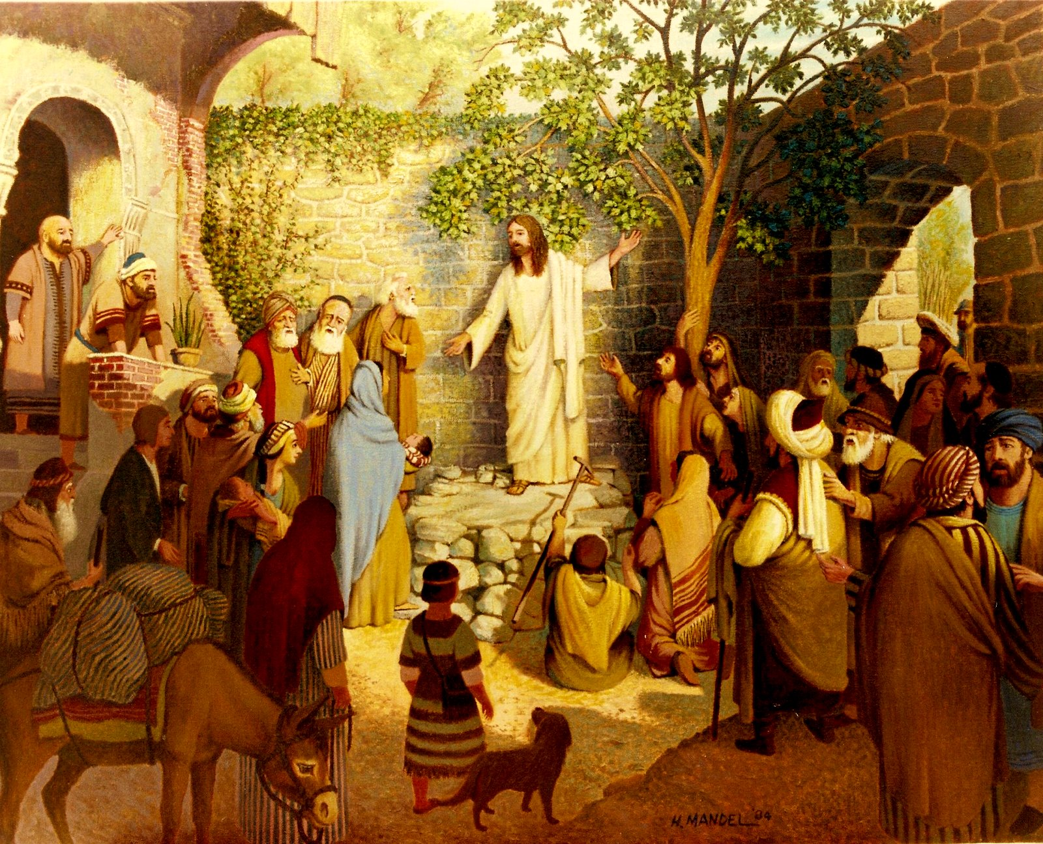
Notes:
Jesus has started his final week of ministry. You can read some really interesting things that he said about the Pharisees and Sadducees in Matthew 21-23. Jesus told his disciples and those around of great destruction to come among the Jews and that not one stone of the temple would be left to stand upon another.

Slide 154
Christ’s Prophecy of His Return
And as he sat upon the mount of Olives, the disciples came unto him privately, saying, Tell us, when shall these things be which thou hast said concerning the destruction of the temple, and the Jews; and what is the sign of thy coming; and of the end of the world? (or the destruction of the wicked, which is the end of the world.)
Matthew 24:4

Slide 155
Christ’s Prophecy of His Return
Joseph Smith was reading Matthew and was confused about what was to happen in the end times.
What was Joseph’s fallback scripture?

Slide 156
Christ’s Prophecy of His Return
If any of you lack wisdom, let him ask of God, that giveth to all men liberally, and upbraideth not; and it shall be given him.
James 1:5

Slide 157
Christ’s Prophecy of His Return
God’s answer to Joseph concerning Christ’s prophecy of His return (Matthew 24):
And now, behold, I say unto you, It shall not be given unto you to know any further concerning this chapter, until the New Testament be translated, and in it all these things shall be made known; wherefore I give unto you that you may now translate it, that ye may be prepared for the things to come; for verily I say unto you, that great things await you;
D&C 45:11a-b
Doctrine & Covenants 45
Inspired Version

Slide 158
Christ’s Prophecy of His Return
And verily I say unto you, that it is my will that you should hasten to translate my Scriptures, and to obtain a knowledge of history, and of countries, and of kingdoms, of laws of God and man, and all this for the salvation of Zion. Amen.
D&C 90:12

Slide 159
Christ’s Prophecy of His Return
Why did God say the
Inspired Version is important?
Understanding of prophecy shall be made known (knowledge)
That we may be prepared for that which is to come
For the salvation of Zion

Slide 160
Christ’s Prophecy of His Return
Three questions asked by the disciples:
(Recorded in Matthew 24, Mark 13, & Luke 21)
When shall your prophecy come to pass of the destruction of Jerusalem and temple?
What are the signs of thy return?
What are the signs of the end of the world (or destruction of the wicked)?
  See class on the “Destruction of the Wicked”
Notes:
Each book covers the questions and answers a little differently, but the IV makes it clear which question was being answered. In my opinion, Luke is the easiest to understand.

Slide 161
Christ’s Prophecy of His Return
Timeline of Christ’s Prophecy (IV vs KJV)
Significant events described in prophecy by Christ
Inspired Version
King James Version
1. Persecution of disciples
1. Signs of Christ’s return
2. Daniel’s abomination
2. Persecution of disciples
Olden Times
3. Destruction of Jerusalem
3. Daniel’s abomination
4. False Christs
End Times
4. Destruction of Jerusalem
5. Gathering of the elect
5. False Christs
6. Signs of Christ’s return
6. Gathering of the elect
End Times
6. Signs of Christ’s return
7. Christ’s return
7. Christ’s return

Slide 162
Summary of 1 Nephi 3:165-175:
Bible was given in purity and truth
  Plain and precious things were taken away
Why?
  To pervert the right ways of the Lord
  To blind our eyes
  To harden our hearts
Result:
  An exceeding great many of people do stumble
  Satan hath great power over people
Notes:
Why are we to know the signs?
SO WE CAN BE READY!!

Slide 163
Are you ready to see some stumbling blocks?

Slide 164
Christ’s Prophecy of His Return
Question 1: Destruction of Jerusalem (IV)
When ye therefore, shall see the abomination of desolation, spoken of by Daniel the prophet, concerning the destruction of Jerusalem, then ye shall stand in the holy place…let them who are in Judea, flee…woe unto them that are with child…pray ye the Lord, that your flight not be in the winter…in those days, shall be great tribulations on the Jews, and upon the inhabitants of Jerusalem…All things which have befallen them, are only the beginning of the sorrows which shall come upon them. For all I have told you must come to pass. But the end is not yet. Excerpts from Matthew 24:12-25(IV)

Slide 165
Christ’s Prophecy of His Return
Question 1: Destruction of Jerusalem (IV)
Notes:
As a sign, they were to look to Daniel’s vision and the abomination that brings desolation for when Jerusalem was to be destroyed
Great destruction was to come upon whom?
  Jerusalem and the Jews
This was just to be the beginning of their sorrows
Was this a sign of the end?
  NO

Slide 166
Christ’s Prophecy of His Return
Question 1: Destruction of Jerusalem (KJV)
But he that shall endure unto the end, the same shall be saved. And this gospel of the kingdom shall be preached in all the world for a witness unto all nations; then shall the end come. When ye therefore, shall see the abomination of desolation, spoken of by Daniel the prophet, concerning the destruction of Jerusalem, then ye shall stand in the holy place…let them who are…in Judaea, flee…woe unto them that are with child…pray ye the Lord, that your flight not be in the winter…For then shall be great tribulation, such as was not since the beginning… Excerpts from Matthew 24:13-21(KJV)

Slide 167
Christ’s Prophecy of His Return
Question 1: Destruction of Jerusalem (KJV)
Notes:
Was this passage from the KJV a sign of the end times?
  Sure looks like it !!!
This passage starts with talking about the end times and then goes straight into Daniel’s abomination that bring desolation
Who was the destruction to come upon?
  It’s not explicit like in the Inspired Version

Slide 168
Christ’s Prophecy of His Return
INSPIRED VERSION REVIEW
When ye therefore, shall see the abomination of desolation, spoken of by Daniel the prophet, concerning the destruction of Jerusalem, then ye shall stand in the holy place…let them who are in Judea, flee…woe unto them that are with child…pray ye the Lord, that your flight not be in the winter…in those days, shall be great tribulations on the Jews, and upon the inhabitants of Jerusalem…All things which have befallen them, are only the beginning of the sorrows which shall come upon them. For all I have told you must come to pass. But the end is not yet. Excerpts from Matthew 24:12-25(IV)

Slide 169
Christ’s Prophecy of His Return
KING JAMES VERSION REVIEW
But he that shall endure unto the end, the same shall be saved. And this gospel of the kingdom shall be preached in all the world for a witness unto all nations; then shall the end come. When ye therefore, shall see the abomination of desolation, spoken of by Daniel the prophet, concerning the destruction of Jerusalem, then ye shall stand in the holy place…let them who are…in Judaea, flee…woe unto them that are with child…pray ye the Lord, that your flight not be in the winter…For then shall be great tribulation, such as was not since the beginning… Excerpts from Matthew 24:13-21(KJV)

Slide 170
Christ’s Prophecy of His Return
Timeline of Christ’s Prophecy (IV vs KJV)
Significant events described in prophecy by Christ
Inspired Version
King James Version
1. Persecution of disciples
1. Signs of Christ’s return
2. Daniel’s abomination
2. Persecution of disciples
Olden Times
3. Destruction of Jerusalem
3. Daniel’s abomination
4. False Christs
End Times
4. Destruction of Jerusalem
5. Gathering of the elect
5. False Christs
End Times
6. Signs of Christ’s return
6. Gathering of the elect
7. Christ’s return
7. Christ’s return

Slide 171
Christ’s Prophecy of His Return
Remember the GAP Theory (Daniel’s 70 Weeks)
First 69 Weeks
Last 1 Week
2,000
YEARS
Daniel’s 70 Week Vision
  The KJV says that Daniel’s abomination that makes desolate is to take place in the end.
Inspired Version CLARIFIES!!!
IV
KJV
2. Daniel’s abomination
1. Signs of Christ’s return
6. Signs of Christ’s return
3. Daniel’s abomination

Slide 172
Christ’s Prophecy of His Return
7 Years Tribulation Idea
  KJV Matthew says Daniel’s desolation is in the end
  Now must creatively explain Daniel’s 70 week vision
  Misunderstanding Matthew leads to errors in Daniel

Slide 173
Christ’s Prophecy of His Return
Remember the question:
How long will this desolation upon Jerusalem last?

Slide 174
Christ’s Prophecy of His Return
How long is the desolation on Jerusalem to last?
And now I show unto you a parable. Behold, wheresoever the carcass is, there will the eagles be gathered from the four quarters of the earth.
And again shall the abomination of desolation, spoken of by Daniel the prophet, be fulfilled.
Verily I say unto you, this generation, in which these things shall be shown forth, shall not pass away until all I have told you shall be fulfilled [concerning Christ’s return].
Matthew 24: 28,33,35(IV)

Slide 175
Christ’s Prophecy of His Return
How long is the desolation on Jerusalem to last?
And they shall fall by the edge of the sword [inhabitants of Jerusalem], and shall be led away captive into all nations; and Jerusalem shall be trodden down of the Gentiles, until the times of the Gentiles be fulfilled.
…Master, tell us concerning thy coming. And he answered them, and said, in the generation in which the times of the Gentiles shall be fulfilled, there shall be signs…
And when these things begin to come to pass, then look up and lift up your heads, for the day of your redemption draweth nigh. Luke 21:23,24,25,27(IV)

Slide 176
Christ’s Prophecy of His Return
How long is the desolation on Jerusalem to last?
Matthew 24 says when the eagles [elect] are gathered, this is a sign of the end times and when the desolation of Jerusalem is lifted
Luke says that Jerusalem will be trodden down of the Gentiles until the time of the Gentiles is fulfilled, then the end times
When the gathering back to Jerusalem starts, this is a sign of Christ’s return and the end of the desolation spoken of by Daniel

Slide 177
Christ’s Prophecy of His Return
Has the gathering in Jerusalem started and is Jerusalem no longer trodden down of the Gentiles?
YES – Early 1900’s (1948)
See Class on “Luke 21 & the Times of the Gentiles”

Slide 178


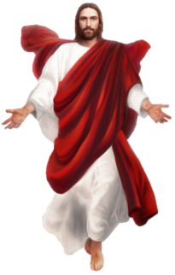


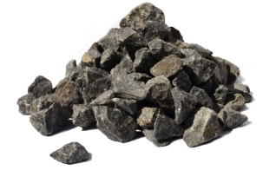
Christ’s Prophecy of His Return
Destroyed
Rebuilt
Destroyed
Controlled
Period of Desolation
586 B.C.
457 B.C.
70 A.D.
1967
Christ’s Return
Book of Mormon
Daniel 9
Daniel 9
Luke 21
Luke 21
End of the desolation from Daniel 9.
End of the desolation upon Jerusalem!

Slide 179
Christ’s Prophecy of His Return
And as he sat upon the mount of Olives, the disciples came unto him privately, saying, Tell us, when shall these things be which thou hast said concerning the destruction of the temple, and the Jews; and what is the sign of thy coming; and of the end of the world? (or the destruction of the wicked, which is the end of the world.)
Matthew 24:4

Slide 180
Christ’s Prophecy of His Return
Conclusion

Slide 181
Christ’s Prophecy of His Return
Inspired Version makes the timeline of Christ’s prophecy clear
The desolation of Daniel started with the destruction of Jerusalem and is finished with the gathering of the elect

Slide 182
Christ’s Prophecy of His Return
The destruction of Jerusalem in Matthew 24 & Daniel 9 is
NOT TO HAPPEN
IN THE END TIMES!!!

Slide 183
Satan does not want us ready:
He wants us to believe that things that have ALREADY happened are yet to come
He wants us looking for things that will not happen
He twists the word of God so we don’t understand God’s plan

Slide 184
Any final discussion?

Slide 185
What do OTHERS believe?
Foundation of the concept of 7 years tribulation
Prophecy didn’t fit world view = Incorrect Understanding
Daniel’s 70 Weeks
Plain & Precious Taken Away = Incorrect Understanding
Matt. 24, Mark 13, Luke 21
Revelation 1,260 days/years

Slide 186
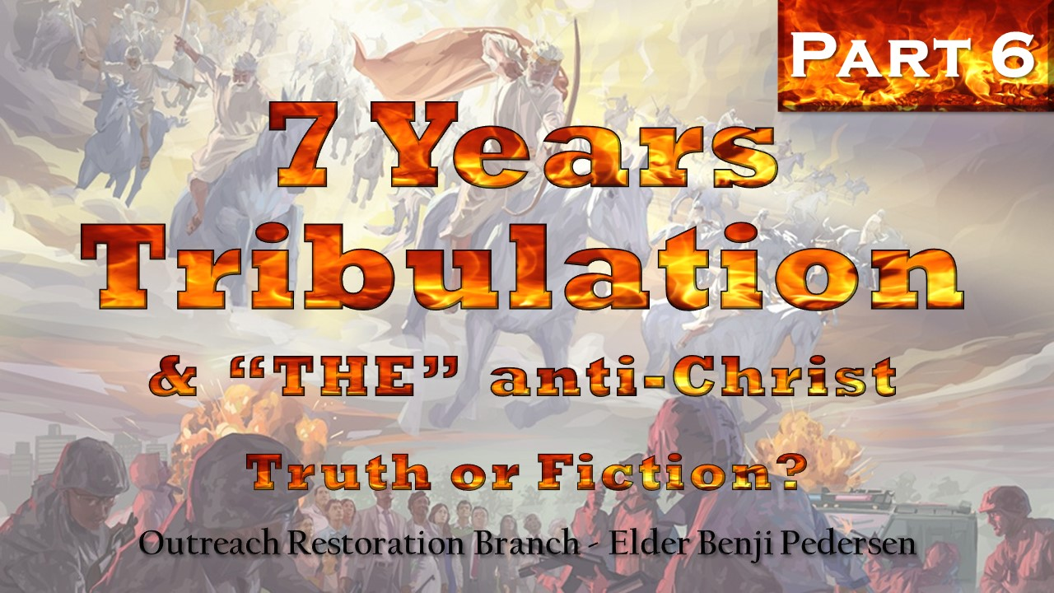

Slide 187
Testimonies:
Creating this class (line-upon-line)
Same story told before
Eusebius
Marvelous Work & A Wonder
Frank Frye

Slide 188
The Book of
Revelation and its association with Daniel

Slide 189
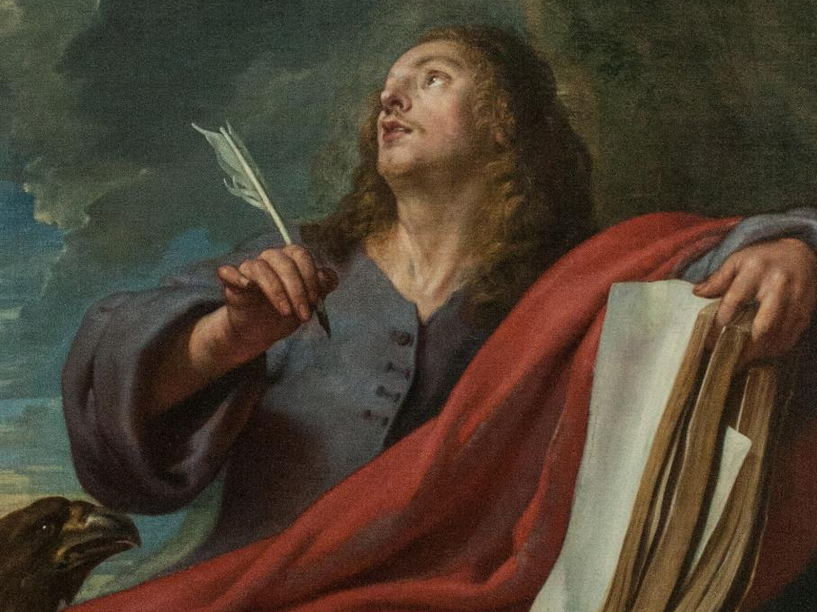
Notes:
John of Patmost, John the Beloved, John the Revelator, “Son of Thunder”
One of the original 12 Apostles and one of the closest to Jesus (Peter, James, and John)
Wrote the Gospel of John, 1st John, 2nd John, 3rd John, and the Book of Revelation (EASY TO UNDERSTAND, RIGHT?)
As recorded in 3 Nephi 13:17 – the 3 Nephites desired the same thing as John, to serve in life until Christ’s return (See also John 20:21-24)

Slide 190
Revelation
Ether, speaking to people in the last days:
Come unto me, O ye Gentiles, and I will shew unto you the greater things, the knowledge which is hid up because of unbelief.
Come unto me, O ye house of Israel, and it shall be made manifest unto you how great things the Father hath laid up for you, from the foundation of the world; and it hath not come unto you, because of unbelief.
Behold, when ye shall rend that vail of unbelief which doth cause you to remain in your awful state of wickedness and hardness of heart, and blindness of mind,
Ether 1:109-114 (Cont.)→

Slide 191
Revelation
then shall the great and marvelous things which have been hid up from the foundation of the world from you;
Yea, when ye shall call upon the Father in my name, with a broken heart and a contrite spirit, then shall ye know that the Father hath remembered the covenant which he made unto your fathers, O house of Israel;
And then shall my revelations which I have caused to be written by my servant John, be unfolded in the eyes of all the people.
Ether 1:109-113

Slide 192
Revelation
Period of 1,260 days/years, 3½ years and also 42 months
Same: 12 hours = dozen hours = ½ day = 720 minutes
The book of Revelation says the following things will occur during this period of time:
Church to be removed from the earth
Beast to rise to power
False prophet to rise
Cannot trade, buy or sell without the mark of the beast
Dragon to war against the saints
Great blasphemies against God
Are these end-time events OR related to some other time?

Slide 193
Revelation
What scriptures in the book of Revelation do others use to support end-time seven years tribulation?

Slide 194
Revelation
Key Revelation scriptures:
Chapter 12 – Woman and the Beast
Chapter 13 – Beast in power

Slide 195
Revelation
Key figures of Revelation scriptures:
The woman =
The man-child =
The dragon =
The beast =
the church
the kingdom of God
the devil
earthly kingdoms that are given power by the devil

Slide 196
Revelation
And after then things I heard another voice saying, Woe to the inhabiters of the earth, yea, and they who dwell upon the islands of the sea! for the devil is come down unto you, having great wrath, because he knoweth that he hath but a short time.
For when the dragon saw that he was cast unto the earth, he persecuted the woman which brought forth the man-child.
Therefore, to the woman were given two wings of a great eagle, that she might flee into the wilderness, into her place, where she is nourish for a time, and times, and half a time, from the face of the serpent.
Revelation 12:12–14

Slide 197
Revelation
And there was given unto him [the beast] a mouth speaking great things and blasphemies; and power was given unto him to continue forty and two months.
Revelation 13:5
Therefore, the dragon was wroth with the woman, and went to make war with the remnant of her seed, which keep the commandments of God, and have the testimony of Jesus Christ.
Revelation 12:17

Slide 198
Revelation
And the dragon prevailed not against Michael, neither the child, nor the woman which was the church of God, who had been delivered of her pains, and brought forth the kingdom of our God and his Christ.
Revelation 12:7
And the woman fled into the wilderness, where she had a place prepared of God, that they should feed her there a thousand two hundred and threescore years (KJV = days).
Revelation 12:5

Slide 199



Revelation
Balance of POWER

Slide 200

Revelation
Beast & Dragon have POWER for:
1,260 years
Time, times, & ½ times
42 months
POWER
= APOSTASY (Dark Ages)
Balance of POWER

Slide 201
Revelation
Numbers
Day is 1 year
Week has 7 days
Month has 30 days
Year has 360 days
Time is 1 year
Score is 20 units

Slide 202
Revelation
Daniel 9 refers to 70 weeks
  = 7 + 62 + 1 = 70 weeks
  = last week was in two 3½ year parts
  = last week of power of THE “anit-Christ” or what THE CHRIST would do?
Revelation 13:5 refers to 42 months
  = 30 days/month X 42 months
  = 1,260 days
  = 1,260 years (prophetic days)
  DESTRUCTION OF JERUSALEM
  Prophecy of Apostasy and Restoration

Slide 203
Revelation
Revelation 12:14 refers to a time, times, and half a time (1 time = 1 year)
  = 1 year + 2 years + ½ year
  = 3½ years
  = 360 days + 720 days + 180 days
  = 1,260 years (prophetic days)
  Revelation 12:5 (IV) states that this same period is 1,260 years
  Prophecy of Apostasy and Restoration
  Prophecy of Apostasy and Restoration

Slide 204
Revelation
Judgment Upon Jerusalem:
  Daniel 9 – 70 weeks
Time of the Apostasy:
  Revelation 13:5 – 42 months = 1,260 years
  Revelation 12:14 – time, times, ½ time = 1,260 years
  Revelation 12:5 – 1,260 years
  These are not even relating to the same events or time periods

Slide 205
Revelation
What do others believe to support end-time seven years tribulation?

Slide 206
Revelation: What OTHERS believe
  KJV in Matthew indicates Daniel’s desolation is in the end times
First 69 Weeks
Last 1 Week
2,000
YEARS
Daniel’s 70 Week Vision
Last 1 “Week”
Revelation 13:5 refers to 42 months
  = 3½ years
Revelation 12:14 time, times, and half a time
  = 3½ years
  Revelation 12:5 1,260 days (years in I.V.)
  = 3½ years
3 ½ Years
3 ½ Years
Anti-Christ rises to power in time of peace
Last 3½ years are full of tribulation and horror

Slide 207
Revelation: What OTHERS believe
7 Years Tribulation Idea
(Connection with Revelation)
  KJV Matthew says Daniel’s desolation is in the end
  Creatively explain Daniel’s 70 week vision
  Take last week of Daniel’s vision to mean THE anti-Christ
  Take 3½ years from Revelation and apply to end times
INCORRECT ASSOCIATION OF SCRIPTURE

Slide 208
Revelation
KEY POINTS TO ADDRESS (next few slides):
Use KJV timeline of Christ’s prophecy of events
Interpret Daniel’s last week to be in the end of time
Inconsistently interpret prophecy: literal years and prophetic years
Believe in 7 literal years of tribulation with 3½ years being the 42 months of apostasy from Revelation
Believe that this beast is “THE” anti-Christ **
** Must also believe that the mark of the beast, rule the nations, destroying of the temple, etc. will all occur in the end times

Slide 209
Revelation
KEY POINTS:
1) Use KJV timeline of Christ’s prophecy of events:
  The Inspired Version clarifies the timeline to where the prophecy of abomination that makes desolate by Daniel is NOT in the end times
  The Inspired Version clarifies when the desolation to be finished
  The Inspired Version clarifies which signs indicate the destruction of Jerusalem and which signs indicate the end times and Christ’s return

Slide 210
Revelation
Destroyed
Rebuilt
Destroyed
Controlled
Period of Desolation
586 B.C.
457 B.C.
70 A.D.
1967
Christ’s Return
Book of Mormon
Daniel 9
Daniel 9
Luke 21
Luke 21
End of the desolation from Daniel 9.
End of the desolation upon Jerusalem!

Slide 211
Revelation
KEY POINTS TO ADDRESS (next few slides):
Use KJV timeline of Christ’s prophecy of events
Interpret Daniel’s last week to be in the end of time
Inconsistently interpret prophecy: literal years and prophetic years
Believe in 7 literal years of tribulation with 3½ years being the 42 months of apostasy from Revelation
Believe that this beast is “THE” anti-Christ **
** Must also believe that the mark of the beast, rule the nations, destroying of the temple, etc. will all occur in the end times

Slide 212
Revelation
KEY POINTS:
2) Daniel 9: Interpret Daniel’s last week to be in the end of time:
  Daniel’s last week in his 70 week vision was the period when Christ taught the people at Jerusalem and was a judgment upon Jerusalem
  When the Jews crucified him, this started the period of abomination that makes desolate

Slide 213
Revelation
KEY POINTS:
2) Daniel 9: Interpret Daniel’s last week to be in the end of time (cont.):
  This desolation began with the complete destruction of Jerusalem and such a desolation that the people of Israel even ate their children and each other. Jerusalem and the temple were completely destroyed in A.D. 70 by the Romans – no stone left on top of another, thus fulfilling Christ’s prophecy
  In order to believe in the seven years tribulation using Daniel’s last week, you must believe that there was a “gap” of 2,000 between the 69th and the 70th weeks

Slide 214
Revelation
KEY POINTS TO ADDRESS (next few slides):
Use KJV timeline of Christ’s prophecy of events
Interpret Daniel’s last week to be in the end of time
Inconsistently interpret prophecy: literal years and prophetic years
Believe in 7 literal years of tribulation with 3½ years being the 42 months of apostasy from Revelation
Believe that this beast is “THE” anti-Christ **
** Must also believe that the mark of the beast, rule the nations, destroying of the temple, etc. will all occur in the end times

Slide 215
Revelation
KEY POINTS:
3) Inconsistently interpret prophecy: literal years and prophetic years:
“…I have appointed thee each day for a year.”
Ezekiel 4:6
Daniel 9 is interpreted as a day is a prophetic year, but then the Book of Revelation is interpreted as literal days
  So why do you interpret these 42 months, which is 3½ years, to be a literal 3½ years?
  To make it work with their ideas

Slide 216
Revelation
KEY POINTS TO ADDRESS (next few slides):
Use KJV timeline of Christ’s prophecy of events
Interpret Daniel’s last week to be in the end of time
Inconsistently interpret prophecy: literal years and prophetic years
Believe in 7 literal years of tribulation with 3½ years being the 42 months of apostasy from Revelation
Believe that this beast is “THE” anti-Christ **
** Must also believe that the mark of the beast, rule the nations, destroying of the temple, etc. will all occur in the end times

Slide 217
Revelation
KEY POINTS:
4) Believe in 7 literal years of tribulation with 3½ years being the 42 months of apostasy from Revelation:
Combine the three errors:
the “gap” theory, and
the misinterpretation of a prophetic year, and
THE “anti-Christ”

Slide 218
Revelation
KEY POINTS:
4) Believe in 7 literal years of tribulation with 3½ years being the 42 months of apostasy from Revelation (cont.):
Revelation’s 1,260 years, 42 months, or 3½ years refers to the period of the apostasy
King James version says 1,260 days while the Inspired Version says 1,260 years – clearing up the confusion to what time period is being referred
The apostasy was when power was given to the beast
Foundational Restoration Beliefs

Slide 219
Revelation
KEY POINTS TO ADDRESS (next few slides):
Use KJV timeline of Christ’s prophecy of events
Interpret Daniel’s last week to be in the end of time
Inconsistently interpret prophecy: literal years and prophetic years
Believe in 7 literal years of tribulation with 3½ years being the 42 months of apostasy from Revelation
Believe that this beast is “THE” anti-Christ **
** Must also believe that the mark of the beast, rule the nations, destroying of the temple, etc. will all occur in the end times

Slide 220
Revelation
KEY POINTS:
5) Revelation 12:5: Believe that this beast is “THE” anti-Christ:
This anti-Christ figure refers to people who teach against Christ, who would arise all throughout time, and that there was never referred to in the scriptures that there would be one powerful “THE” anti-Christ.
We will discuss this more in later slides
THERE IS NOT “THE” ANTI-CHRIST

Slide 221
Revelation
KEY POINTS:
5) Revelation 12:5: Believe that this beast or the false prophet is “THE” anti-Christ (cont.):
In Daniel’s last week, other people misinterpret the last verse to be that reference to “he” is “THE” anti-Christ would do those things, which are the things that Christ himself did. This is an abomination before God to attribute the things of God to the devil
Also, the beast had 10 horns, if “THE” anti-Christ united the nations now, there would have to be around 30 horns, because Europe is no longer ruled by only 10 kingdoms

Slide 222
Revelation
What has our church taught?

Slide 223
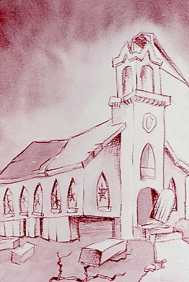
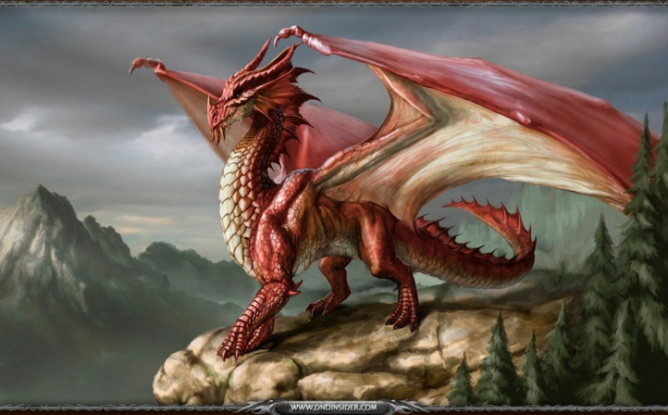
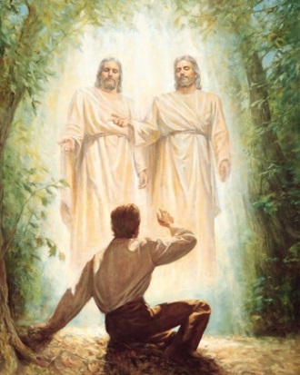
Revelation
What has our church taught?
570 A.D.
Period of 1,260 years
A.D. 1830

Slide 224

Notes:
The end of the abomination of desolation was when the eagles were gathered back to Jerusalem (Matthew 24, Luke 21).
Does this mean there will NOT be any more troubles for the Jews? NO – there are terrible things yet ahead,
Zechariah 14 – destruction in Jerusalem in which few survive. All would be killed if not for Christ returning.
Great tribulations are yet before us. Troubles for the USA, the world, and the modern day nation of Israel. EVIL is everyone. Judgment is coming.
Genesis 7:67-70 (IV) – SCRIPTURE OF PROMISE – My people will I preserve

Slide 225
Prior Class Comments:
Ray – Zechariah 14 (troubles on the Jews in the future)
Laurie – Elevating the prince is what Satan wanted from the beginning (Daniel 9:27)

Slide 226
Revelation
What has our church taught?

Slide 227
Revelation
What has our church taught?
570 A.D.
Period of 1,260 years
A.D. 1830

Slide 228
Revelation
What our church has taught:
The woman in this vision is the church of God. She fled into the wilderness because of the persecutions of the beast
This ushered in a period of 1,260 years where the church was not on the earth (dark ages)
The dragon, which is Satan, gained power over the earthly kingdoms and gave power to the beast
The woman, or church, was later restored by Jesus Christ himself through Joseph Smith

Slide 229
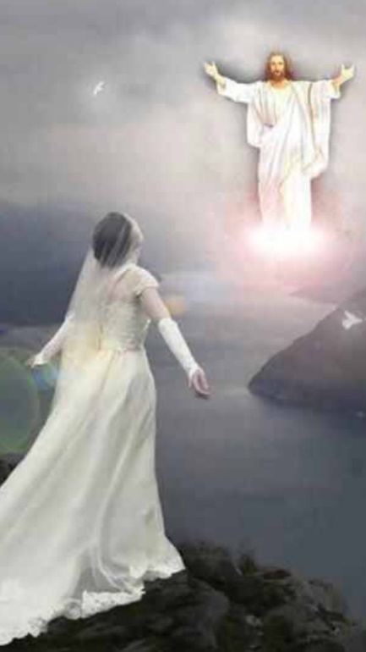


Revelation
We know 1830 A.D., but why 570 A.D.?

Slide 230
Revelation
So he carried me away in the spirit into the wilderness; and I saw a woman sit upon a scarlet colored beast, full of names of blasphemy, having seven heads and ten horns. And the woman was arrayed in purple and scarlet color, and decked with gold and precious stones and pearls, having a golden cup in her hand full of abominations and filthiness of her fornication; And upon her forehead was a name written, MYSTERY, BABYLON THE GREAT, THE MOTHER OF HARLOTS AND ABOMINATIONS OF THE EARTH. And I saw the woman drunken with the blood of the saints, and with the blood of the martyrs of Jesus; and when I saw her, I wondered with great admiration. Revelation 17:3-6

Slide 231
Revelation
What our church has taught:
The church was changed and true believers were persecuted and killed – resulting in a complete apostasy
  A harlot took the place of the true bride of Christ (which is the church)
  Book: “570 Early Christians from Apostles to Apostasy” by R. Ben Madison, M.A.
Thus, there was a falling away from true belief in God, which is why the woman (the church) fled into the wilderness.
This is the start of the timing when the beast was given power and when the mark of the beast would be instituted with unchallenged power

Slide 232
Revelation
What our church has taught (cont.):
The beast’s heads and horns with crowns represented the nations in power around A.D. 570
The little horn was Rome/Italy, the one that was wounded was brought back to life by the Bishop of Rome
  meaning the government power was destroyed and the ecclesiastical power took over and brought Rome back to life (The Holy Roman Empire)
In A.D. 570, the Bishop of Rome became the ecclesiastical and civil authority over the Roman government

Slide 233
Revelation
What our church has taught (cont.):
“…and power was given unto him (the beast) to continue forty and two months…”
Revelation 13:5
The woman fled into the wilderness, “…where she is nourished for a time, and times, and half a time…”
Revelation 12:14
This is the period of the Apostasy

Slide 234
Revelation
What our church has taught (cont.):
And there appeared a great sign in heaven, in the likeness of things on the earth; a woman clothed with the sun, and the moon under her feet, and upon her head a crown of twelve stars.
And the woman being with child, cried, travailing in birth, and pained to be delivered.
And she brought forth a man child, who was to rule all nations with a rod of iron; and her child was caught up unto God and his throne.
Revelation 12:1-5 (cont.)→

Slide 235
Revelation
What our church has taught (cont.):
And there appeared another sign in heaven; and behold, a great red dragon, having seven heads and ten horns, and seven crowns upon his heads. And his tail drew the third part of the stars of heaven, and did cast them to the earth.
And the dragon stood before the woman which was delivered, ready to devour her child after it was born.
And the woman fled into the wilderness, where she had a place prepared of God, that they should feed her there a thousand two hundred and threescore years.
Revelation 12:1-5

Slide 236
Revelation
What our church has taught (cont.):
From A.D. 570, the church fell away from the earth and brought about the falling away where there was great famine for spiritual food and where the voice of God was not heard on the earth (for more on the falling away, see the Go Ye and Teach lesson on the Apostasy)
Add 1,260 years (42 months, which is also a time, times, and half a time) to A.D. 570 and you get A.D. 1830
In 1830, the woman/church returned, or was restored, to the earth

Slide 237
Revelation
The Restoration of God’s Church on Earth
Timeline
History
Prophecy
POINT OF REFERENCE?

Slide 238
Revelation
What our church has taught (cont.):
And I saw another angel fly in the midst of heaven, having the everlasting gospel to preach unto them that dwell on the earth, and to every nation, and kindred, and tongue, and people,
Saying with a loud voice, Fear God, and give glory to him; for the hour of his judgment is come, and worship him that made heaven, and earth, and the sea, and the fountains of waters.
Revelation 14:6-7

Slide 239
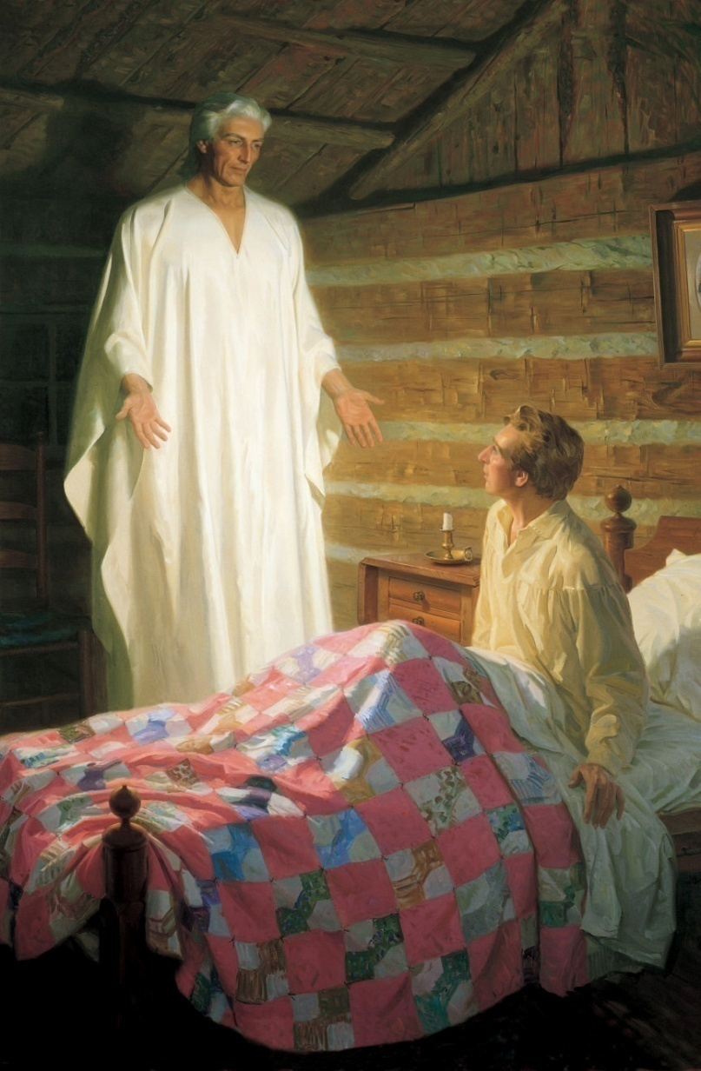
Revelation
What our church has taught (cont.):
He said there was a book deposited, written upon gold plates, giving an account of the former inhabitants of this continent, and the source from whence they sprang. He also said that the fullness of the everlasting gospel was contained in it, as delivered by the Savior to the ancient inhabitants.
Joseph Smith and His Progenitors
– by Lucy Mack Smith (p. 84)

Slide 240
Revelation
What our church has taught (cont.):
Restoration of Christ’s Church in 1830
Little Season
Apostasy
Millennial Reign
1260 years*
Second Coming With His Church
Final Judgment
* the period of the beast’s power and how long the church was in the wilderness
For more on the Restoration of Christ’s church, see “Go Ye and Teach” slides.

Slide 241
Revelation
What our church has taught (cont.):
Thus, in 1830, the woman came back to the earth, which means the church was brought back to the earth and the beast was no longer given power over the saints
The 3½ years of Revelation refer to the period when the church was gone and the beast had power and not something that is to happen in the end times
Once again, this is an attempt to deceive people; to take an important scripture and twist it into untruths

Slide 242
Satan does not want us ready:
He wants us to believe that things that have ALREADY happened are yet to come
He wants us looking for things that will not happen
He twists the word of God so we don’t understand God’s plan

Slide 243
Any final discussion?

Slide 244
What do OTHERS believe?
Foundation of the concept of 7 years tribulation
When using the Inspired Version of
scripture, there appears to be
NO scriptural foundation
for Seven Years Tribulation
Prophecy didn’t fit world view = Incorrect Understanding
Daniel’s 70 Weeks
Plain & Precious Taken Away = Incorrect Understanding
Matt. 24, Mark 13, Luke 21
Incorrect Association of Scripture = Incorrect Understanding
Revelation 1,260 days/years

Slide 245
Other Notes

Slide 246
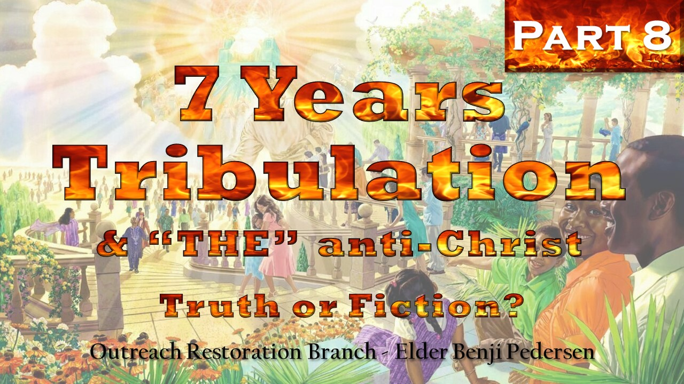

Slide 247
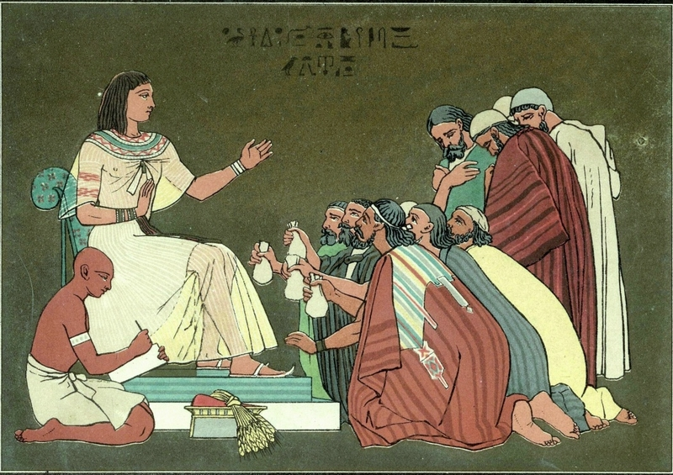
Joseph of Egypt 7 Years of Famine (Type & Shadow Theory
For 7 Years Tribulation)

Slide 248
Other Notes
Joseph of Egypt Seven Years Tribulation Theory:
Some who uphold the “seven year tribulation” theory get this belief from the “seven years of tribulation” that Joseph, son of Israel, told the Pharaoh of Egypt they were going to have.
This is the thing which I have spoken unto Pharaoh; What God is about to do he shows unto Pharaoh. Behold, there come seven years of great plenty throughout all the land of Egypt; And there shall arise after them seven years of famine; ....
Genesis 41:28-30
People believe this is a type and a shadow of the concept of seven years tribulation

Slide 249
Other Notes
Let’s look at scriptures about the times near Christ’s return:
But of the times and the seasons, brethren, you have no need that I write unto you. For yourselves know perfectly that the day of the Lord will come as a thief in the night. For when they shall say, Peace and safety; then sudden destruction comes upon them, as travail upon a woman with child; and they shall not escape. But you, brethren, are not in darkness, that that day should overtake you as a thief. You are all the children of light, and the children of the day; we are not of the night, nor of darkness. Therefore let us not sleep, as do others; but let us watch and be sober. 1 Thessalonians 5:1-2

Slide 250
Other Notes
Other scriptures attest the fact that the Lord will “suddenly” come when people least expect it:
Behold, I will send my messenger, and he shall prepare the way before me; and the Lord whom you seek, shall suddenly come to his temple, even the messenger of the covenant, whom you delight in; behold, he shall come, saith the Lord of hosts.
Malachi 3:1

Slide 251
Other Notes
But as it was in the days of Noah, so it shall be also at the coming of the Son of Man. For it shall be with them as it was in the days which were before the flood; for until the day that Noah entered into the ark,
- they were eating and drinking,
- marrying and giving in marriage, and
- knew not until the flood came and took them all away;
so shall also the coming of the Son of Man be.
Matthew 24:44-45 & Mark 13:48-49
In the selfsame day they entered the ark and all the fountains of the great deep broken up, and the windows of heaven were opened… Genesis 8:36-41

Slide 252
Other Notes
And as it was in the days of Noe; so shall it be also in the days of the Son of Man. They did eat, they drank, they married wives, they were given in marriage, until the day that Noe entered into the ark, and the flood came, and destroyed them all. Likewise also as it was in the days of Lot;
But the same day that Lot went out of Sodom, it rained fire and brimstone from heaven, and destroyed them all. Even thus shall it be in the day when the Son of Man is revealed.
Luke 17:26-30
- they did eat,
- they drank,
- they bought,
- they sold,
- they planted,
- they built;

Slide 253
Other Notes
Parallel to days of Lot and Noah indicates Jesus’ return will be:
sudden and provides
physical signs and
spiritual signs
of the end times

Slide 254
Other Notes
2 Peter 2: He lists the conditions of the people in the end times that are like the people in the days of Lot and Noah
- False prophets and teachers
- Destructive
- False doctrines
- Deny God & Jesus
- Immoral ways
- Speak evil of truth
- Teachers profit from telling fables
- Lawless conduct, rioting
- Follow lusts of the flesh
- Despise God's authority
- Bold and arrogant
- Disrespect and insult things above
- Deceitful
- Adulterers
- Cannot cease from sin
- Beguiling unstable souls
- Use immorality and bodily lusts to trap those trying to change
- Servants of corruption who promise liberty, but give bondage

Slide 255
Other Notes
I believe using the
seven years of famine in Egypt event
as a type and shadow of
seven years tribulation
DOES NOT have enough
scriptural support.

Slide 256
Conclusion to
7 Years Tribulation

Slide 257
Conclusion
In order to believe the 7 years tribulation:
  Believe there is a 2,000 year gap between weeks 69 and 70 in Daniel chapter 9
  Attribute the things that Christ will accomplish in Daniel’s vision to the devil (“THE” anti-Christ)
  Ignore that the 70 weeks were determined upon Jerusalem and not the whole world
  Use the timeline of Christ’s prophecy of His own return from the KJV instead of the Inspired Version

Slide 258
Conclusion
In order to believe the 7 years tribulation:
  Incorrectly associate the Book of Revelation’s “time, times, and half a time” to the end times
    NOT recognize it as the time period of the apostasy (cornerstone belief of the Restoration)
  Believe in THE “anti-Christ” which is not found in scripture (we will discuss next)
  In Daniel believe a day = a year in prophecy, but in Revelation 12 & 13 believe that a day = a day

Slide 259
Conclusion
In order to believe the 7 years tribulation:
  Disregard the Inspired Version and the revelation Joseph Smith received in D&C 45
  Ignore the Restoration of God’s Church and the Everlasting Gospel in 1830

Slide 260
Conclusion
End result: too many theories not founded in scripture.
***We cannot believe in the Restoration and also believe in the theory of seven years tribulation***
  You either believe Revelation 12 & 13 refers to the apostasy where the church left the earth and was restored after 1,260 years in A.D. 1830 OR you believe this same scripture refers to the period of “THE” anti-Christ
Truth or Fiction?

Slide 261
Any final discussion?

Slide 262

“THE” anti-Christ
Truth or Fiction?

Slide 263


“THE” anti-Christ
anti-
a prefix meaning:
“against,”
“opposite of,”
“antiparticle of,”
used in the formation of compound words (anticline);
used freely in combination with elements of any origin
  antibody; antifreeze; antiknock; antilock

Slide 264
“THE” anti-Christ
Remember what people incorrectly believe in Daniel 9 about what Christ or “THE” anti-Christ will do?

Slide 265
“THE” anti-Christ
Daniel 9:24 Seventy weeks are determined upon thy people and upon thy holy city,
to finish the transgression,
and to make an end of sins,
and to make reconciliation for iniquity,
and to bring in everlasting righteousness,
and to seal up the vision and prophecy,
and to anoint the Most Holy.

Slide 266
“THE” anti-Christ
And after threescore and two weeks shall Messiah be cut off, but not for himself; and the people of the prince that shall …And he shall… Daniel 9:26-27
Two people discussed here:
Who is the he ?
a prince
Messiah

Slide 267
“THE” anti-Christ
And after threescore and two weeks shall Messiah be cut off, but not for himself; and the people of the prince [anti-Christ] that shall come shall destroy the city and the sanctuary; and the end thereof shall be with a flood, and unto the end of the war desolations are determinable.
And he shall confirm the covenant with many for one week; and in the midst of the week he shall cause the sacrifice and the oblation to cease, and for the overspreading of abominations he shall make it desolate, even until the consummation, and that determination shall be poured upon the desolate. Daniel 9:26-27

Slide 268
“THE” anti-Christ
Two thing Daniel prophesied that Christ, the Messiah would accomplish:
Confirm the covenant
Cause the sacrifice and the oblation to cease
This is what Christ will do, NOT the “anti-Christ”

Slide 269
“THE” anti-Christ
The Nature of the Devil (the old dragon):
And I, the Lord God, spake unto Moses, saying, That Satan whom thou hast commanded in the name of mine Only Begotten, is the same which was from the beginning; And he came before me, saying, Behold I, send me, I will be thy Son, and I will redeem all mankind, that one soul shall not be lost, and surely I will do it; wherefore, give ME thine honor.
Genesis 3:1-2
Satan wants to be elevated!!

Slide 270
“THE” anti-Christ
26 And after threescore and two weeks shall Messiah be cut off, but not for himself; and the people of the prince that shall come shall destroy the city and the sanctuary…
  My attempt to diagram this sentence:
shall
destroy
after
shall
Messiah
be cut off
sanctuary
adjective
verb
subject
verb
verbs
direct object
people
three score and two weeks
indirect-object
prince (“the” anti-Christ)
sub indirect-object
  Satan wants to be elevated

Slide 271
“THE” anti-Christ
What is commonly believed:
After the 7 + 62 weeks is when Christ died or was “cut off”
After that comes a prince of the people, “THE” anti-Christ
shall
destroy
after
shall
Messiah
be cut off
sanctuary
adjective
verb
subject
verb
verbs
direct object
people
three score and two weeks
indirect-object
  Switched the objects
prince (“the” anti-Christ)
sub indirect-object

Slide 272
“THE” anti-Christ
What is commonly believed:
27 And he (“THE” anti-Christ) shall confirm the covenant with many for one week; and in the midst of the week, he shall cause the sacrifice and the oblation to cease…
shall
destroy
after
shall
Messiah
be cut off
sanctuary
adjective
verb
subject
verb
verbs
direct object
prince (“the” anti-Christ)
three score and two weeks
indirect-object
  Switched the subject
people
sub indirect-object

Slide 273
“THE” anti-Christ
26 And after threescore and two weeks shall Messiah be cut off, but not for himself; and the people of the prince that shall come shall destroy the city and the sanctuary…
  My attempt to diagram this sentence:
shall
destroy
after
shall
Messiah
be cut off
sanctuary
adjective
verb
subject
verb
verbs
direct object
  IT’S ALL ABOUT JESUS
people
three score and two weeks
indirect-object
prince (Titus)
sub indirect-object
Not Satan

Slide 274
What do OTHERS believe?
Foundation of the concept of 7 years tribulation
Prophecy didn’t fit world view = Incorrect Understanding
Matt. 24, Mark 13, Luke 21
Revelation 1,260 days/years
Without Daniel 9, you lose these concepts for 7 years tribulation and “the” anti-Christ:
7 years
1 week of covenant
Destruction of the temple by “THE” anti-Christ
Putting an end of sacrifices

Slide 275
“THE” anti-Christ
Daniel 9 is so critical to the concept of “THE” anti-Christ that without it, there really isn’t much of anything left.
Foundation of “THE” anti-Christ
Daniel’s 70 Weeks

Slide 276
“THE” anti-Christ
Are there other scriptures people use for “THE” anti-Christ?

Slide 277
“THE” anti-Christ
Do the scriptures ever say “THE” anti-Christ, referring to one being doing many things?
RLDS scriptures search:
Key word: “antichrist” =
Key word: “anti-Christ” =
    7 results
    I John 2:18
    I John 2:22
    I John 4:3
    II John 1:Intro
    II John 1:7
    Alma 16:7
    Alma 16:13
    0 results

Slide 278
“THE” anti-Christ
RLDS scriptures search:
Key word: “false Christ” =
Key word: “false Messiah” =
Key word: “the false prophet” =
    3 results
    Matthew 24:23
    Mark 13:25
    Words of Mormon 1:23
    1 results
    II Nephi 11:33
    3 results
    Revelation 16:13
    Revelation 19:20
    Revelation 20:10

Slide 279
“THE” anti-Christ
Search results (7): key word “antiChrist”:
I John 2:18 – …as ye have heard that antichrist shall come, even now are there many antichrists…
I John 2:22 – Who is a liar but he that denieth that Jesus is the Christ? He is antichrist, that denieth the Father and the Son.
I John 4:3 – And every spirit that confesseth not that Jesus Christ is come in the flesh is not of God; and this is that spirit of antichrist, whereof ye have heard that it should come; and even now it is already in the world.
II John 1:Intro – not scripture

Slide 280
“THE” anti-Christ
Search results (7): key word “antiChrist” (cont.):
II John 1:7 – For many deceivers are entered into the world, who confess not that Jesus Christ is come in the flesh. This is a deceiver and an antichrist.
Alma 16:7 – But it came to pass in the latter end of the seventeenth year, there came a man into the land of Zarahemla; and he was antichrist, for he began to preach unto the people against the prophecies which had been spoken by the prophets concerning the coming of Christ.
Alma 16:13 – And this antichrist, whose name was Korihor (and the law could have no hold upon him,) began to preach unto the people, that there should be no Christ.

Slide 281
“THE” anti-Christ
Search results (3): key word “false Christ”:
Matthew 24:22-23 – And again, after the tribulation of those days which shall come upon Jerusalem if any man shall say unto you Lo! here is Christ, or there; believe him not, For in those days, there shall also arise false Christs, and false prophets, and shall show great signs and wonders; insomuch that, if possible, they shall deceive the very elect, who are the elect according to the covenant.
  Inspired Version clarifies that this is talking about the time of the destruction of Jerusalem and NOT about the time when Christ will return

Slide 282
“THE” anti-Christ
Search results (3): key word “false Christ” (cont.):
Mark 13:25 – For in those days there shall also arise false Christs, and false prophets, and shall show great signs and wonders; insomuch, that if possible, they shall deceive the very elect, who are the elect according to the covenant.
Words of Mormon 1:23 – And it came to pass that after there had been false Christs, and their mouths had been shut, and they punished according to their crimes;…

Slide 283
“THE” anti-Christ
Search results (1): key word “false Messiah”:
II Nephi 11:28-35 – And the Lord will set his hand again the second time to restore his people from their lost and fallen state. Wherefore, he will proceed to do a marvelous work, and a wonder among the children of men. Wherefore, he shall bring forth his words unto them, which words shall judge them at the last day; For they shall be given them for the purpose of convincing them of the true Messiah, who was rejected by them; (continued)…

Slide 284
“THE” anti-Christ
Search results (1): key word “false Messiah” (cont.):
II Nephi 11:28-35 – (continued) …And unto the convincing of them that they need not look forward anymore for a Messiah to come, For there should not any come, save it should be a false Messiah, which should deceive the people: For there is save one Messiah spoken of by the prophets, and that Messiah is he who should be rejected of the Jews. For according to the words of the prophets, the Messiah cometh in six hundred years from the time that my father left Jerusalem;

Slide 285
“THE” anti-Christ
Search results (3): key word “the false prophet”:
Revelation 16:13 – And I saw three unclean spirits like frogs come out of the mouth of the dragon, and out of the mouth of the beast, and out of the mouth of the false prophet.
Revelation 19:20 – And the beast was taken, and with him the false prophet that wrought miracles before him, with which he deceived them that had received the mark of the beast, and them that worshiped his image. These both were cast alive into a lake of fire burning with brimstone.

Slide 286
“THE” anti-Christ
Search results (3): key word “the false prophet” (cont.):
Revelation 20:10 – And the devil that deceived them was cast into the lake of fire and brimstone, where the beast and the false prophet are, and shall be tormented day and night forever and ever.
Notes:
“The false prophet” title was introduced in Revelation 16:13 as during the time of the 6th vial. However, this could also be the beast from Revelation 13:11-13 during the dark ages.
Very little is given about what the false prophet would do other than deceive those who have the mark of the beast.
Benjamin believes this could be the Papacy.

Slide 287
“THE” anti-Christ
Antichrist (common attachment):
Antichrist against Christ, or an opposition Christ, a rival Christ. The word is used only by the apostle John. Referring to false teachers, he says (1 John 2:18, 22; 4:3; 2 John 1:7), "Even now are there many antichrists."
This name has been applied to the "little horn" of the "king of fierce countenance" (Dan. 7:24-25; 8:23-25).
It has been applied also to the "false Christs" spoken of by our Lord (Matt. 24:5, 23-24).
To the "man of sin" described by Paul (2 Thess. 2:3-4, 8-10).
And to the "beast from the sea" (Rev. 13:1; 17:1-18).
Easton's 1897 Bible Dictionary

Slide 288
“THE” anti-Christ
Search results (1): key word “man of sin”:
II Thessalonians 2:1-10 – Now we beseech you, brethren, by the coming of our Lord Jesus Christ, and by our gathering together unto him, That ye be not soon shaken in mind, or be troubled by letter, except ye receive it from us; neither by spirit, nor by word, as that the day of Christ is at hand. Let no man deceive you by any means; for there shall come a falling away first, and that the man of sin be revealed, the son of perdition; Who opposeth and exalteth himself above all that is called God, or that is worshiped; so that he as God sitteth in the temple of God, showing himself that he is God...And then shall that wicked one be revealed, whom the Lord shall consume with the spirit of his mouth, and shall destroy with the brightness of his coming… (continued)

Slide 289
“THE” anti-Christ
Search results (1): key word “man of sin” (cont.):
II Thessalonians 2:1-10 – (continued) …Yea, the Lord, even Jesus, whose coming is not until after there cometh a falling away, by the working of Satan with all power, and signs and lying wonders, And with all deceivableness of unrighteousness in them that perish; because they received not the love of the truth, that they might be saved…
Notes:
“Man of sin” is revealed in the falling away or apostasy which is during the 1,260 years
Thus, “the man of sin” is NOT someone who is yet to come as he was reveled during the apostasy. Could be the Papacy.

Slide 290
Conclusion
“THE” anti-Christ

Slide 291
Conclusion
Many references in scripture refer to the “spirit of antichrist” and not “THE” anti-Christ
The beast and “the man of sin” are all descriptions of people/entities/things that were introduced during the apostasy and NOT to rise up during the end times.
“The false prophet” scriptures do not expressly connect him to other entities in other verses, however he could be associated with the beast from Revelation 13.
We do expect antichrists to arise, as prophesied. The world belief of “THE” anti-Christ includes concepts NOT founded in scripture.
Truth or Fiction?

Slide 292


Slide 293
The MARK of the BEAST
Truth or Fiction?

Slide 294
The MARK of the BEAST
And he [second beast] causeth all, both small and great, rich and poor, free and bond, to receive a mark in their right hand, or in their foreheads; And that no man might buy or sell, save he that had the mark, or the name of the beast, or the number of his name. Here is wisdom. Let him that hath understanding count the number of the beast; for it is the number of a man; and his number is Six hundred threescore and six.
Revelation 13:16-18

Slide 295
The MARK of the BEAST
…If any man worship the beast and his image, and receive his mark in his forehead or in his hand, The same shall drink of the wine of the wrath of God, which is poured out without mixture into the cup of his indignation; and he shall be tormented with fire and brimstone in the presence of the holy angels, and in the presence of the Lamb; And the smoke of their torment ascendeth up forever and ever; and they have no rest day nor night, who worship the beast and his image, and whosoever receiveth the mark of his name.
Revelation 14:9-11

Slide 296
The MARK of the BEAST
What are the world’s views of the mark of the beast?

Slide 297
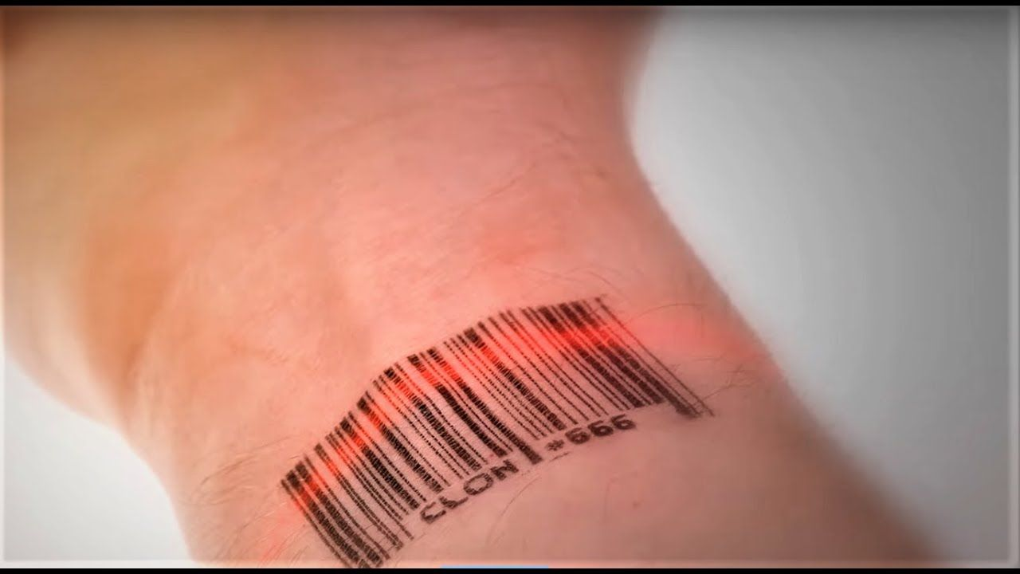

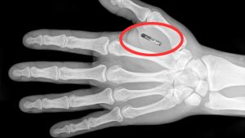
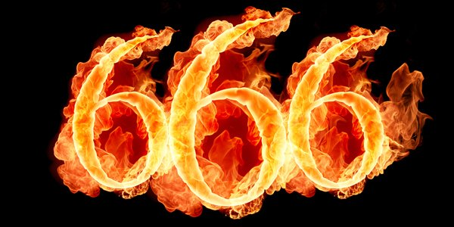



The MARK of the BEAST
People just don’t know

Slide 298
The MARK of the BEAST
Is the mark of the beast:
physical OR
spiritual ?

Slide 299
The MARK of the BEAST
And the smoke of their torment ascendeth up forever and ever; and they have no rest day nor night, who worship the beast and his image, and whosoever receiveth the mark of his name.
Revelation 14:11
And the first went, and poured out his vial upon the earth; and there fell a noisome and grievous sore upon the men which had the mark of the beast, and upon them which worshiped his image.
Revelation 16:2

Slide 300
The MARK of the BEAST
And the beast was taken, and with him the false prophet that wrought miracles before him, with which he deceived them that had received the mark of the beast, and them that worshiped his image. These both were cast alive into a lake of fire burning with brimstone.
Revelation 19:20
Worshipers is exactly what the Lucifer wants!
Spiritual mark

Slide 301

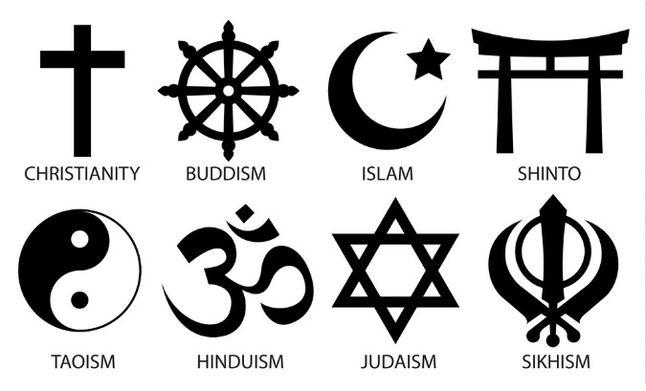




The MARK of the BEAST
Those who have taken the mark will often display their marks.
Physical symbols everywhere

Slide 302
The MARK of the BEAST
First Spiritual, then Physical:
The “Mark” symbolizes worshiping the beast
Giving over our mind & actions to the Devil
People will make physical markings on themselves to display their worship of Satan

Slide 303
The MARK of the BEAST
Physical marks are an outward show of an inward choice to serve and worship Satan.

Slide 304
The MARK of the BEAST
Where do people take upon them the mark of the beast?

Slide 305



The MARK of the BEAST
Think symbolism…
Thoughts →
←Actions
666

Slide 306
The MARK of the BEAST
And he causeth all, both small and great, rich and poor, free and bond, to receive a mark in their right hand, or in their foreheads; And that no man might buy or sell, save he that had the mark, or the name of the beast, or the number of his name. Here is wisdom. Let him that hath understanding count the number of the beast; for it is the number of a man; and his number is Six hundred threescore and six.
Revelation 13:16-18

Slide 307
The MARK of the BEAST
When did people start taking the mark of the beast?

Slide 308

The MARK of the BEAST
Let’s go back to the beginning

Slide 309
The MARK of the BEAST
Satan’s Sins (in the beginning):
1. Pride 2. Take away our agency
And I, the Lord God, spake unto Moses, saying, That Satan whom thou hast commanded in the name of mine Only Begotten, is the same which was from the beginning; And he came before me, saying, Behold I, send me, I will be thy Son, and I will redeem all mankind, that one soul shall not be lost, and surely I will do it; wherefore, give ME thine honor.
Genesis 3:1-2

Slide 310
The MARK of the BEAST
God’s Character: (in the beginning):
Wherefore, because that Satan rebelled against me, and sought to destroy the agency of man, which I, the Lord God, had given him; and also that I should give unto him mine own power; by the power of mine Only Begotten I caused that he should be cast down; and he became Satan.
Genesis 3:4
And in the garden of Eden gave I unto man his agency; and unto thy brethren have I said, and also gave commandment, that they should love one another; and that they should choose me their Father.
Genesis 7:40

Slide 311


The MARK of the BEAST
Freedom
Choice
Glory to God
Domination
Control
Pride
vs

Slide 312
The MARK of the BEAST
Wherefore, because that Satan rebelled against me, and sought to destroy the agency of man…and also that I should give unto him mine own power; by the power of mine Only Begotten I caused that he should be cast down; and he became Satan. Yea, even the devil, the father of all lies, to deceive, and to blind men, and to lead them captive at his will, even as many as would not hearken unto my voice….Satan put it into the heart of the serpent, for he had drawn away many after him…for he knew not the mind of God; wherefore, he sought to destroy the world.
Genesis 3:4-7

Slide 313


The MARK of the BEAST
The mark of the beast is the same mark from the beginning of time all the way through the end.

Slide 314
The MARK of the BEAST
Ye can not say, when ye are brought to that awful crisis, that I will repent, that I will return to my God. Nay, ye can not say this; for that same spirit which doth possess your bodies at the time that ye go out of this life, that same spirit will have power to possess your body in that eternal world. For behold, if ye have procrastinated the day of your repentance, even until death, behold, ye have become subjected to the spirit of the devil, and he doth seal you his; Therefore the Spirit of the Lord hath withdrawn from you, and hath no place in you, and the devil hath all power over you; and this is the final state of the wicked.
Alma 16:231-234

Slide 315
The MARK of the BEAST
And it was given unto him [the beast] to make war with the saints, and to overcome them; and power was given him over all kindreds, and tongues, and nations. And all that dwell upon the earth shall worship him, whose names are NOT written in the book of life of the Lamb slain from the foundation of the world.
Revelation 13:7-8
Those who worshiped the beast will not receive salvation.

Slide 316
The MARK of the BEAST
And I saw thrones, and they sat upon them, and judgment was given unto them; and I saw the souls of them that were beheaded for the witness of Jesus, and for the word of God, and which had not worshiped the beast, neither his image, neither had received his mark upon their foreheads, or in their hands: and they lived and reigned with Christ a thousand years.
Revelation 20:4
Those who worshiped the beast will not be in the millennium.

Slide 317

The MARK of the BEAST
OR
We choose God’s ways
We choose Satan’s ways

Slide 318
The MARK of the BEAST
What about agency?

Slide 319
The MARK of the BEAST
And I saw at it were a sea of glass mingled with fire; and them that had gotten the victory over the beast, and over his image, and over his mark, and over the number of his name, stand on the sea of glass, having the harps of God.
Revelation 15:2
Many will overcome the beast

Slide 320
The MARK of the BEAST
What does the mark then actually symbolize?

Slide 321
The MARK of the BEAST
Having a mark can be viewed as:
A seal (official and permanent mark)
A sign of who has right and claim upon you
An indication of who is your master
A symbol of ownership
A symbol of a binding servanthood
An indication of whose inheritance you are

Slide 322
The MARK of the BEAST
If Satan’s followers receive a mark, do God’s followers also?
And I looked, and, lo, a Lamb stood on the mount Sion, and with him a hundred forty and four thousand, having his Father's name written in their foreheads.
Revelation 14:1 and also in D&C 108:5c
The MARK of GOD

Slide 323


The MARK of the BEAST
Jewish Phylacteries

Slide 324
The MARK of the BEAST
I say unto you, I would that ye should remember to retain the name written always in your hearts, that ye are not found on the left hand of God, but that ye hear and know the voice by which ye shall be called, and also, the name by which he shall call you:
Therefore, I would that ye should be steadfast and immovable, always abounding in good works, that Christ, the Lord God Omnipotent, may seal you his, that you may be brought to heaven, that ye may have everlasting salvation and eternal life, through the wisdom, and power, and justice, and mercy of him, who created all things, in heaven and in earth, who is God above all. Amen.
Mosiah 3:16,21
The MARK of GOD

Slide 325
The MARK of the BEAST
Additional scriptures
Seal of God:
John 6:27
2 Timothy 2:19
Revelation 7:2-4
Revelation 9:4
Ephesians 1:13
D&C 76:5d
Covenant of God:
2 Nephi 13:16
Mosiah 3:11
Alma 16:237
3 Nephi 12:18-21
D&C 17:22d-23b
Moroni 4

Slide 326
The MARK of the BEAST
Do we need to look for a time where we need the mark to buy and sell?
Satan doesn’t change – always trying to take away the agency of man. But…

Slide 327
The MARK of the BEAST
Book of Revelation:
Chapter 12 – the woman (church) fled the earth and the dragon was wroth with her
Therefore, the dragon was wroth with the woman, and went to make war with the remnant of her seed, which keep the commandments of God, and have the testimony of Jesus Christ.
Revelation 12:17
How did he make war? With two beasts (Rev.13)

Slide 328
The MARK of the BEAST
Balance of POWER

Slide 329
The MARK of the BEAST
Beast & Dragon have POWER for:
1,260 years
Time, times, & ½ times
42 months
to make WAR
POWER
= APOSTASY (Dark Ages)
Balance of POWER

Slide 330
The MARK of the BEAST
Book of Revelation:
Chapter 13 – the dragon gave power to two beast to make war with the remnant of the Church
…in the likeness of the kingdoms of the earth; a beast rise up out of the sea, and he stood upon the sand of the sea, having seven heads and ten horns; and upon his horns ten crowns; and upon his heads the name of blasphemy.
Revelation 13:1

Slide 331
The MARK of the BEAST
And there was given unto him a mouth speaking great things and blasphemies; and power was given unto him to continue forty and two months. And he opened his mouth in blasphemy against God, to blaspheme his name, and his tabernacle, and them that dwell in heaven. And it was given unto him to make war with the saints, and to overcome them; and power was given him over all kindreds, and tongues, and nations.
Revelation 13:5-7
Power given during the Apostasy

Slide 332
The MARK of the BEAST
570 A.D.
Period of 1,260 years
A.D. 1830
During the Apostasy:
Power given to overcome the saints
Power given over all nations, etc.

Slide 333
The MARK of the BEAST
Daniel’s vision in chapter 7 is of the same beast from Revelation 13

Slide 334
The MARK of the BEAST
After this I saw in the night visions, and behold a fourth beast, dreadful and terrible, and strong exceedingly; and it had great iron teeth; it devoured and brake in pieces, and stamped the residue with the feet of it; and it was diverse from all the beasts that were before it; and it had ten horns.
Daniel 7:7
Same beast from Revelation 13

Slide 335
The MARK of the BEAST
And he shall speak great words against the Most High, and shall wear out the saints of the Most High, and think to change times and laws; and they shall be given into his hand until a time and times and the dividing of time.
Daniel 7:25
Time, times, and the dividing of time = 1,260 years = Apostasy

Slide 336
The MARK of the BEAST
I beheld, and the same horn made war with the saints, and prevailed against them; Until the Ancient of days came, and judgment was given to the saints of the Most High; and the time came that the saints possessed the kingdom.
Daniel 7:21-22
When did/will the saints possess the kingdom?

Slide 337
The MARK of the BEAST
570 A.D.
Period of 1,260 years
A.D. 1830
And the dragon prevailed not against Michael, neither the child, nor the woman which was the church of God, who had been delivered of her pains, and brought forth the kingdom of our God and his Christ.
Revelation 12:7

Slide 338
The MARK of the BEAST
And when he was demanded of the Pharisees, when the kingdom of God should come, he answered them, and said, The kingdom of God cometh not with observation; Neither shall they say, Lo, here! or, Lo, there! For, behold, the kingdom of God has already come unto you.
Luke 17:20-21
The authority of God, the power of God, this is the Kingdom

Slide 339
The MARK of the BEAST
570 A.D.
Period of 1,260 years
A.D. 1830
And I saw another angel fly in the midst of heaven, having the everlasting gospel to preach unto them that dwell on the earth, and to every nation, and kindred, and tongue, and people,
Revelation 14:6

Slide 340
The MARK of the BEAST
570 A.D.
Period of 1,260 years
A.D. 1830
Kingdom on Earth
Kingdom left the Earth and power given to the beast to overcome the saints of God
Kingdom on Earth
Apostasy from 570-1830 A.D.
is when beast could overcome the saints

Slide 341
The MARK of the BEAST
POWER
= APOSTASY (Dark Ages)
Balance of POWER

Slide 342
The MARK of the BEAST
She’s BACK!!!
Therefore, the dragon was wroth with the woman, and went to make war with the remnant of her seed, which keep the commandments of God, and have the testimony of Jesus Christ.
Revelation 12:17
God’s Kingdom is back on the Earth

Slide 343
The MARK of the BEAST
And he [second beast] causeth all, both small and great, rich and poor, free and bond, to receive a mark in their right hand, or in their foreheads; And that no man might buy or sell, save he that had the mark, or the name of the beast, or the number of his name. Here is wisdom. Let him that hath understanding count the number of the beast; for it is the number of a man; and his number is Six hundred threescore and six.
Revelation 13:16-18
This is the time period when the beast had power to overcome the saints of God = Apostasy

Slide 344
The MARK of the BEAST
Do we need to look for a time where we need the mark to buy and sell?
Satan doesn’t change – always trying to take away the agency of man. But…

Slide 345
The MARK of the BEAST
570 A.D.
Period of 1,260 years
A.D. 1830
Kingdom on Earth
Kingdom left the Earth and power given to the beast to overcome the saints of God
Kingdom on Earth
Apostasy from 570-1830 A.D. is when people couldn’t buy or sell without the mark, being part of that evil kingdom.

Slide 346
Conclusion the MARK of the BEAST

Slide 347
The MARK of the BEAST
Should we fear the coming mark of the beast?

Slide 348
Conclusion
We who are baptized, can still take upon us the mark
Taking upon us the mark is our personal choice to worship Satan and give ourselves over to his actions
Physical things forced upon us in these latter days is NOT the mark of the beast
We do NOT have to fear being forced to take upon us the mark of the beast in order to buy or sell as this time period was during the Apostasy
God’s restored church WILL receive the promises and will have the POWER of God to overcome the beast
Truth or Fiction?

Slide 349
FINAL Conclusion to this class

Slide 350
Importance of Signs
Satan does not want us ready:
He wants us to believe that things that have ALREADY happened are yet to come
He wants us looking for things that will not happen
He twists the word of God so we don’t understand God’s plan
We’ll saw examples of all three in this class

Slide 351
Restored Gospel Is Critical
Ye are not sent forth to be taught, but to teach the children of men the things which I have put into your hands by the power of my Spirit; and ye are to be taught from on high.
D&C 43:4b-c
Notes:
Arthur Oakman said that “We have nothing to learn from theologians”
They do not have the promise of the Holy Ghost after baptism and they do not have the fullness of the gospel

Slide 352
Restored Gospel Is Critical
Old & New Testaments
Historical Records
Can we FULLY understand with only a PORTION of the knowledge?
Book of Mormon
Doctrine & Covenants
Church History & Records
Personal Revelation
(KJV)
Sources of our REFERENCE POINTS to understand prophecy
Restored Gospel Is Critical

Slide 353
What do OTHERS believe?
Foundation of the concept of 7 years tribulation
When using the Inspired Version of
scripture, there appears to be
NO scriptural foundation
for Seven Years Tribulation
Prophecy didn’t fit world view = Incorrect Understanding
Daniel’s 70 Weeks
Plain & Precious Taken Away = Incorrect Understanding
Matt. 24, Mark 13, Luke 21
Incorrect Association of Scripture = Incorrect Understanding
Revelation 1,260 days/years

Slide 354
End Times Scriptures
(What is coming)
1 Nephi 7
2 Nephi 7
2 Nephi 12
Jacob 3
3 Nephi 7
3 Nephi 9-12
Mormon 2
D&C 1
D&C 83:8c
D&C 105

Slide 355

And the Lord said unto Enoch, As I live, even so will I come in the last days--in the days of wickedness and vengeance, to fulfill the oath which I made unto you, concerning the children of Noah:
And the day shall come that the earth shall rest, but before that day, shall the heavens be darkened, and a veil of darkness shall cover the earth;
And the heavens shall shake, and also the earth; and great tribulations shall be among the children of men, but my people will I preserve; and righteousness will I send down out of heaven; and truth will I send forth out of the earth, to bear testimony of my Only Begotten;
His resurrection from the dead; yea, and also the resurrection of all men; and righteousness and truth will I cause to sweep the earth as with a flood, to gather out my own elect from the four quarters of the earth unto a place which I shall prepare;
D&C 36: 12c-14a (cont.)→

Slide 356
←(cont.) A holy city, that my people may gird up their loins, and be looking forth for the time of my coming; for there shall be my tabernacle, and it shall be called Zion, a New Jerusalem.
And the Lord said unto Enoch, Then shall you and all your city meet them there, and we will receive them into our bosom, and they shall see us, and we will fall upon their necks, and they shall fall upon our necks, and we will kiss each other,
And there shall be my abode, and it shall be Zion which shall come forth out of all the creations which I have made; and for the space of a thousand years shall the earth rest.
And it came to pass that Enoch saw the days of the coming of the Son of man, in the last days, to dwell on the earth in righteousness, for the space of a thousand years.
D&C 36: 12c-14a

Slide 357

And they shall see the Son of man coming in the clouds of heaven, with power and great glory.
And whoso treasureth up my word shall not be deceived.
Mark 13:42-43

Slide 358
The End
Elder Benjamin Pedersen
(816) 517-7971
b1nzion@yahoo.com
Notes:
Name is Benjamin Pedersen
Elder at Outreach Restoration Branch
Teaching on the concept of Seven Years Tribulation

