Slide 1
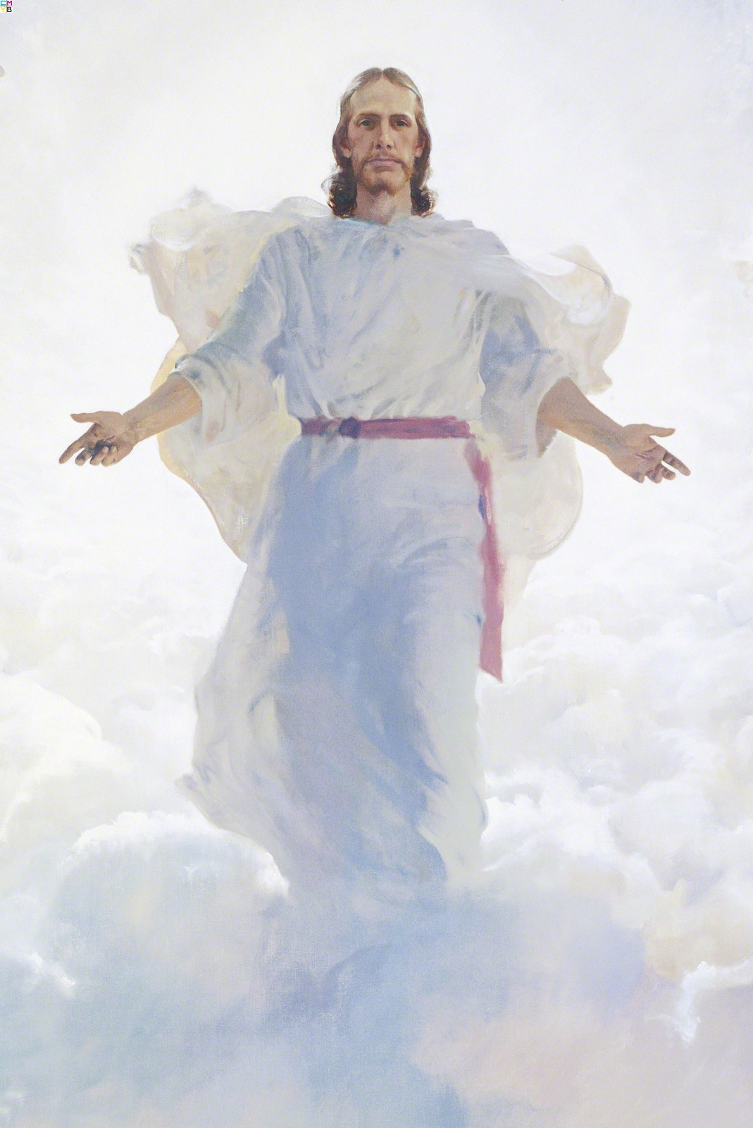
(1) The Church of Jesus Christ
(2) The Falling Away
(3) The Restoration
(4) The Evidences of the Book of Mormon
(6) Life After Death
(5) The Book of Mormon

Slide 2
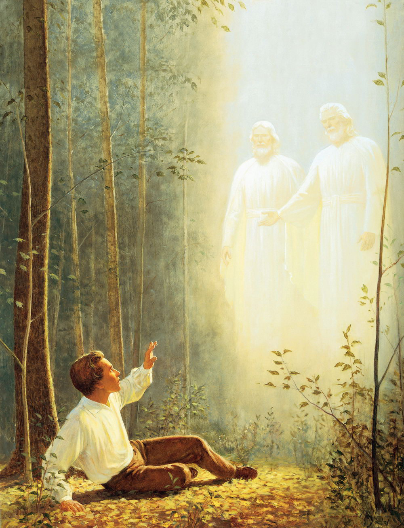
The Book of Mormon
Internal Evidences and Restored Truths

Slide 3
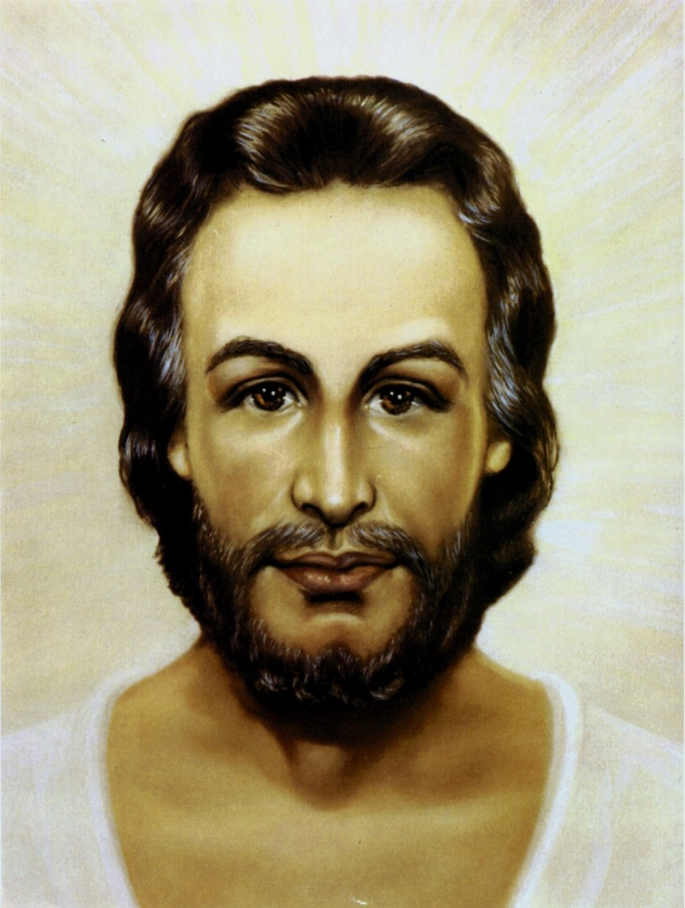
Notes:
Head of Christ (John 1:1-4)
Christ is the light and life of the world
All things were made by him
Without him was not anything made that was made
Christ is the center of all we believe and teach
There is no salvation except through him

Slide 4
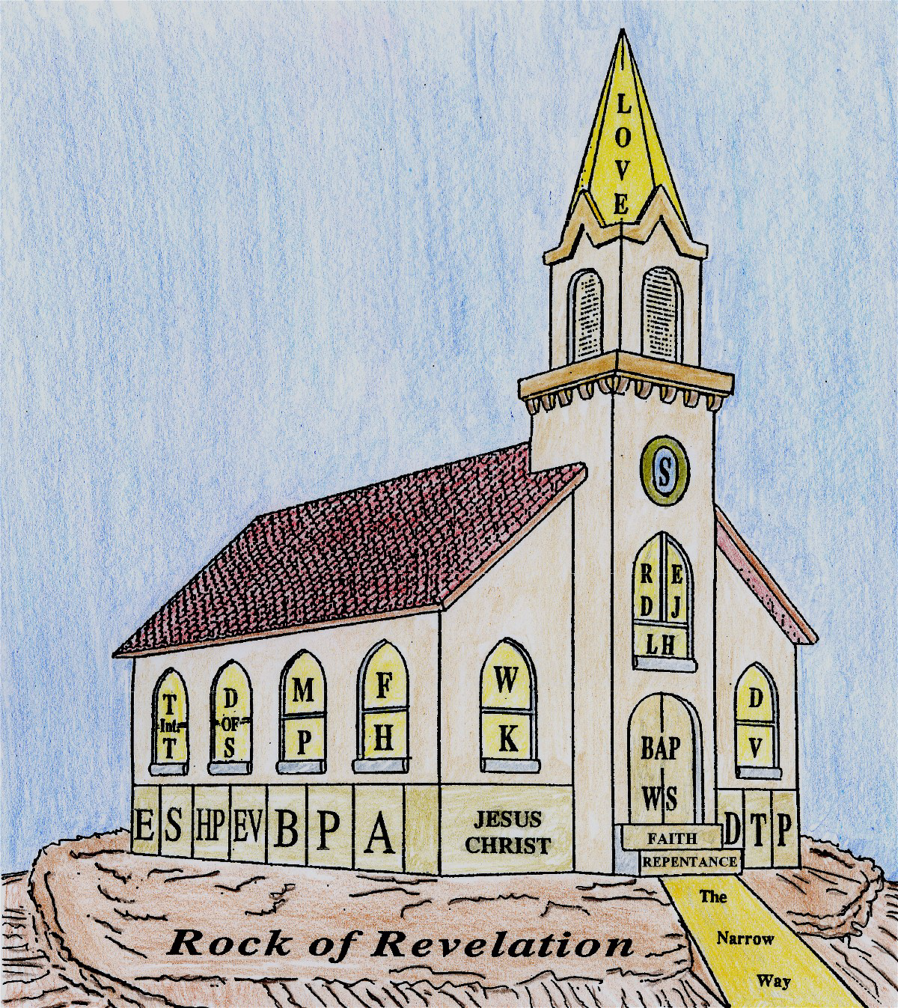
Notes:
The Church of Christ (Matt. 16:16-18)
Christ said, “I will build my church”
The church was to be built on the revealed word of God
Certain specific priesthood offices were set in the church
The men to fill these offices are to be called of God as was Aaron
Each of the offices is needed and was to remain until Christ’s work was finished (Eph. 4:12-16)

Slide 5
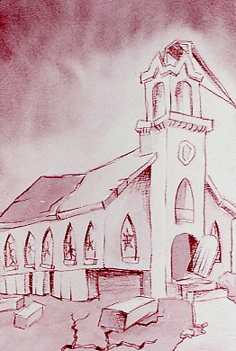
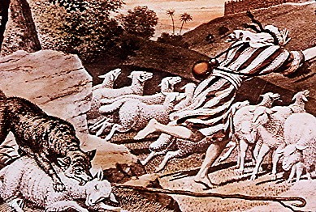
What happened to the Church that Christ built?
Notes:
The Hirelings Flee (John 10:12-14)
A good shepherd cares for his flocks because of his love for them. This love cannot be purchased with money
Only love and genuine concern cause the shepherd to place his life in jeopardy for his flock
When the shepherd is a hired servant, he is no longer motivated by love [2 Ths 3:6-10]
When personal danger outweighs the wage, the hireling leaves the flock
Without the guidance of a shepherd, the flock soon scattered, a victim of the grievous wolves of the apostasy
The principles of the doctrine of Christ and the ordinances which God had given unto man began to be changed, such as baby blessings, baptism, the Lord’s Supper…
Jesus Christ established His Church through the authority that He gave the apostles
This authority was to spread one true gospel, but the gospel was corrupted by the precepts of men and the adversary.
The ordinances were changed and the fundamental principles of salvation altered

Slide 6
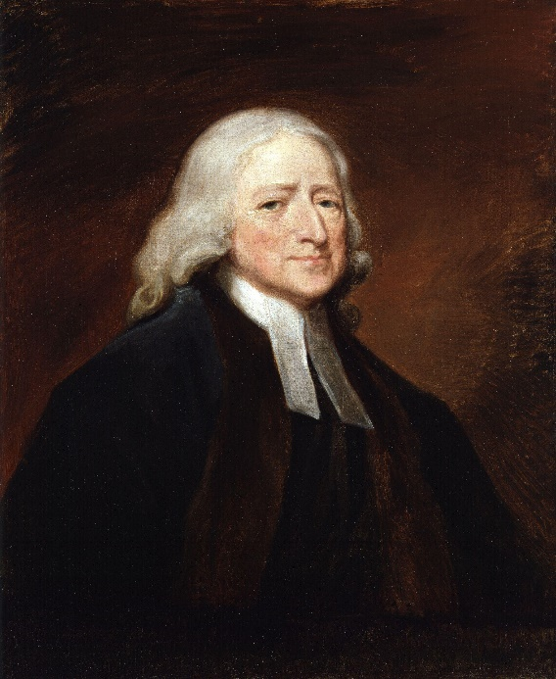
The real cause was, ‘the love of many’ almost of all Christians, so called, was ‘waxed cold.’ The Christians had no more of the Spirit of Christ, than the other heathens. This was the real cause why extraordinary gifts of the Holy Ghost were no longer to be found in the Christian church; because the Christians were turned heathens again, and had only a dead form left. – John Wesley
John Wesley
(1703-1791)
Methodist
Notes:
John and Charles Wesley, Roger Williams, Alexander Campbell, Mosheim, etc. all saw that the Church established by Jesus Christ was no longer in existence

Slide 7
“The times which we have reason to believe are at hand—if they are not already begun—are what many pious men have termed, the time of ‘the Latter-Day Glory’; meaning the time wherein God would gloriously display his power and love…and set up his kingdom over the earth.” – John Wesley’s Sermon #71
What could God have done which He hath not done, to convince you that the day is coming, that the time is at hand, when He will fulfill His glorious promises; when He will arise and maintain His own cause and to set up His Kingdom over all the earth? —Wesley's Sermons, vol. 2, p. 98
Notes:
“The times which we have reason to believe are at hand…”
John Wesley, John Robinson, and others were convinced that the time for restoration was very near, if not already begun.

Slide 8
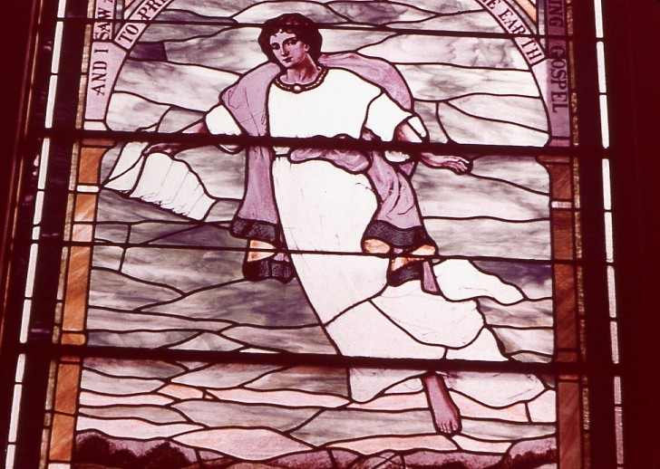
Notes:
Angel Flying In the Midst of Heaven (Revelation 14:6-7)
“And I saw another angel fly in the midst of heave, having the
everlasting gospel to preach unto them that dwell on the earth
and to every nation, and kindred, and tongue, and people.”
The angelic messenger was bringing the gospel to earth
If he was bringing it with him, it must not have been on earth at the time
Notice, too, that this gospel was being brought to earth from the midst of heaven

Slide 9
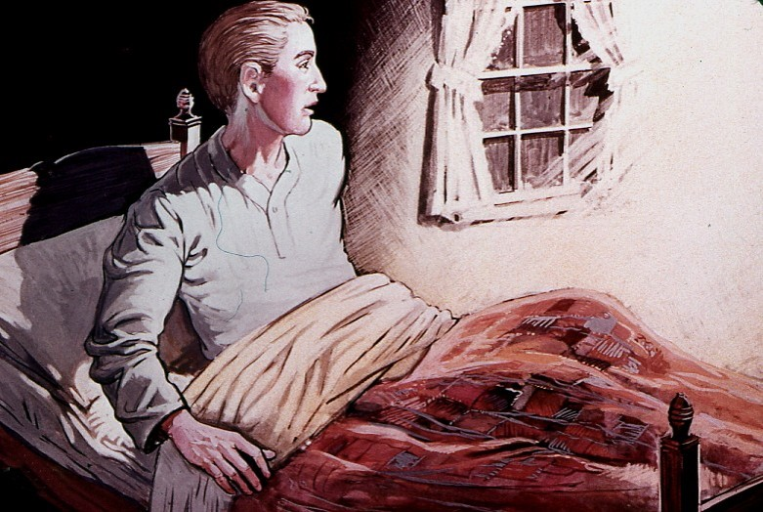
Notes:
Moroni Appears [1820-1823]

Slide 10
He said there was a book deposited written upon gold plates, giving an account of the former inhabitants of this continent, and the source from whence they sprang. He also said that the fullness of the everlasting gospel was contained in it, as delivered by the Savior to the ancient inhabitants.
Church History, vol. 1, p. 13
Notes:
Script – “He said there was a book…” (Church History, vol. 1, p. 13)
He said there was a book deposited which was written upon gold plates,
…giving an account of the former inhabitants of this continent,
…and the source from whence they sprang
He also said that the fullness of the everlasting gospel was contained in it,
…as delivered by the Savior to the ancient inhabitants

Slide 11

Notes:
Book of Mormon Plates. The next day on Sept 22, 1823, Joseph went to “a hill of considerable size” outsized Manchester, NY. “On the west side of this hill, not from the top, under a stone of considerable size, lay the plates deposited in a stone box.”
“I made an attempt to take them out, but was forbidden...until four years from that time; but he told me that I should come to that place precisely in one year...I went at the end of each year, and at each time I found the same messenger there...” Joseph was given the same vision with Moroni 3 more times and warned that he must be very careful when he received the plates and the Urim and Thummim in September 1827 These items were to be used for the Kingdom of God and not for financial gain

Slide 12
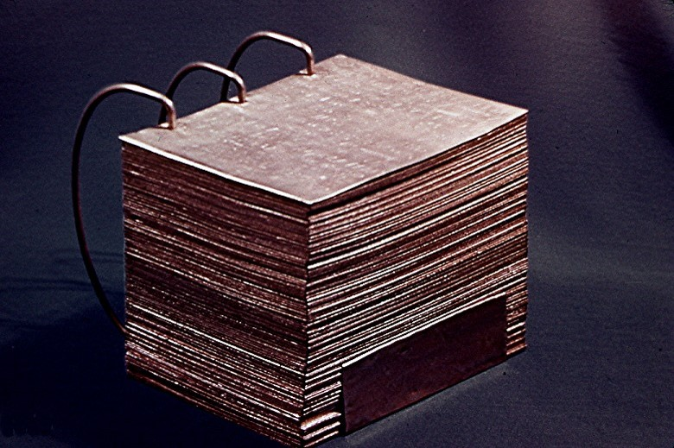
Notes:
When Joseph found the plates in the place shown him in a vision, they looked something like this – each plate was 6 inches wide and 8 inches long. It was bound together with 3 rings; the volumes were about 6 inches thick, part of which was sealed

Slide 13
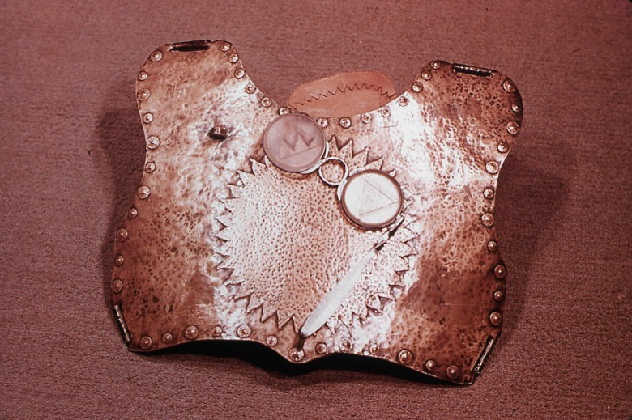
Notes:
Breastplate and Urim and Thummim [Exo 28:29-30, Lev 8:8, Num 27:18-21, 1 Sam 28:6]
The angel further said there were two stones in silver bows deposited with the plates
These stones, fastened to a breastplate of judgment, constituted what is called the Urim and Thummim, and God had prepared them for the purpose of translating the book
This is close-up of a model of an ancient Hebrew breastplate with two transparent stones in metal rims attached to it

Slide 14
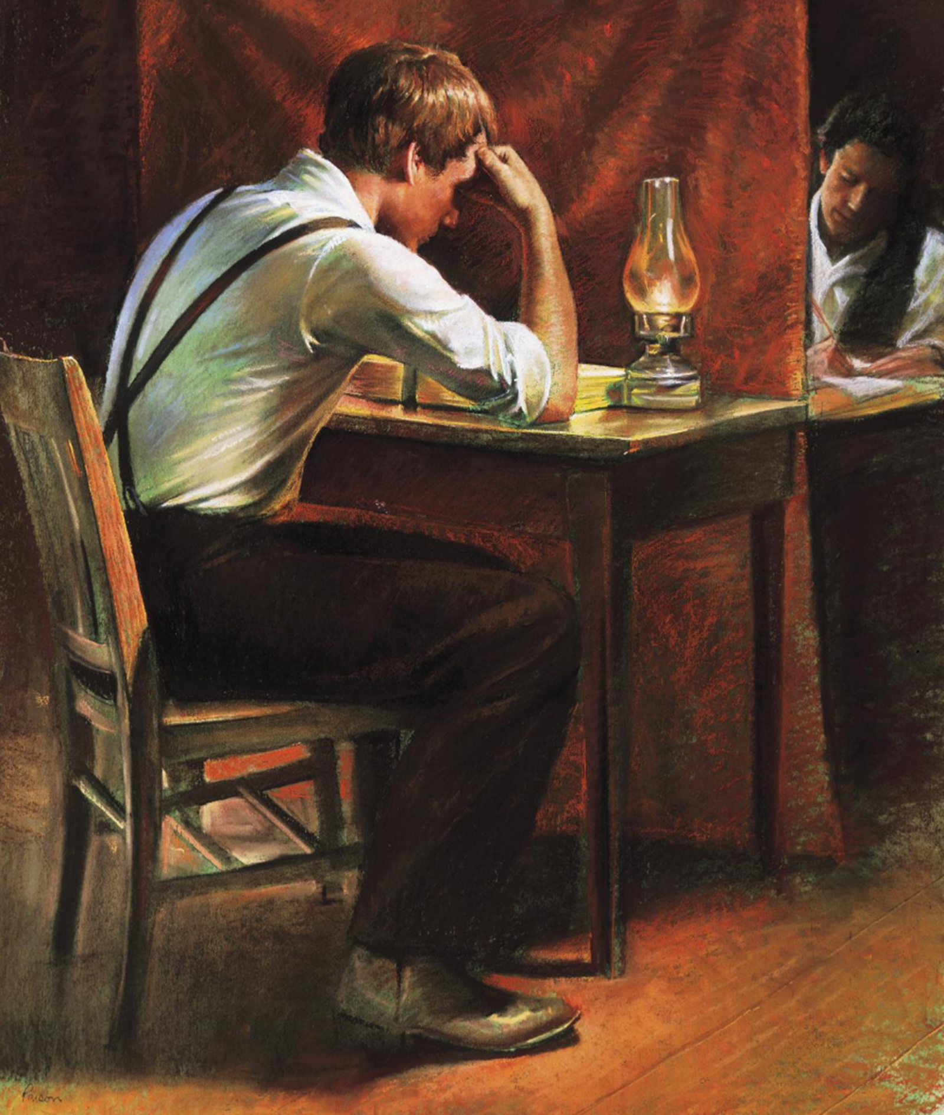
Notes:
TRANSLATION PROCESS
In Harmony, PA, Martin Harris served as scribe for the translation process from April to June of 1828, but the first 116 pages were lost. Translation ceased for ten months. On April 7, 1829, the work of translating resumed with Oliver Cowdery acting as Joseph’s scribe

Slide 15
Oliver Cowdery:
“These were days never to be forgotten – to sit under the sound of a voice dictated by the inspiration of heaven, awakened the utmost gratitude of this bosom! Day after day I continued, uninterrupted, to write from his mouth, as he translated, with the Urim and Thummim, or, as the Nephites would have said, ‘Interpreters,’ the history, or record, called ‘The Book of Mormon.’”
Notes:
The Book of Mormon covers a period of over 2,600 years, and was finished in approximately eighty days (less than three months).
It contains 102 chapters, 25 about wars, 10 about history, 21 about prophecy, 32 about doctrines, 5 about missionaries, and 9 about the mission of Christ
It added 180 proper nouns to the English language (William Shakespeare added 30)

Slide 16
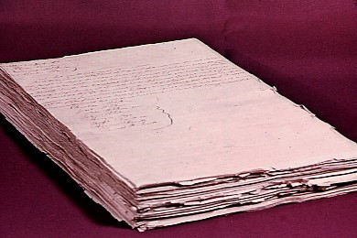
Notes:
Book of Mormon Manuscript [Was delivered to E.B. Grandin, a printer in Palmyra, NY]
This is the manuscript of the Book of Mormon, the translation was completed in Fayette, NY by August 1829.
This is the only complete manuscript of the Book of Mormon in existence and it is the original
The first printing of the Book of Mormon was in March 1830
The Book of Mormon was not, and could not have been written by Joseph Smith
It was translated by him with the help of God through the use of the Urim and Thummim

Slide 17
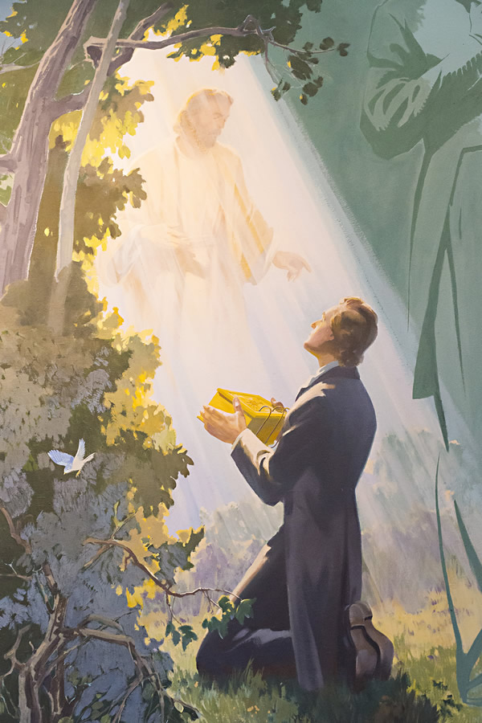

INTERNAL EVIDENCE IN THE BOOK OF MORMON
Chiasmus
Hebraisms
Notes:
Now, in this lesson, we want to talk about “internal evidence” that can be found in the writing of the Book of Mormon. This lesson is divided into two sections: 1. Chiasmus and 2. Hebraisms in the Book of Mormon.
1. “Chiasmus” refers to a ancient literary device that was not generally known by scholars, let alone the general public, in 1830, when the Book of Mormon was published.
2. The Hebrew language has some distinctive markers, or syntax (i.e., the way words are put together), that set it apart from English.

Slide 18
A “chiasm” is a literary device in which a series of topics are repeated in inverted parallel order (i.e., in reverse order). The second half is a mirror image of the first half. Subjects in a typical chiasm could have the following order:
A – first subject
B – second subject
C – third subject
C’ – third subject repeated
B’ – second subject repeated
A’ – first subject repeated
Notes:
A chiasm was used in ancient literature. It conveyed a series of subjects, and then repeated those subjects in reverse order. Chiasms don’t always repeat the center point or theme (item C in this case).
In the ancient world:
writing had no paragraphs, punctuation or capitalization to convey the end of one idea and start of the next.
stories were committed to memory and transmitted orally.
repetition and redundancy were the rule.
so chiasms were helpful for organizing, retaining and conveying material.
In the modern world, we do not repeat points in this way. We expect a linear progression of thought, without having to mention something repeatedly.

Slide 19
The following is an example from Leviticus 14:49-53:
A cleanse the house (14:49)
B kill one of the birds (50)
C cedar wood, hyssop, scarlet (51)
D the slain bird (51)
E running water (51)
F sprinkle the house (51)
G seven times (51)
F’ cleanse the house (52)
E’ running water (52)
D’ the living bird (52)
C’ cedar wood, hyssop, scarlet (52)
B’ the living bird (53)
A’ the house . . . be clean (53)
Notes:
Here, we see an example in the Bible of a chiasm in consecutive verses. Carefully examine point A and then A’, then B and B’, and so on. Note that Item G is only mentioned once.

Slide 20
The epistle to the Galatians is one example in which some scholars believe sections were organized in a chiastic structure:
A Prologue (1:1 to 1:12)
B Autobiographical Section (1:13 to 2:10)
C Justification by Faith (2:11 to 3:4)
D Arguments from Scripture (3:5 to 3:29)
E Central Chiasm (4:1-10)
D’ Arguments from Scripture (4:11 to 4:31)
C’ Justification by Faith (5:1 to 5:10)
B’ Moral Section (5:11 to 6:11)
A’ Epilogue (6:12 to 6:18)
Notes:
Chiastic order was not just used in consecutive sentences, but it was also followed in ordering sections of a book or writing. Compare the sections in the first half to their corresponding sections in the second half.

Slide 21
1830 - Book of Mormon was published.
1800s - Scholars were not generally aware of chiasmus in ancient literature.
1908 - Nils W. Lund, a skeptic, began the first formal investigation into biblical chiasmus.
1940s - There was finally a consensus among scholars that such inversions existed in ancient literature.
1969 - John W. Welch identified chiasmus in the Book of Mormon.
Notes:
The point here is quite astounding. Throughout the 1800s, this phenomenon had not yet been generally recognized by scholars, yet the Book of Mormon contains many chiastic structures.

Slide 22
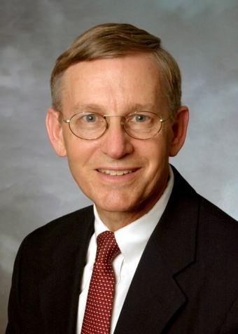
John W. Welch is one of the foremost experts in this area of ancient literature. He states:
. . . of all the things which can be said about the Book of Mormon, it must be acknowledged that the book, especially in its most literary portions, is replete with precise and extensive chiastic compositions. These passages are often meaningfully creative, original, and intricate, judged to be highly successful by any consistently applied criteria.”
John Welch, Chiasmus in Antiquity
(Provo: Research Press, 1981), p. 198

Slide 23
In 1 Nephi 1:104-130, Nephi tells the story of going back to Jerusalem in a chiastic fashion:
A Nephi leaves his brothers at the city walls.
B Heads to house of Laban; finds him on the street.
C Nephi sees and describes Laban’s steel sword.
D He is constrained to kill Laban.
E Laban had been delivered into Nephi’s hands.
F Nephi recalls that his nation must not perish in unbelief.
G He remembers promise: If nation obeys, it will prosper.
F’ It is essential to have the law to not perish in unbelief.
E’ Nephi accepts that Laban was delivered into his hands.
D’ He kills Laban.
C’ Takes sword, armor and clothing.
B’ Proceeds to the house of Laban and obtains the plates.
A’ Returns to his brothers outside the city walls
Notes:
Regarding 1 Nephi and 2 Nephi, Welch says:
“Both books are independent chiastic units, centrally focused and symmetrically organized, which itself explains why Nephi divided his writings into two books. 1 Nephi is a well-structured book, with almost every element in the first half of the book having a specific counterpart in the second half.” (Chiasmus, p. 199)

Slide 24
Not only sections, but Nephi’s words are also written in carefully constructed inversions 1 Nephi 5:126-131:
A behold, the Lord hath created the earth that it should be inhabited; and he hath created his children, that they should possess it.
B and he raiseth up a righteous nation; and destroyeth the nations of the wicked.
B’ and he leadeth away the righteous into precious lands, and the wicked he destroyeth and curseth the land unto them for their sakes.
A’ he ruleth high in the heavens, for it is his throne, and this earth is his footstool. And he loveth those who will have him to be their God.
Notes:
Welch states:
“The next four books in the Book of Mormon (Jacob, Enos, Jarom and Omni) manifest virtually no chiasmus. These books are increasingly brief and, particularly the last two, were composed during a dark age in Nephite history . . .” (Chiasmus, p. 202)
Questions: If Joseph Smith, Jr. fabricated this book:
How did he insert inversions into his writing and then at certain points, abruptly turn that literary technique on and off, all while dictating 777 pages of material in a few months, without the help of printed materials?
How would he even know about chiasmus, since they had not yet been discovered?

Slide 25
Mosiah 3:13-16:
A whosoever shall not take upon them the name of Christ
B must be called by some other name
C therefore he findeth himself on the left hand of God
D ye should remember also that this is the name
E that never should be blotted out
F except it be through transgression
F’ Therefore, take heed that you do not transgress
E’ that the name be not blotted out of your hearts
D’ I would that ye should remember to retain this name
C’ that ye are not found on the left hand of God
B’ but that ye hear and know the voice by which ye shall be called
A’ and also the name by which he shall call you
Notes:
Welch describes King Benjamin’s Final Proclamation in the book of Mosiah:
“a high classical style, being thoroughly chiastic” (Chiasmus, p. 202)
“Benjamin’s ideas flow, seemingly without effort, through one sequence of thoughts and then again through the opposite order of that same series.” (Chiasmus, p. 203)
“Again, the repetition here is precise, extensive and meaningful. It simply strains reason to imagine that such structure in this oration occurred accidentally. Furthermore, the historical setting and classical interests of Benjamin make it all the more plausible to view this speech as one of the great chiastic writings of all time.” (Chiasmus, p. 205)

Slide 26
John W. Welch’s conclusion:
“No one seriously contends that Joseph Smith or anyone associated with him knew or could have known of chiasmus or had the training to discover this principle for himself. The evidence is overwhelming against such a claim. And even if he had known in theory of chiasmus, there would still have remained the formidable task of composing the well-balanced, meaningful chiastic structures (combined with other structures unknown or unanalyzed in his time) which are found in precisely those portions of the Book of Mormon in which one would logically and historically expect to find them.”
(continued on next slide)

Slide 27
John W. Welch (continued):
“Accomplishing all of this would have been an especially imposing task, since the Book of Mormon was Joseph Smith’s first work, which, at age 24, he dictated without notes mostly inside of six months and rarely revised the only draft which the manuscript ever saw . . . As with much of ancient literature, the design and depth of the Book of Mormon often comes to light only when the book is studied with chiastic principles in mind.”
John Welch, Chiasmus in Antiquity
(Provo: Research Press, 1981), p. 208-209
Notes:
Note: Translation activity paused several times during that six-month period.
Since the translation process was interrupted so many times during that six months, scholars have studied the impact this had and concluded that only about 65 to 75 days could have actually been spent on the translation. See the following source for more information on this: Welch and Rathbone, How Long Did It Take to Translate the Book of Mormon?, FARMS Update, February 1986

Slide 28
Hebraisms Used in the
Book of Mormon
Cognate Accusatives
Compound Subjects
Prophetic Perfect
Construct State
Repeated Prepositions
Idiom
Unique Uses of “And”
Compound Numbers
Compound Prepositions
Plural and Singular Forms
Notes:
To get our Old Testament of the Bible, scholars had to translate from Hebrew to English. The Hebrew language has some distinctive markers that set it apart from English.
In translating, a scholar has to decide:
a. “Should wording simply be expressed in a manner that is clear to the English-speaking reader? or
b. Should the distinctiveness of the Hebrew syntax (i.e., the way words are put together) be preserved?”
Sometimes translators would keep the original order of words from the Hebrew, but quite often that order is lost because it sounds strange to us in English.

Slide 29
“And now, behold, we have written this record according to our knowledge in the characters, which are called among us the reformed Egyptian, being handed down and altered by us, according to our manner of speech. And if our plates had been sufficiently large, we should have written in the Hebrew.” [Mormon 4:98-99]
Notes:
The writers of the Book of Mormon were steeped in Hebrew language, culture and religion.
There can be no doubt that “reformed Egyptian” referred to a “Hebrew-ized Egyptian.”
Egyptian apparently used less room to write, but the Hebrew influence in their writing was readily apparent.

Slide 30
Angela M. Crowell, at the time she wrote the following, was working toward her Ph.D. in Hebrew:
“How could a young man, who did not have the knowledge of Hebrew or any other Semitic language, produce a work such as the Book of Mormon? How did so many literal translations of Hebrew words and Hebrew grammatical structures get into the record? We have seen that many Hebraic usages have not even been translated literally into English in the King James Version of the Bible. Mere copying of the words and style of the King James Version of the Bible would not produce the vast number of Hebraisms used correctly in the Book of Mormon.”
Angela M. Crowell, Hebraisms in the Book of Mormon, Recent Book of Mormon Developments, vol. 2 (Independence: Zarahemla Research Foundation: 199), page 10.
Notes:
At this point the listener’s mind might be drifting a little bit because studying syntax and grammar is a very difficult subject!
That is precisely the point: If we have to delve this deeply into grammar and syntax to analyze what Joseph did, think how difficult it would have been to dictate this translation in the first place with all of its odd Hebraic expressions!

Slide 31
1. Hebraisms: Cognate Accusatives
In 2 Samuel 12:16, the original Hebrew text says, “David fasted a fast.” However, in this case, the King James scholars translated this simply as, “David fasted.”
In Hebrew, “fasted a fast” is a very common form of writing in which a noun has the same root as a verb in order to add emphasis or intensity (i.e., called a “cognate accusative”).
In Genesis 27:34, they chose to preserve the more cumbersome Hebrew syntax by saying, “He cried with a great and exceeding bitter cry . . .” (noun and verb have the same root, adding emphasis).

Slide 32
1. Hebraisms: Cognate Accusatives
1 Nephi 1:57 – “cursed with a sore curse”
1 Nephi 1:60 – “I have dreamed a dream”
1 Nephi 3:140 – “yoketh them with a yoke”
1 Nephi 3:214 – “work a great and marvelous work”
Enos 1:19 – “desire which I desired”
Mosiah 2:28 – “succor those that stand in need of your succor”
Mosiah 5:20 – “taxed with a tax”
Alma 12:72 – “feared exceedingly with fear”
Notes:
There are numerous passages in the Book of Mormon in which a noun and verb have the same root to add emphasis, such as:

Slide 33
2. Hebraisms: Compound Subjects
In English, if there is a compound subject, we speak of the other person first and then ourselves. For example, “My father and I.”
In ancient Hebrew, if there was a compound subject, the speaker always mentioned himself first and the other person next. For example, “I and my father.”
Look at a few examples of compound subjects in the Book of Mormon:
1 Nephi 1:68 - “I and my brethren did consult”
1 Nephi 1:172 - “I and my father”
Mosiah 6:21 - “I and my people”
Alma 15:15 - “I and my brethren will go forth”

Slide 34
3. Hebraisms: Prophetic Perfect
“In Hebrew thinking, an action is regarded as being either completed or incompleted. Hebrew, therefore, knows no past, present, or future tenses, but has instead a Perfect [completed] and an Imperfect [not completed].”
J.A. Weingreen, A Practical Grammar for Classical Hebrew, 2nd. ed., (Oxford: Clarendon Press, 1959), 56-57.
Notes:
J.A. Weingreen, in A Practical Grammar for Classical Hebrew, describes this:

Slide 35
3. Hebraisms: Prophetic Perfect
1 Nephi 1:150: “but behold, I have obtained a land of promise . . .” (spoken while still in the wilderness)
2 Nephi 13:10: “. . . After that he was baptized with water, the holy Ghost descended upon him in the form of a dove” (spoken in 559-545 BC describing Jesus’ baptism)
Mosiah 8:44: “These are they whose sins he hath borne. These are they for whom he hath died to redeem them from their transgressions” (spoken in 148 BC)
Notes:
All three examples speak of a future event as if it had already occurred.

Slide 36
4. Hebraisms: Construct State
In English, we use lots of adjectives. In Hebrew, there are fewer adjectives. So ancient Hebrew writers very often used two nouns together in a “construct state” (i.e., using the two nouns as either a descriptive or a possessive).
Two Uses of “Construct State” in the Book of Mormon:
Descriptive Use of Construct State: “rod of iron” (two nouns) instead of “iron rod” (adjective and noun);
Possessive Use of Construct State: “brother of Jared” (two nouns) instead of Jared’s brother (possessive).

Slide 37
4. Hebraisms: Construct State
In Psalm 23 of the Bible, Hebrew would use the phrase “pastures of greenness” (two nouns) instead of “green pastures” (adjective and noun).
Here are examples of phrases in the Book of Mormon that use the more cumbersome “construct state” common to Hebrew writing:
sword of Laban record of Jared
people of Ammon brother of Jared
language of Jacob descendants of Zarahemla
plates of Nephi words of Isaiah
army of Moroni Book of Mormon
“the days of the years of the life of my fathers.” (four nouns).
“the sharpness of the power of the word of God” (four nouns in 2 Nephi 1:48)
Notes:
Skeptics frequently criticize the Book of Mormon for its stilted, cumbersome language and mistakenly attribute that to its use of King James English, but many of the odd literary forms are actually Hebrew in origin.

Slide 38
5. Hebraisms: Repeated Prepositions
In English, when a preposition governs objects in a series, we normally state the preposition once (unless we want to do it for emphasis). In Hebrew, it is normal and proper to re-state the preposition before each object in the series.
Jarom 1:19:...exceeding rich in gold and in silver and in precious things, and in fine workmanship of wood in buildings, and in machinery and also in iron...
Helaman 1:15:...The Lamanites had gathered...and armed with swords and with cimeters and with bows and with arrows and with head-plates and with breastplates, and with all manner of shields of every kind;
2 Nephi 4:21: “ And to work in all manner of wood, and of iron, and of copper, and of brass, and of steel, and of gold, and of silver, and of precious ores...

Slide 39
6. Hebraisms: Idiom
An “idiom” is an expression peculiar to our language that would make no sense if literally translated into another language. One example of English idiom is “It’s raining cats and dogs,” which actually means “it’s raining very hard.”
In the New Testament, the idiom “eye of a needle” was an expression they commonly used to describe the “gate of a city.” This idiom often confuses modern English readers.
When Matthew 19:24 says “it is easier for a camel to go through the eye of a needle . . . ,” most people today do not realize this referred to the fact that city gates were built low enough to force camels to get down on their knees in order to enter a city, so that invading armies could not rush in.

Slide 40
6. Hebraisms: Idiom
If you did not know Hebrew, it would be very difficult by sheer chance to produce so many idiomatic expressions of the Hebrew language as these:
before my face (3 Nephi 4:30)
give ear (Helaman 4:55)
in the ears (2 Nephi 12:28)
face of the earth (Ether 4:103)
by the mouth of (1 Nephi 3:51)
in the eyes of (1 Nephi 6:35)
from the mouth of (Mosiah 9:170)
burned with fire (3 Nephi 4:28)
right hand (1 Nephi 6:20)
eye to eye (Alma 17:23)
in the presence of (Alma 13:63)
Notes:
Here are more idioms and their meaning in Hebrew:
“right hand” found in 1 Nephi 6:20 (meaning: strength, justice and righteousness)
“generation to generation” found in Mosiah 12:19 (meaning: for all eternity)
“lift up the voice” found in Mosiah 7:78 (meaning: cry, shout, begin speaking)
“open the mouth” found in Mosiah 8:46 (meaning: speaking at length or with great solemnity, liberty, freedom)
“my soul” found in 2 Nephi 3:51 (meaning: myself)
“in the eyes of” found in 1 Nephi 6:35 (meaning: before)
“stiff-necked” found in 2 Nephi 11:52 (meaning: obstinate)

Slide 41
7. Hebraisms: Unique Uses of “And”
In English, it would not be normal to start a sentence with “and.” In a series of nouns, the word “and” would be used once. In Hebrew, sentences and even books commonly begin with “and.” It is also used often within a series or with a possessive pronoun.
“And it came to pass that the people of Nephi did till the land, and raise all manner of grain, and of fruit, and flocks of herds, and flocks of all manner of cattle, of every kind, and goats, and wild goats, and also many horses.” [Enos 1:34]
“And he left his house and the land of his inheritance, and his gold and his silver and his precious things...” [1 Nephi 1:29]
“...to leave the land of their inheritance, and their gold and their silver and their precious things...” [1 Nephi 1:38]
“...our gold and our silver and all our precious things.” [1 Nephi 1:87]
Notes:
In Hebrew, when several nouns are joined by “and,” the possessive pronoun must be repeated with each noun.
In the three bottom examples, “his” and “their” and “our” are the possessive pronouns.

Slide 42
8. Hebraisms: Compound Numbers
In English, we hyphenate compound numbers such as “seventy-nine.” In Hebrew, when speaking of tens and units, they will use the conjunction “and.”
Examples:
“And when Corihor was thirty and two years old...” [Ether 3:41]
“Therefore after that ye are seventy and two years old...” [3 Nephi 13:14]

Slide 43
9. Hebraisms: Compound Prepositions
In English, we use single prepositions. Hebrew syntax however requires “compound prepositions,” which are used to indicate the locale and direction of the action.
“the servant went down into the vineyard” (Jacob 3:50)
“They went down into the land of Nephi” (Mosiah 5:7)
“did not flee from before the Lamanites” (Mosiah 1:52)
“they fled from before my presence” (1 Nephi 1:132)
Notes:
Down” and “into” are both prepositions. “From” and “before” are as well.

Slide 44
10. Hebraisms: Plural & Singular Forms
In English, we would normally use the singular form. In Hebrew, they use the plural form to intensify or heighten the idea of the singular.
“and great slaughters by the sword” (1 Nephi 3:99)
“all the energies of my soul” (1 Nephi 4:42)
“and by bloodsheds, and by pestilence” (2 Nephi 5:39)
“and did reap with your mights” (Alma 14:84)
Exception: In Hebrew, the words “head,” “mouth,” “tongue” and “voice” are used in the singular form when they apply to more than one person.
“by the mouth of his holy prophets” (2 Nephi 6:2)
“with the tongue of angels” (2 Nephi 13:17)
“by the voice of his angels” (Alma 8:29)
Notes:
Examples of plural form.
Examples of singular form. If we start by using the plural form to intensify a point, the complexity increases dramatically if we have to then make an exception and use “singular form” for just these four words (when they apply to more than one person).

Slide 45
“It took Joseph Smith only 65-75 days to translate the entire book of 777 pages. For Joseph to have studied the Hebrew language and then to have produced a Hebraic writing as harmonious and as extensive as the Book of Mormon all in his own power, takes on the proportion of a physical impossibility in that length of time. Considerations such as these lead us to conclude that the Book of Mormon is what it claims to be – an authentic Semitic record written by men thoroughly versed in Hebrew and translated by the ‘gift and power of God.’”
Angela M. Crowell, Hebraisms in the Book
of Mormon, Recent Book of Mormon
Developments, vol. 2 (Independence:
Zarahemla Research Foundation: 1992), 11.
Notes:
We have presented just ten examples of Hebrew literary expressions that consistently appear throughout the 777 pages of the Book of Mormon. Scholars have identified at least 23 such Hebrew grammatical structures in the book.

Slide 46
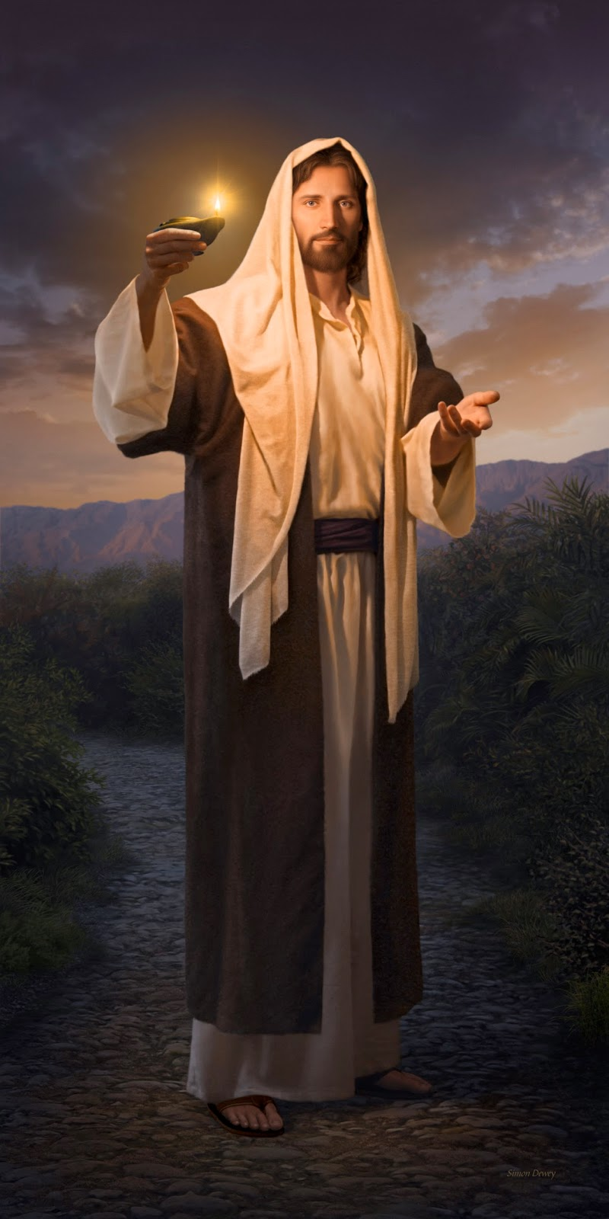
Notes:
The Hope of the World
The rise of the church restored by Jesus Christ, who not only was, but is, and who continues to minister to his church by revelation
Only in and through him is there hope for the world

Slide 47
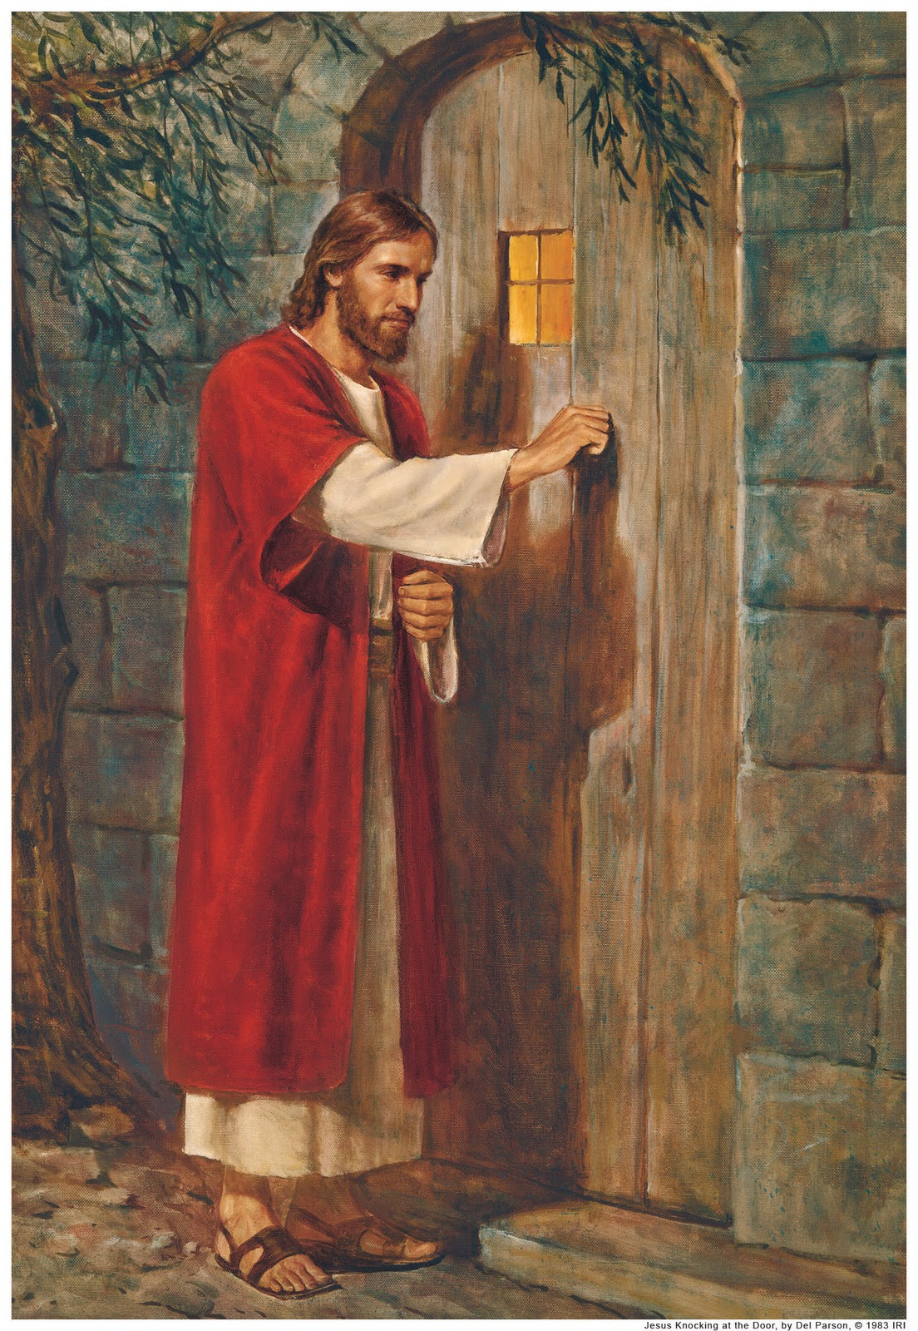
Behold, I stand at the door, and knock; if any man hear my voice, and open the door, I will come in to him, and will sup with him, and he with me. [Revelation 3:20]
Notes:
Christ Standing At the Door
Christ is once again calling us to left him come in a sup with us
He desires for his people to come together, to put aside their quarrels and follow him
He has a great work for us to do, he has given us the Book of Mormon, the ordinances of his church, the fullness of his gospel, and the restoration of the authoritative priesthood.

